Slide 1
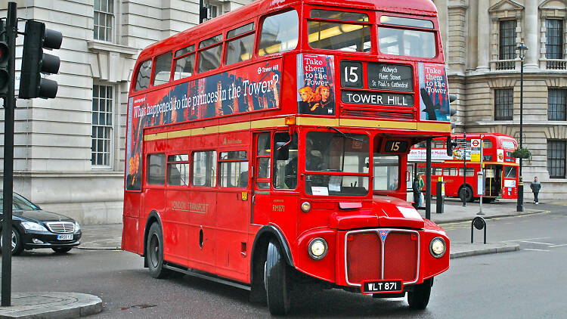
Quiz – About London

Slide 2
Quiz - “The Hot Chair” (Instructions)
Two teams compete (Team 1, Team 2)
There are 6 questions for each team
The team that can answer most of the questions correctly is the winner
Each question has to be answered by one team member/candidate alone
The candidate must not consult the other members of his team
Each team has two 50/50 jokers that can be used by the candidates
Moreover, each team has one “Veto* that can be used if team members believe that the answer of their candidate is wrong
In case of a “Veto” the team can correct the answer of their candidate and replace it by a second - then valid - answer
*Veto – (lat.) „ich verbiete / I forbid“ (Einspruch)

Slide 3
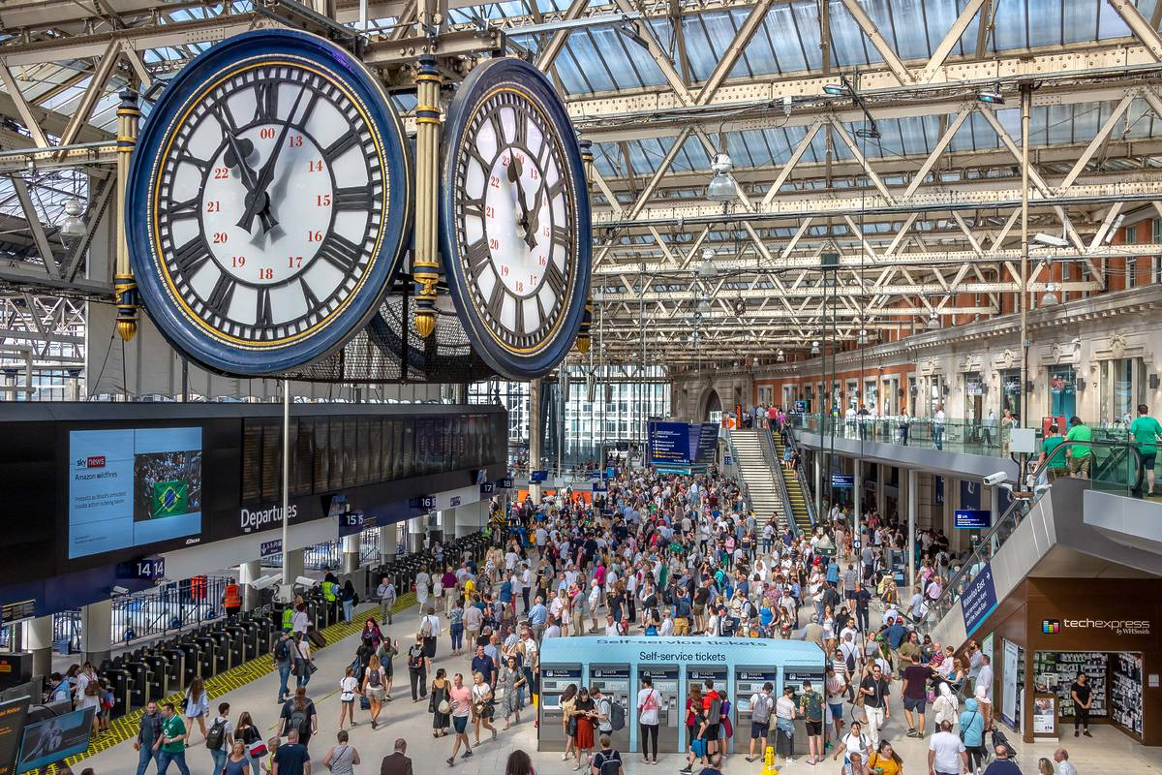
What is London’s largest train station?
Team 1 (1)
a) St Pancras
b) Waterloo
c) Victoria
d) King’s Cross

Slide 4
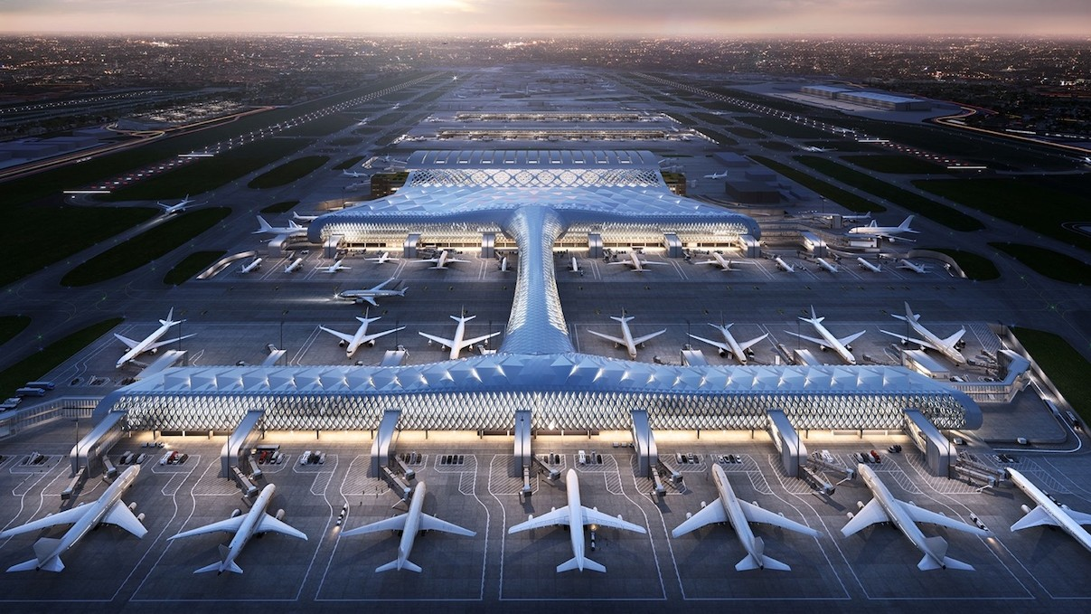
After Heathrow and Gatwick, what is London’s third largest airport?
Team 2 (1)
City
b) Luton
c) Stansted
d) Southend

Slide 5
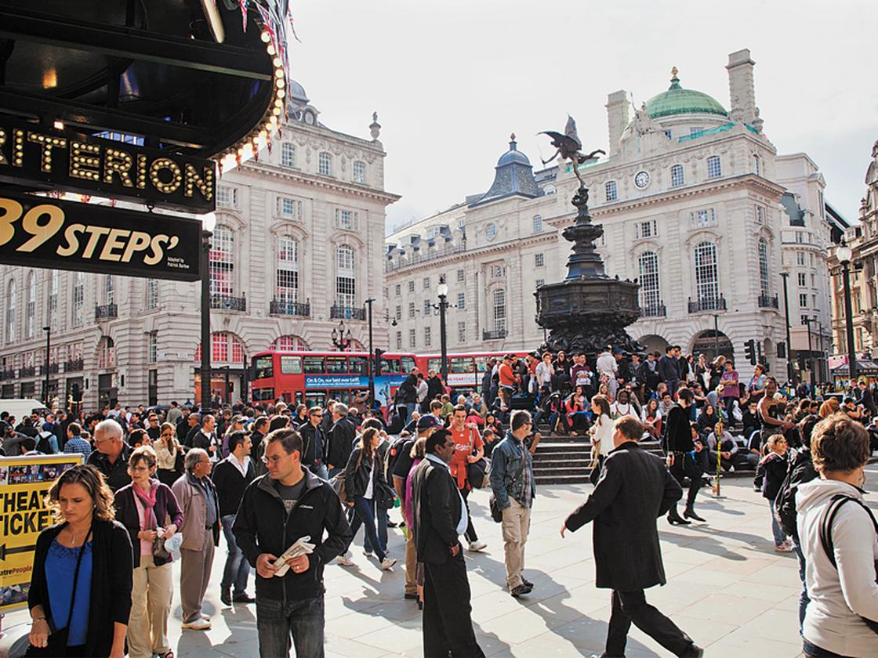
How many residents are there in the City of London?
Team 1 (2)
a) 8.1 million
b) 9.1 million
c) 7.1 million
d) 10.1 million

Slide 6
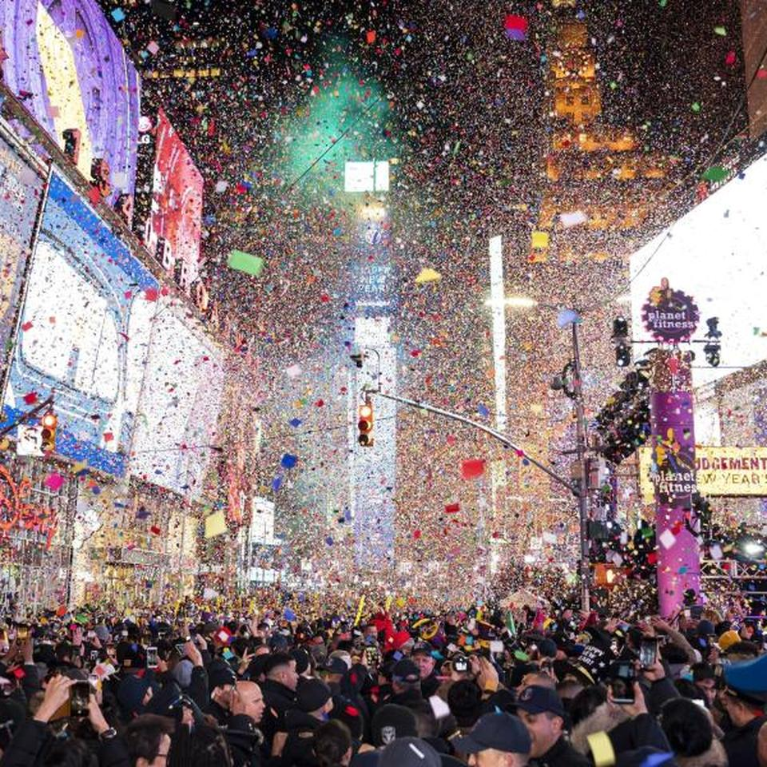
…and how many residents does New York City have?
Team 2 (2)
a) 8.6 million
b) 9.6 million
c) 7.6 million
d) 10.6 million

Slide 7
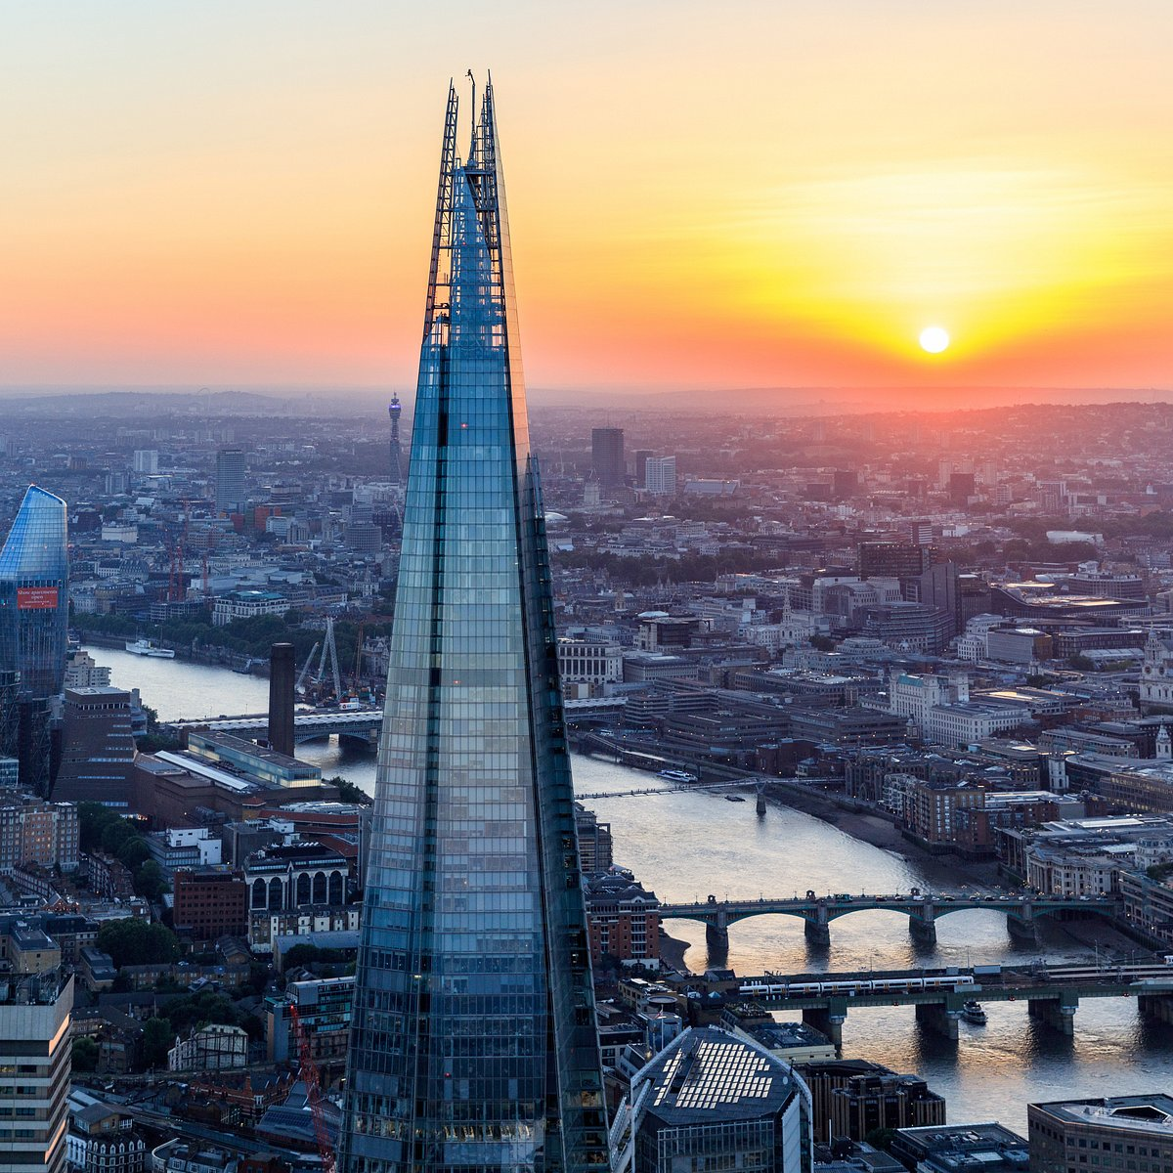
What is not in London?
Team 1 (3)
Covent Garden
b) The Shard
c) Times Square
d) Oxford Street

Slide 8
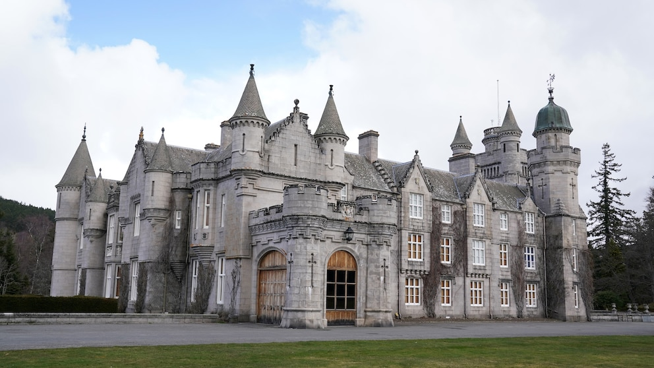
What is not in London?
Team 2 (3)
a) Balmoral Castle
b) Docklands
c) Madame Tussauds
d) Wimbledon

Slide 9
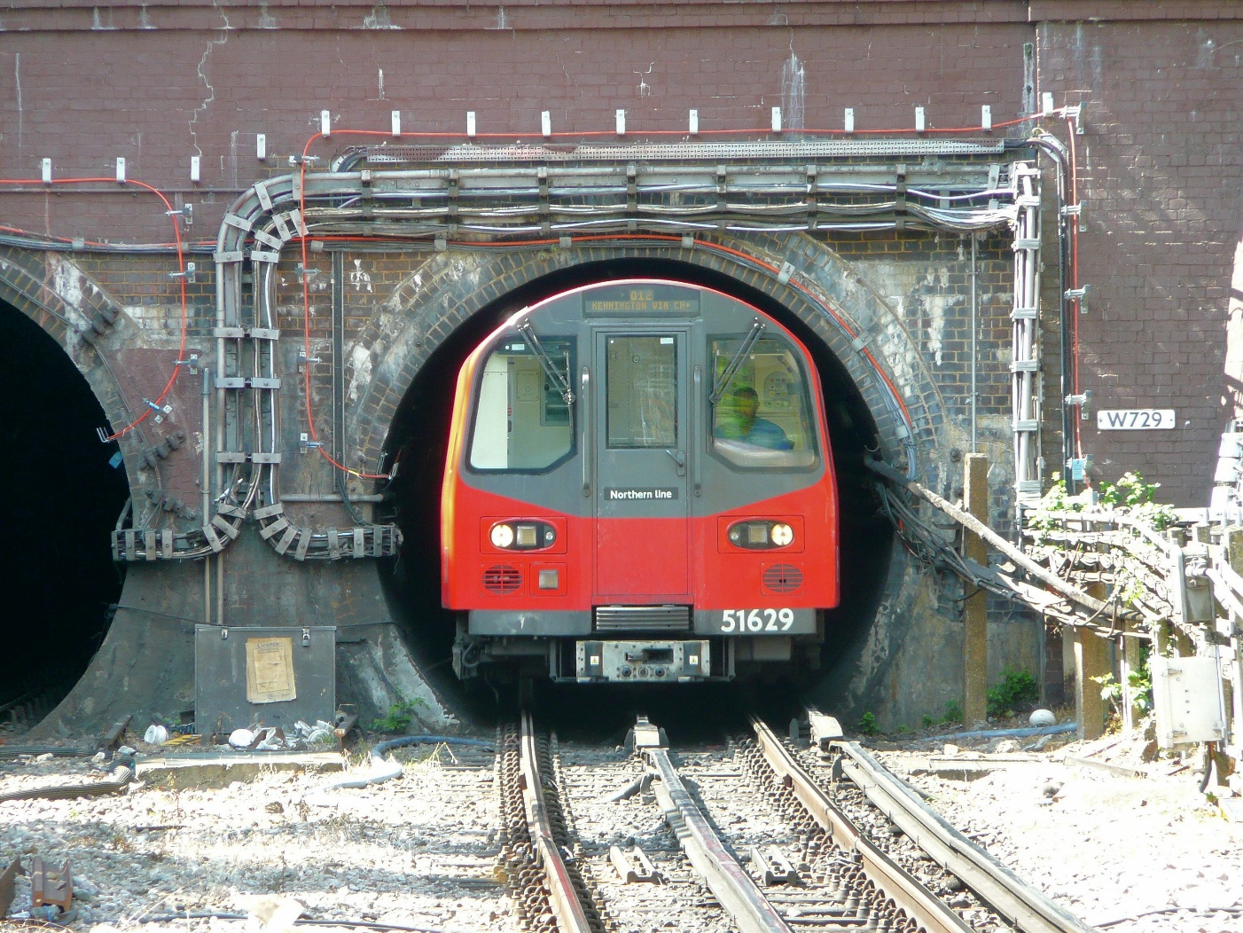
How many lines does the London Underground operate?
Team 1 (4)
a) 9
b) 11
c) 13
d) 15

Slide 10
How many lines does the London Underground operate?
Team 1 (4)
1) Bakerloo (brown)
7) Hammersmith & City (pink)
2) Central (red)
8) Metropolitan (purple)
3) Circle (yellow
9) Piccadilly (dark blue)
4) District (green)
10) Victoria (light blue)
5) Jubilee (grey)
11) Waterloo & City (turquoise)
6) Norhern (black)

Slide 11
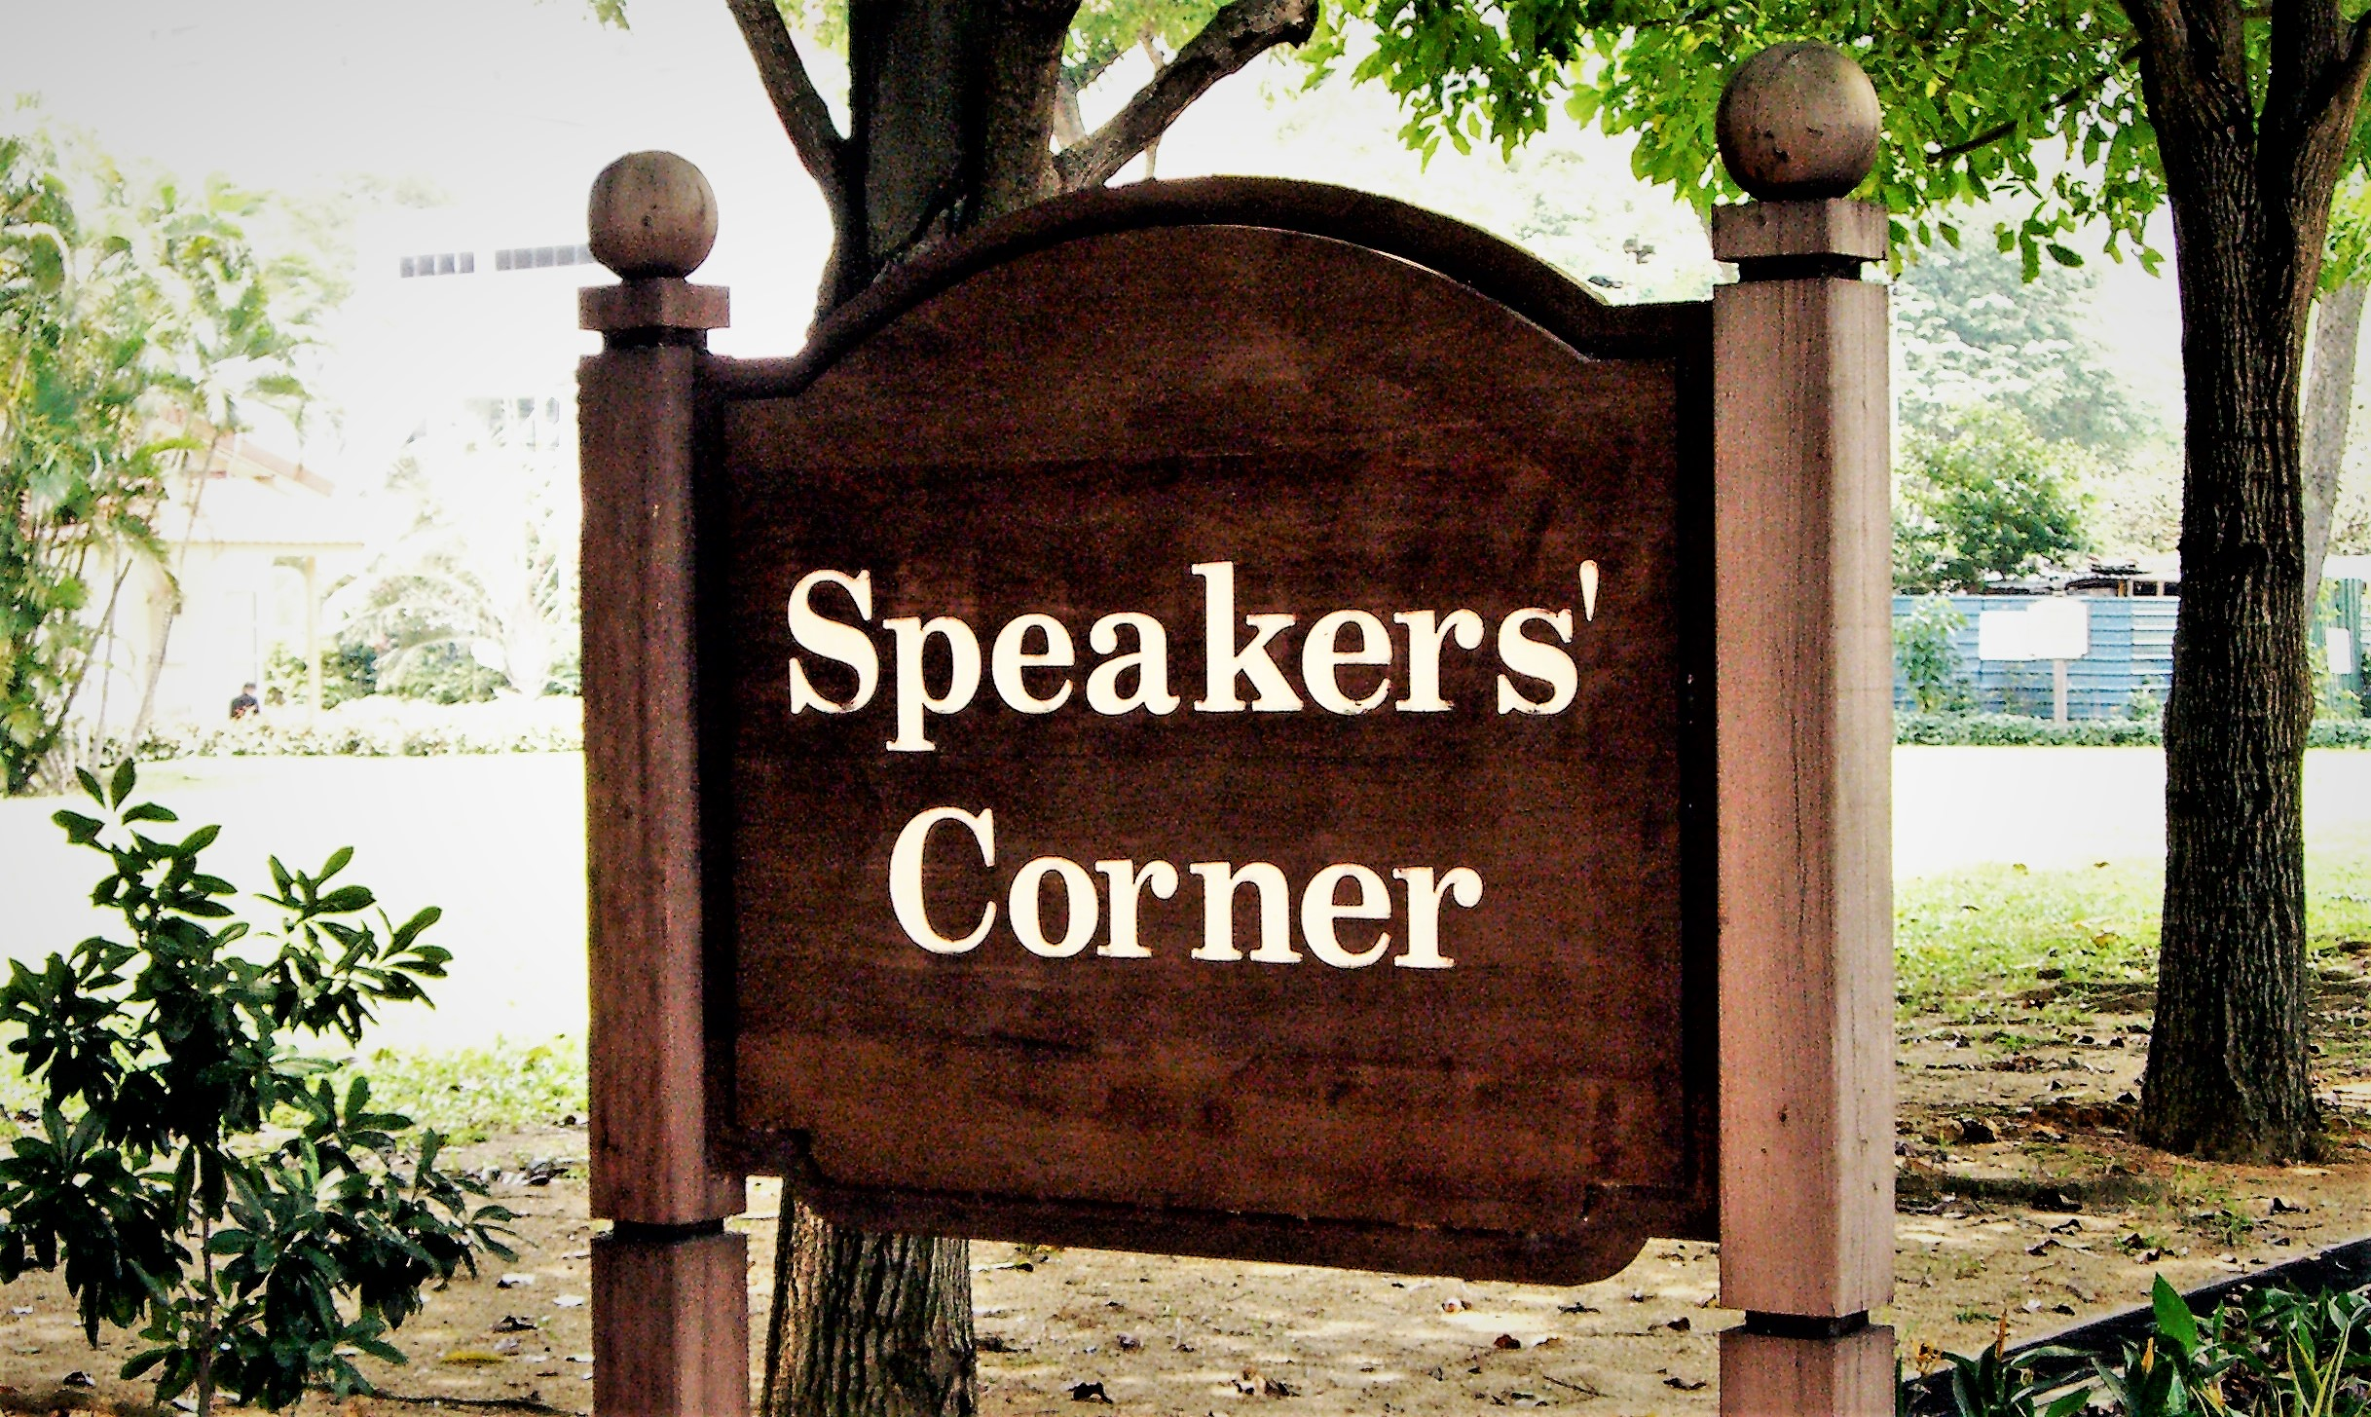
Where is “Speakers’ Corner”?
Team 2 (4)
a) Trafalgar Square
c) Piccadilly Circus
b) Hyde Park
d) opposite Buckingham Palace

Slide 12
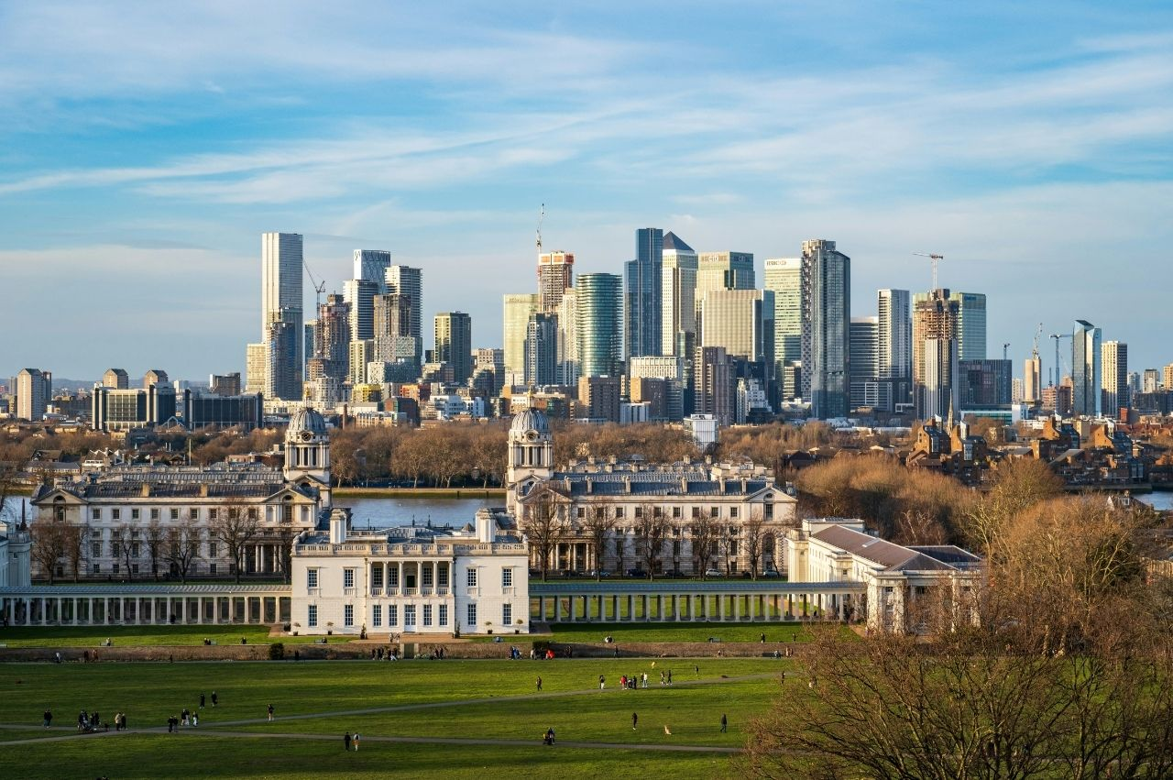
What is not a borough of London?
Team 1 (5)
a) Greenwich
b) East Village
c) Mayfair
d) Hackney

Slide 13
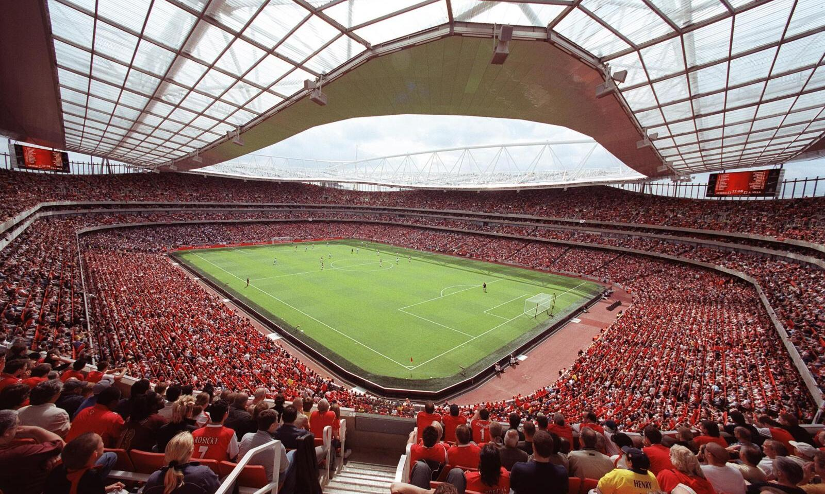
Team 2 (5)
Which of these football clubs in not based in London?
a) FC Arsenal
b) FC Chelsea
c) Aston Villa
d) Tottenham Hotspur

Slide 14
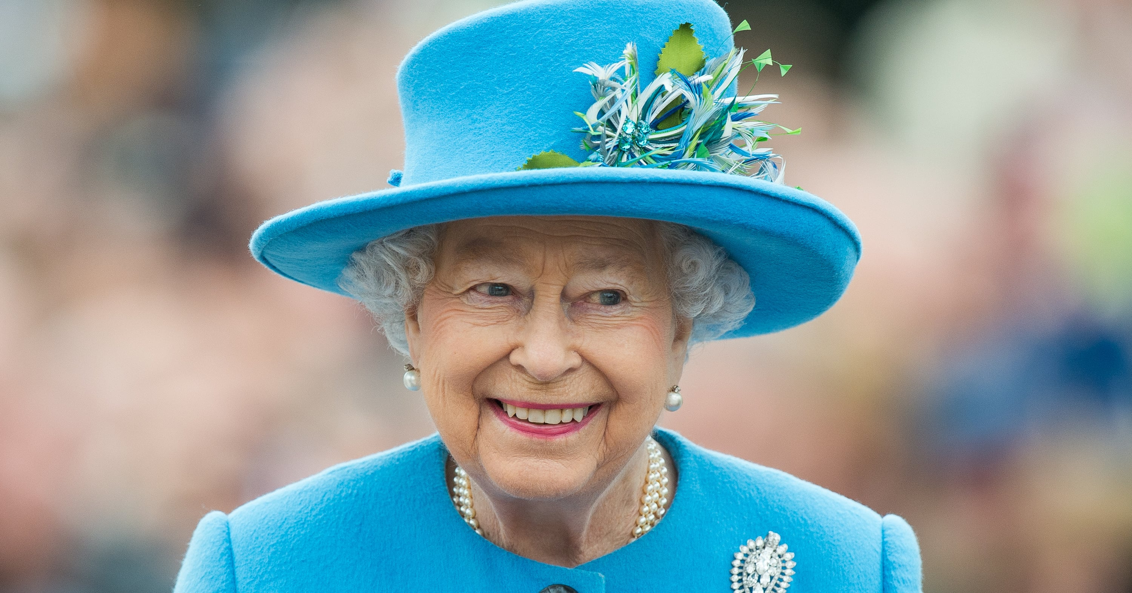
Team 1 (6)
Which of these celebrities was not born in London?
Queen Elizabeth II
b) David Bowie
c) Amy McDonald
d) Adele

Slide 15
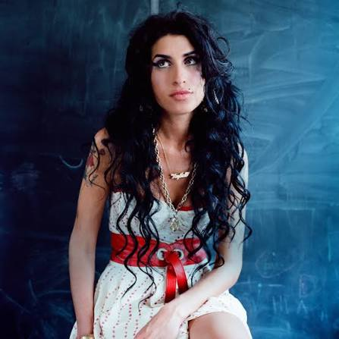
Team 2 (6)
Which of these celebrities was not born in London?
Charlie Chaplin
b) Dua Lipa
c) Mick Jagger
d) Amy Winehouse

