Slide 1
Quiz – About the Republic of Ireland

Slide 2
Quiz - “The Hot Chair” (Instructions)
Two teams compete (Team 1, Team 2)
There are 6 questions for each team
The team that can answer most of the questions correctly is the winner
Each question has to be answered by one team member/candidate alone
The candidate must not consult the other members of his team
Each team has two 50/50 jokers that can be used by the candidates
Moreover, each team has one “Vetos* that can be used if team members believe that the answer of their candidate is wrong
In case of a “Veto” the team can correct the answer of their candidate and replace it by a second - then valid - answer
*Veto – (lat.) „ich verbiete / I forbid“ (Einspruch)

Slide 3
What is the capital of the Republic of Ireland?
Team 1 (1)
a) Galway
b) Dublin
c) Glasgow
d) Belfast

Slide 4

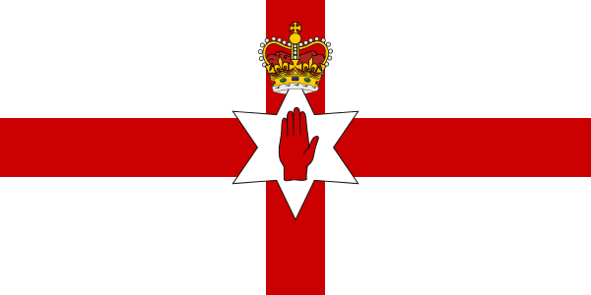
What is the Irish flag?
Team 2 (1)
b)
c)
d)

Slide 5

Which of these places is not in the Republic of Ireland?
Team 1 (2)
Bushmills, Northern Ireland (UK)
a) Cork
b) Old Bushmills Distillery
c) Ring of Kerry
d) Limerick

Slide 6
What kind of drink is Ireland famous for?
Team 2 (2)
a) Guinness
b) Lager
c) Ale
d) Whisky

Slide 7
What is not an official language in Ireland?
Team 1 (3)
Gaeilge (/ˈɡweːlʲɟə/)
b) Irish
c) Celtic
d) English

Slide 8
What is not typical Irish food?
Team 2 (3)
a) Yorkshire Pudding
b) Soda Bread
c) Barmbrack
d) Colecannon

Slide 9
What is not typical Irish food?
Team 2 (3)
a) Yorkshire Pudding
English side dish made of flour, milk and eggs
b) Soda Bread
using natron bicarbonate instead of yeast
c) Barmbrack
a fruit cake for Halloween
d) Colecannon
mashed potatoes with cabbage

Slide 10
Who is Ireland’s Patron Saint?
Team 1 (4)
a) St. George
b) St. Patrick
c) St. Andrew
d) St. David

Slide 11
What is the official Irish national anthem?
Team 2 (4)
a) Londonderry Air
c) The Old Land Of My Fathers
b) The Soldier’s Song
d) God Save The King

Slide 12
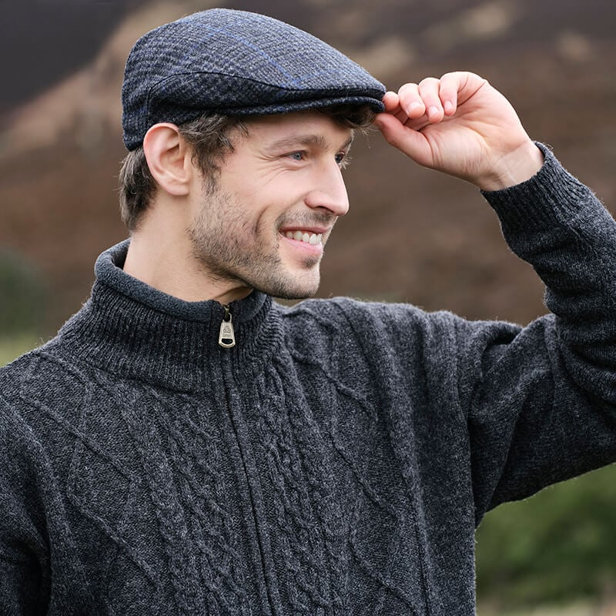
What is the typical Irish headpiece called?
Team 1 (5)
a) bunnet
b) paddy cap
c) Dai cap
d) Kerry top

Slide 13
Which musical instrument is not typical for Ireland?
Team 2 (5)
a) Harp
b) Violin
c) Bagpipe
d) Tin Whistle

Slide 14
Team 1 (6)
Which of these celebrities is not Irish?
Jessie Buckley
b) Liam Neeson
c) Amy McDonald
d) Pierce Brosnan

Slide 15
What is Ireland’s head of government called?
Team 2 (6)
First Minister
b) Taoiseach
pronounced tee-shock
c) Premier
d) Prime Minister

