Slide 1
Quiz – What do you know about Australia?
Unit 7, 16 April 2026

Slide 2
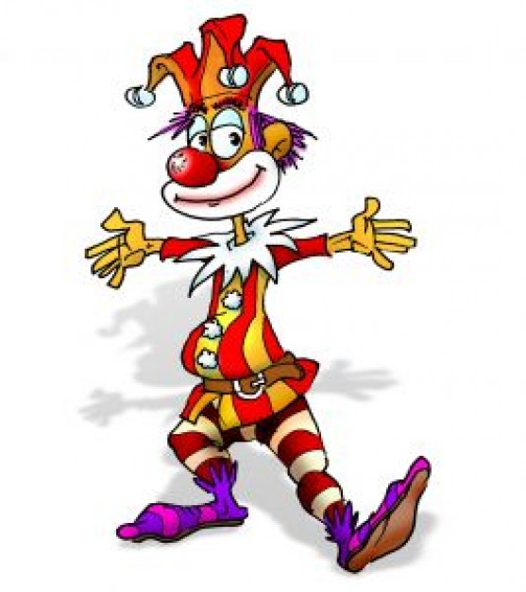
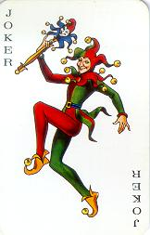
Quiz - “Australia” (Instructions) Two teams compete (Team 1 & Team 2) There are six (6) questions for each team The team that can answer most of the questions correctly wins To answer the questions the team members can consult each other There are two small jokers and two big jokers for each team
The small joker deletes one false answer
The big joker deletes two false answers

Slide 3
What is a didgeridoo?
Team 1 (1)
a) Aboriginal weapon
b) Australian mammal
c) Musical instrument
d) Kitchen aid

Slide 4
What is a didgeridoo?
Team 1 (1)
a) Aboriginal weapon
b) Australian mammal
c) Musical instrument

Slide 5
What is a didgeridoo?
Team 1 (1)
a) Aboriginal weapon
c) Musical instrument

Slide 6
What is a didgeridoo?
Team 1 (1)
c) Musical instrument

Slide 7
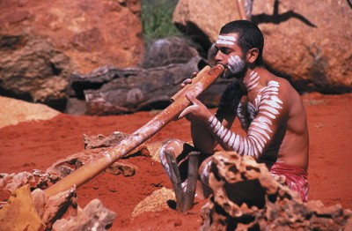
This is a didgeridoo.
Team 1 (1)

Slide 8
What is the official Australian currency?
Team 2 (1)
British Pound
b) Australian Dollar
c) Australian Pound
d) Pacific Dollar

Slide 9
What is the official Australian currency?
Team 2 (1)
British Pound
b) Australian Dollar
c) Australian Pound

Slide 10
What is the official Australian currency?
Team 2 (1)
b) Australian Dollar
c) Australian Pound

Slide 11
What is the official Australian currency?
Team 2 (1)
b) Australian Dollar

Slide 12
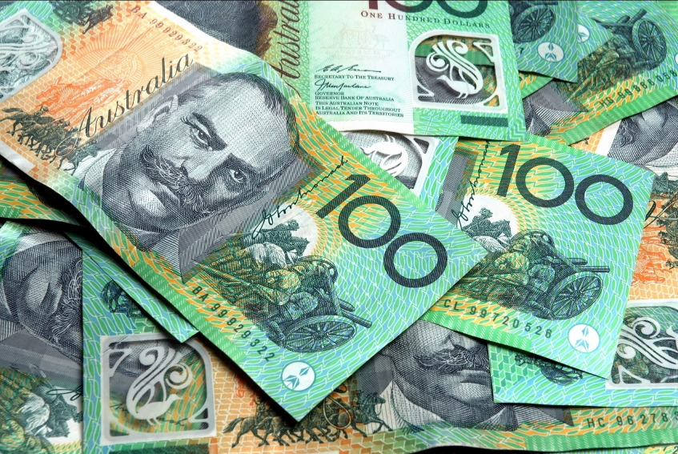
This is the official Australian currency.
Team 2 (1)

Slide 13
Which of these countries is larger than Australia?
Team 1 (2)
Argentina
b) India
c) Brazil
d) Indonesia

Slide 14
Which of these countries is larger than Australia?
Team 1 (2)
b) India
c) Brazil
d) Indonesia

Slide 15
Which of these countries is larger than Australia?
Team 1 (2)
b) India
c) Brazil

Slide 16
Which of these countries is larger than Australia?
Team 1 (2)
c) Brazil

Slide 17
What rank does Australia have among the largest countries ?
Team 2 (2)
3rd largest
b) 6th largest
c) 8th largest
d) 10th largest

Slide 18
What rank does Australia have among the largest countries ?
Team 2 (2)
3rd largest
b) 6th largest
c) 8th largest

Slide 19
What rank does Australia have among the largest countries ?
Team 2 (2)
3rd largest
b) 6th largest

Slide 20
What rank does Australia have among the largest countries ?
Team 2 (2)
b) 6th largest
1. Russian Fed. 2. Canada 3. USA 4. China 5. Brazil
6. Australia 7. India 8. Argentina 9. Kazakhstan 10. Algeria

Slide 21
How many time zones does the Australian continent have?
Team 1 (3)
1
b) 2
c) 3
d) 4

Slide 22
How many time zones does the Australian continent have?
Team 1 (3)
1
b) 2
c) 3

Slide 23
How many time zones does the Australian continent have?
Team 1 (3)
b) 2
c) 3

Slide 24
How many time zones does the Australian continent have?
Team 1 (3)
c) 3

Slide 25
How many federal states does the Australian mainland consist of?
Team 2 (3)
4
b) 5
c) 6
d) 7

Slide 26
How many federal states does the Australian mainland consist of?
Team 2 (3)
b) 5
c) 6
d) 7

Slide 27
How many federal states does the Australian mainland consist of?
Team 2 (3)
b) 5
c) 6

Slide 28
How many federal states does the Australian mainland consist of?
Team 2 (3)
c) 6
Victoria – New South Wales – Queensland
Northern Territory – Western Australia – South Australia
+ as a separate administrative district: Australian Capital Territory – A.C.T. + the island of Tasmania

Slide 29
What are the heads of the Australian state governments called?
Team 1 (4)
Prime Minister
b) Premier
c) State Minister
d) Chancellor

Slide 30
What are the heads of the Australian state governments called?
Team 1 (4)
Prime Minister
b) Premier
c) State Minister

Slide 31
What are the heads of the Australian state governments called?
Team 1 (4)
Prime Minister
c) State Minister

Slide 32
What are the heads of the Australian state governments called?
Team 1 (4)
Prime Minister

Slide 33
Who is Australia‘s Head of State?
Team 2 (4)
Anthony Albanese
b) Christopher Luxon
c) Jacinda Ardern
d) King Charles III

Slide 34
Who is Australia‘s Head of State?
Team 2 (4)
Anthony Albanese
c) Jacinda Ardern
d) King Charles III

Slide 35
Who is Australia‘s Head of State?
Team 2 (4)
Anthony Albanese
d) King Charles III

Slide 36
Who is Australia‘s Head of State?
Team 2 (4)
d) King Charles III

Slide 37
What are the national colours of Australia?
Team 1 (5)
Yellow and Green
b) Green and Gold
c) Blue and Red
d) Blue and White

Slide 38
What are the national colours of Australia?
Team 1 (5)
Yellow and Green
b) Green and Gold
d) Blue and White

Slide 39
What are the national colours of Australia?
Team 1 (5)
b) Green and Gold
d) Blue and White

Slide 40
What are the national colours of Australia?
Team 1 (5)
b) Green and Gold

Slide 41
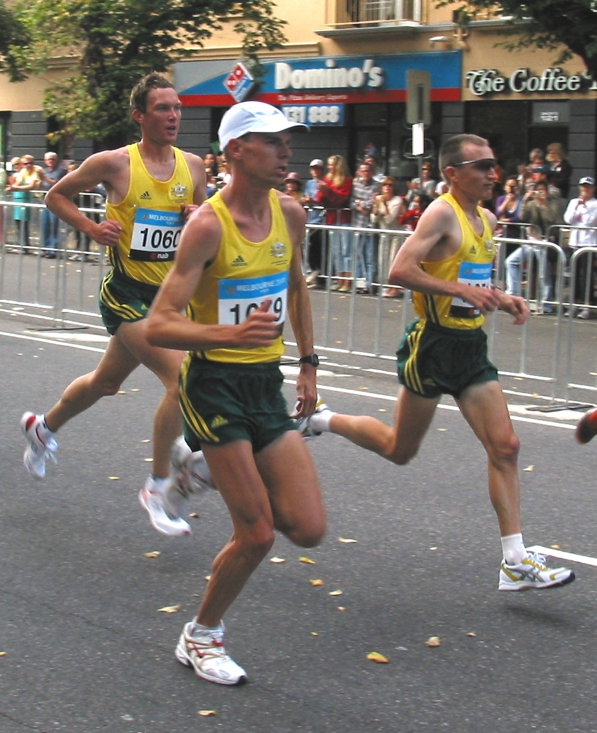
Australian marathon runners in green and gold at the 2006 Commonwealth Games

Slide 42
Sydney is the capital of …?
Team 2 (5)
New South Wales
b) Victoria
c) Queensland
d) Northern Territory

Slide 43
Sydney is the capital of …?
Team 2 (5)
New South Wales
b) Victoria
c) Queensland

Slide 44
Sydney is the capital of …?
Team 2 (5)
New South Wales
b) Victoria

Slide 45
Sydney is the capital of …?
Team 2 (5)
New South Wales

Slide 46
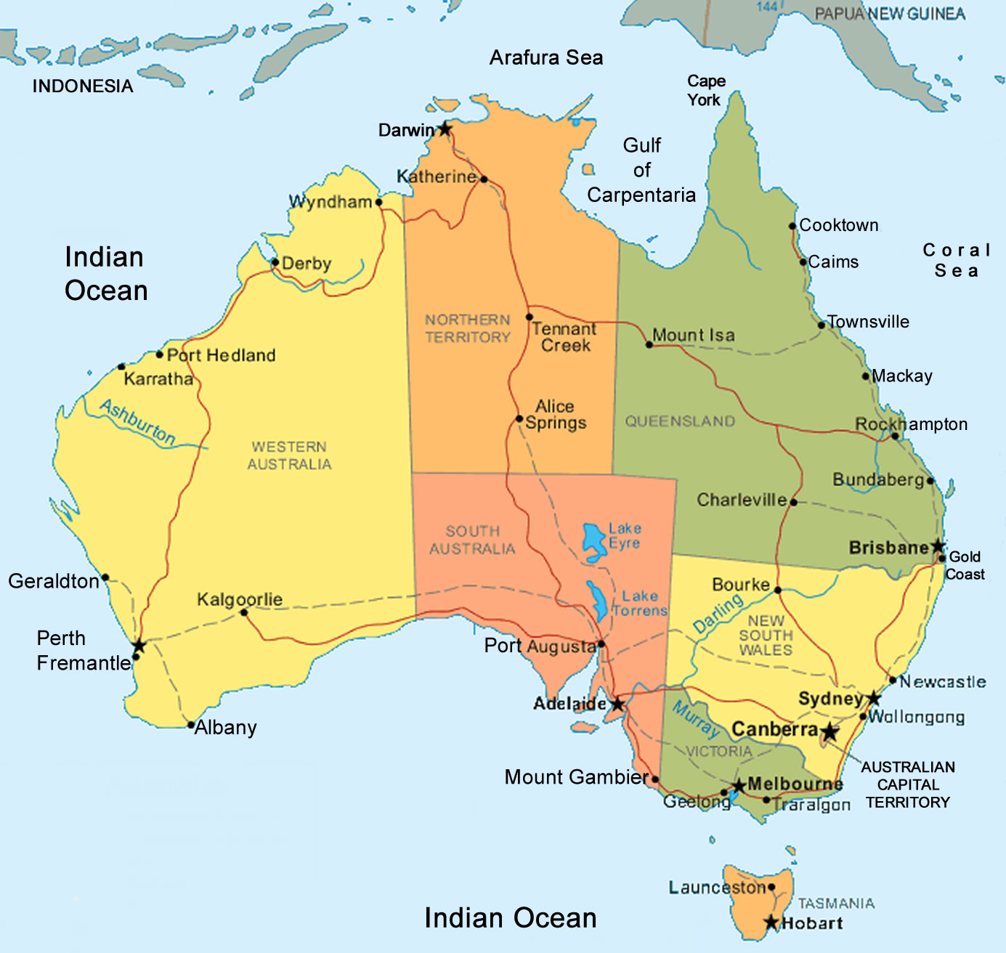

Slide 47
Which of these famous persons is not Australian?
Team 1 (6)
Russel Crowe
b) Neil Young
c) Nicole Kidman
d) Hugh Jackman

Slide 48
Which of these famous persons is not Australian?
Team 1 (6)
Russel Crowe
b) Neil Young
c) Nicole Kidman

Slide 49
Which of these famous persons is not Australian?
Team 1 (6)
b) Neil Young
c) Nicole Kidman

Slide 50
Which of these famous persons is not Australian?
Team 1 (6)
b) Neil Young

Slide 51
Which of these famous persons is not Australian?
Team 2 (6)
Olivia Newton-John
b) Paul Hogan
c) Bryan Adams
d) AC/DC

Slide 52
Which of these famous persons is not Australian?
Team 2 (6)
Olivia Newton-John
c) Bryan Adams
d) AC/DC

Slide 53
Which of these famous persons is not Australian?
Team 2 (6)
Olivia Newton-John
c) Bryan Adams

Slide 54
Which of these famous persons is not Australian?
Team 2 (6)
c) Bryan Adams

