Slide 1
Quiz – “The Hot Chair”
Unit 6, 13 November 2025

Slide 2
Quiz - “The Hot Chair” (Instructions) Two teams compete (Team 1, Team 2) There are 6 questions for each team The team that can answer most of the questions correctly is the winner Each question has to be answered by one team member/candidate alone The candidate must not consult the other members of his team Each team has two 50/50 jokers that can be used by the candidates Moreover, each team has one “Veto”* that can be used if team members believe that the answer of their candidate is wrong In case of a “Veto” the team can correct the answer of their candidate and replace it by a second - then valid - answer *Veto – (lat.) „ich verbiete / I forbid“ (Einspruch)

Slide 3
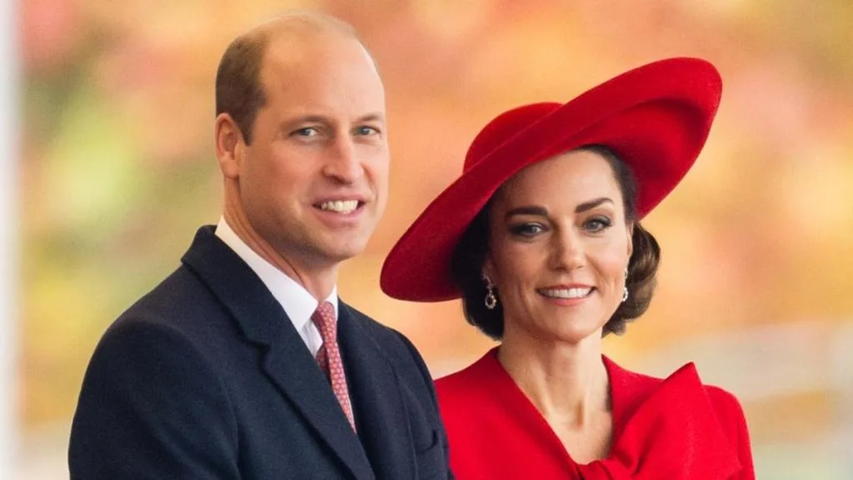
Team 1 (1)

Slide 4
When Kate Middleton married Prince William, she became a member of the royal family, but no…
Team 1 (1)
a) duchess
b) princess
c) baroness
d) countess

Slide 5
before the wedding: Catherine Elizabeth „Kate“ Middleton
after the wedding : Her Royal Highness Catherine Elizabeth, Duchess¹⁾ of
Cambridge^{2).}, Countess³⁾ of Strathearn⁴⁾,
Baroness⁵⁾ Carrickfergus⁶⁾
¹⁾ Duchess - Herzogin
^{2).}Cambridge - capital of Cambridgeshire County in England (ca. 80 km northeast of London)
³⁾ Countess - Gräfin, Komtesse
⁴⁾ Strathearn - dukedom (Herzogtum) in Scotland
⁵⁾ Baroness - Baronin, Freifrau
^{6).}Carrickfergus - town in Northern Ireland (province Ulster), 11 km northeast of Belfast, administrative centre of the identically named district
Only after the death of Queen Elizabeth II on 08 September 2022 she was bestowed the title of Princess of Wales

Slide 6
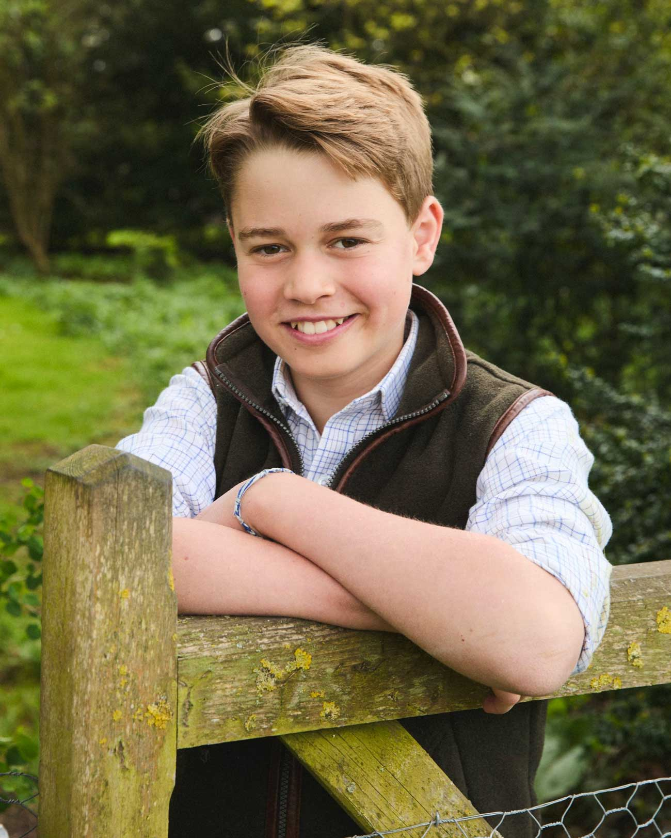
Team 2 (1)

Slide 7
George, the son of Kate and William, is a …
Team 2 (1)
a) duke
b) baron
c) prince
d) count

Slide 8
Team 1 (2)
Ich lebe seit 2010 in Sankt Augustin.
a) I have lived in Sankt Augustin since 2010.
b) I live in Sankt Augustin since 2010.
c) I am living in Sankt Augustin since 2010.
d) I lived in Sankt Augustin since 2010.

Slide 9
Er rief an, als ich Zeitung las.
Team 2 (2)
He called when I read the newspaper.
b) He was calling while I was reading the newspaper.
c) He was calling when I read the newspaper.
d) He called when I was reading the newspaper.

Slide 10
No dice.
Team 1 (3)
a) You don’t have a choice.
b) Forget it.
c) Don’t play around with me.
d) Don’t litter.

Slide 11
to zero in on…
Team 2 (3)
aufs Korn nehmen
a) to give up
b) to relinquish something
c) to direct all attention to one thing
d) to consider something not worth the effort

Slide 12
The westernmost of the United States is…?
Team 1 (4)
Hawaii
b) Washington
c) California
d) Alaska

Slide 13
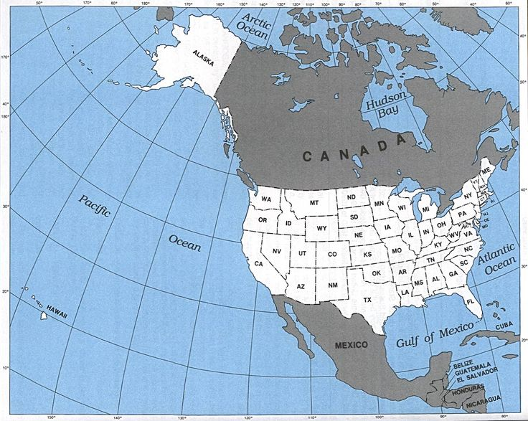
180° meridian
(international date line)
Team 1 (4)
Take note of the longitude
The Aleutian Islands
are part of Alaska
Hawaii

Slide 14
Where is the southernmost point of the United Kingdom’s domestic islands (excluding Antarctica)?
Team 2 (4)
a) Isle of Wight
b) St. Agnes, Isles of Scilly
c) Land’s End, Cornwall
d) Jersey

Slide 15
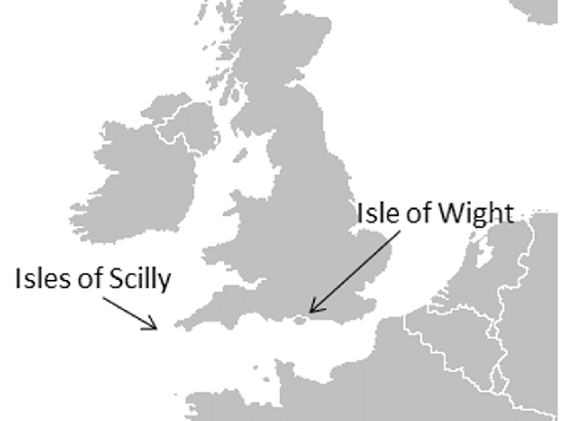
The Channel Islands — primarily Jersey, Guernsey, Alderney, Sark, and Herm —
are Crown Dependencies, not part of the United Kingdom itself.

Slide 16
In the United States, the reshaping of voting districts prior to an election is called…?
Team 1 (5)
a) haberdashering
b) teetotalling
c) gerrymandering
d) distribulating

Slide 17
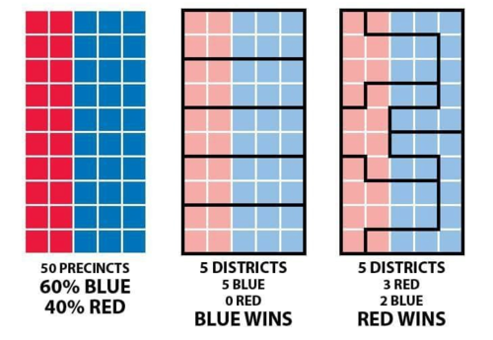
Team 1 (5)
gerrymandering
Stoßdorf
Geistingen
Uckerath
Dambroich
Happerschoß

Slide 18
Team 1 (5)
gerrymandering
Introduced in 1812 by Massachusetts Governor Elbridge Gerry
Stoßdorf
Geistingen
Uckerath
Dambroich
Happerschoß

Slide 19
filibuster
Team 2 (5)
a) tool
b) racketeer, cheater
c) pedant
d) overlong speech

Slide 20
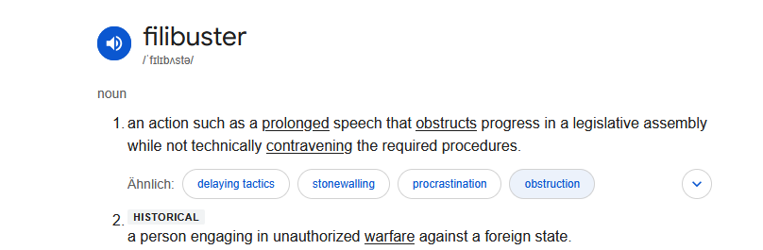
filibuster
Team 2 (5)

Slide 21
Scotland: If you travel from Glasgow to Inverness, you go…?
Team 1 (6)
east
b) west
c) north
d) south

Slide 22
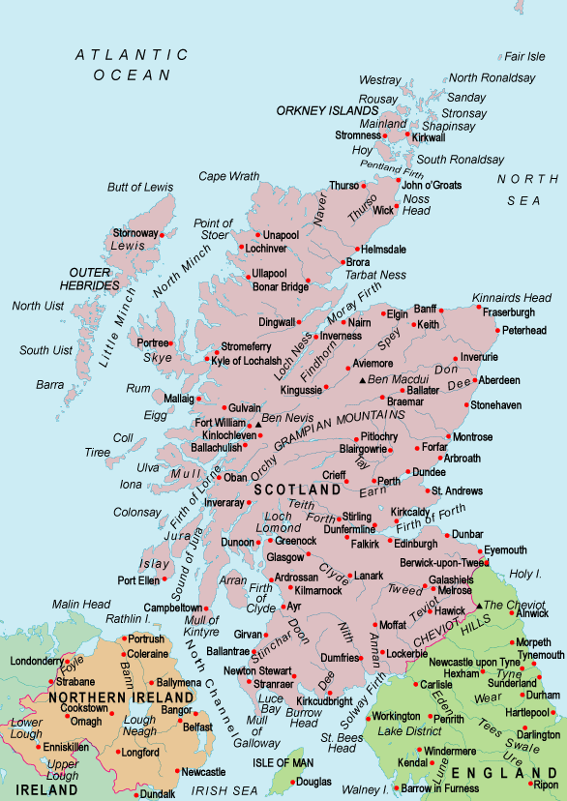
Team 1 (6)

Slide 23
Australia: If you travel from Perth to Adelaide, you go…?
Team 2 (6)
north
b) south
c) east
d) west

Slide 24
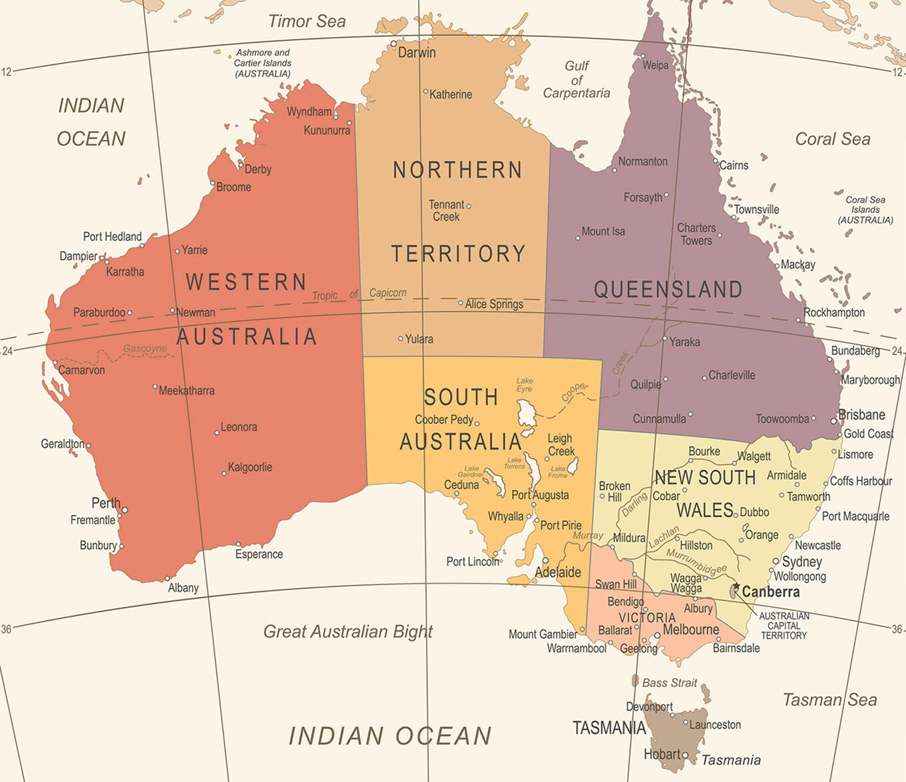
Team 2 (6)

