Slide 1
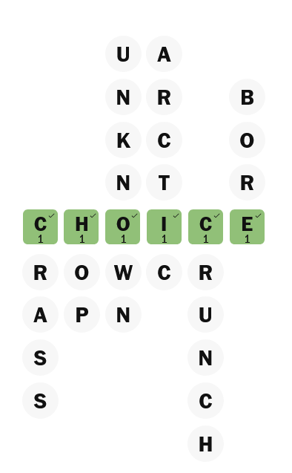
7th unit, 11 November 2025
C
H
O
I
C
E
For your daily keyword challenge go to https://www.washingtonpost.com/games/keyword/

