Slide 1
Find the word.
9th unit, 27/11/25

Slide 2
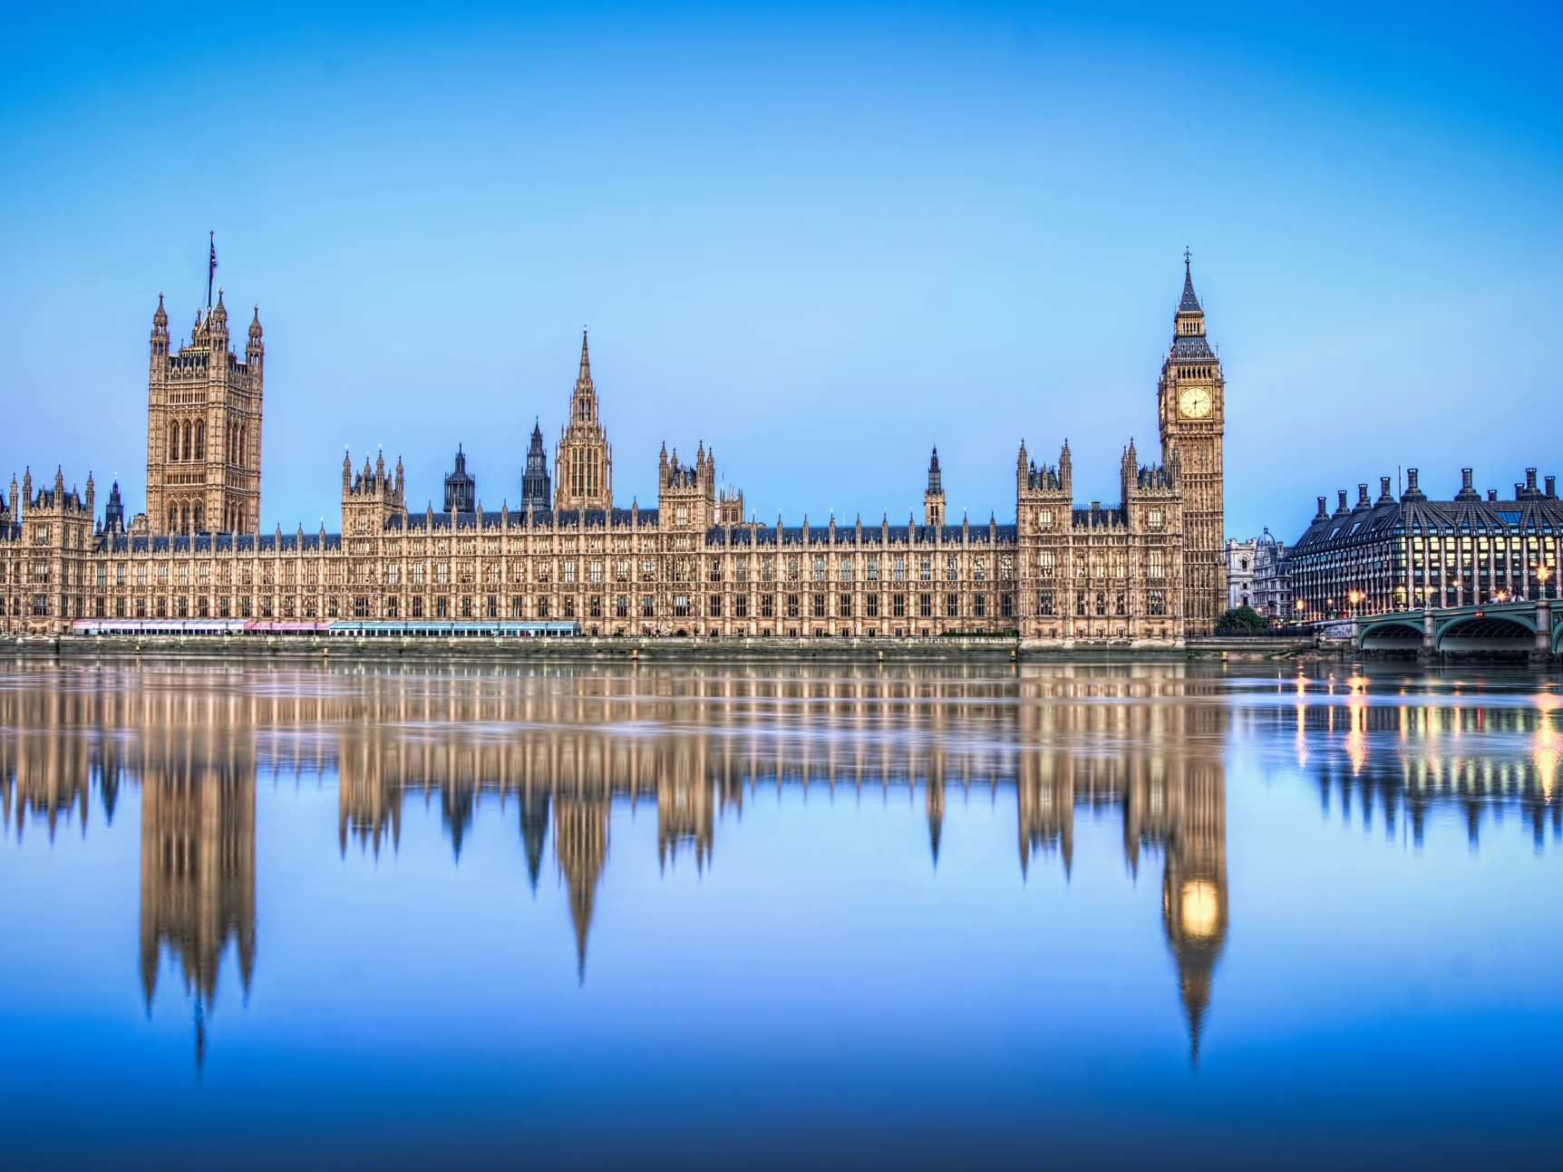
The Palace of Westminster, home of the British Parliament

Slide 3
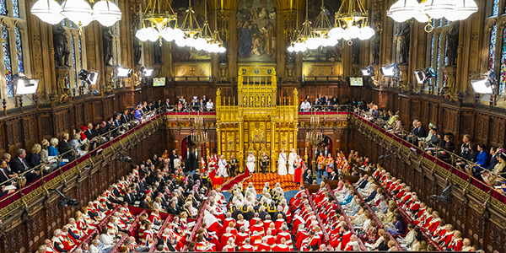
Like the Bundestag and Bundesrat in Germany, the British Parliament has two chambers, namely the House of Commons and the House of …?
We need the second letter of …

Slide 4
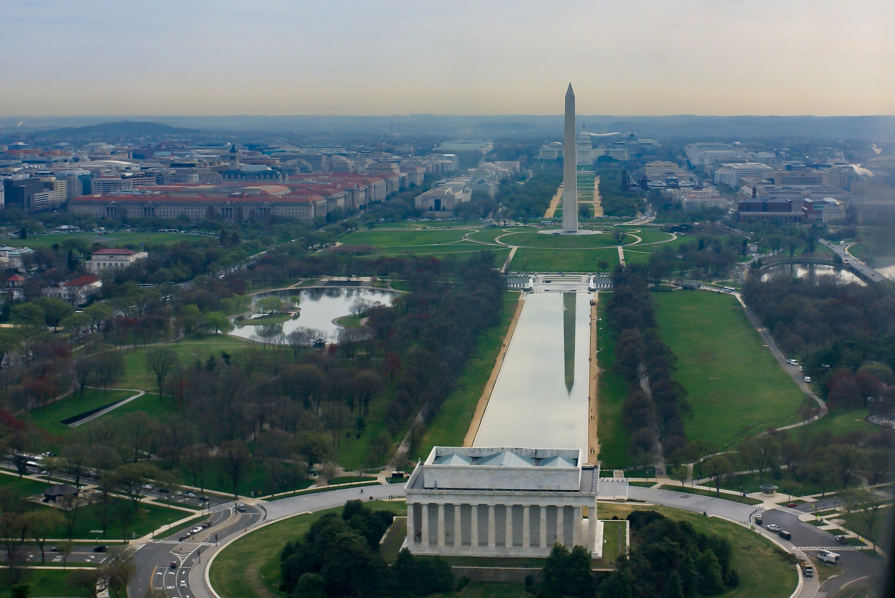

Slide 5
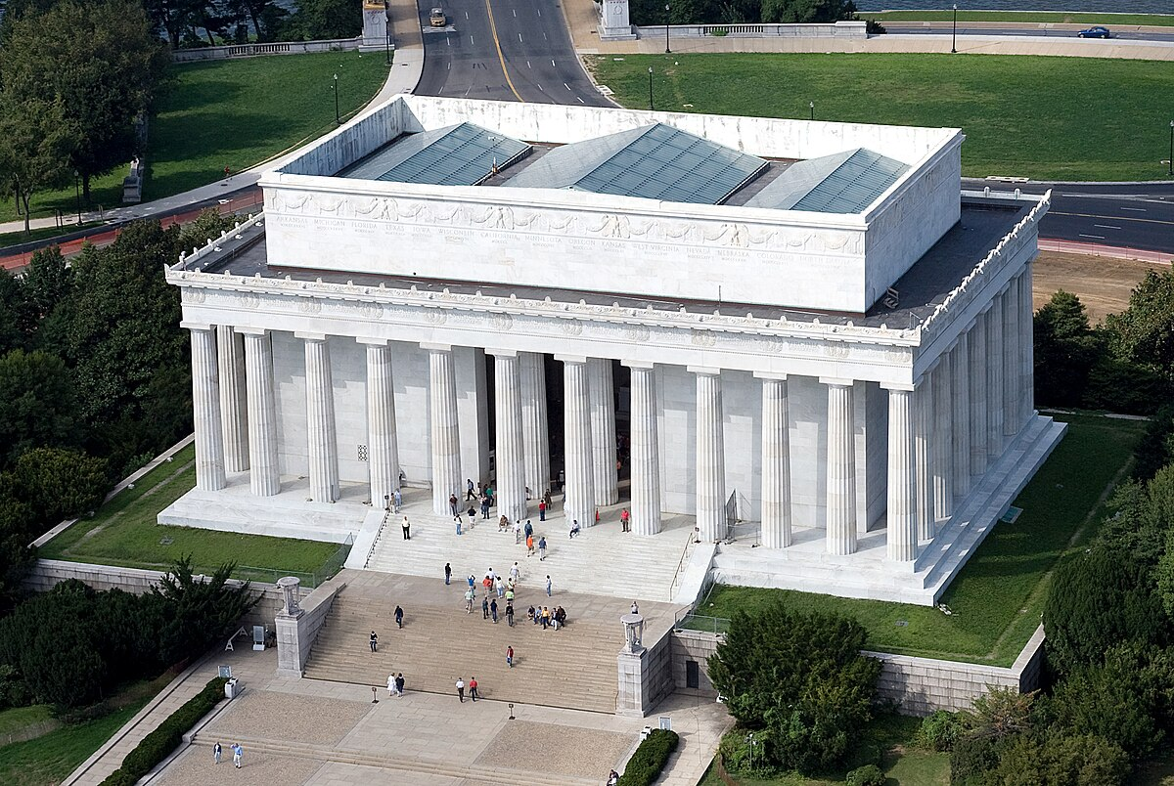
The memorial at the west end of the National Mall in Washington D.C. commemorates an early U.S. president,
called “Abe” by his friends.
We need the third letter of his family name.

Slide 6
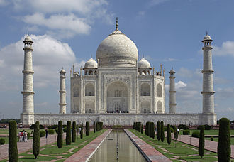
Two years ago, a country that has English as a national language overtook China as the world’s most populous nation. We need the last letter of the country's capital.

Slide 7
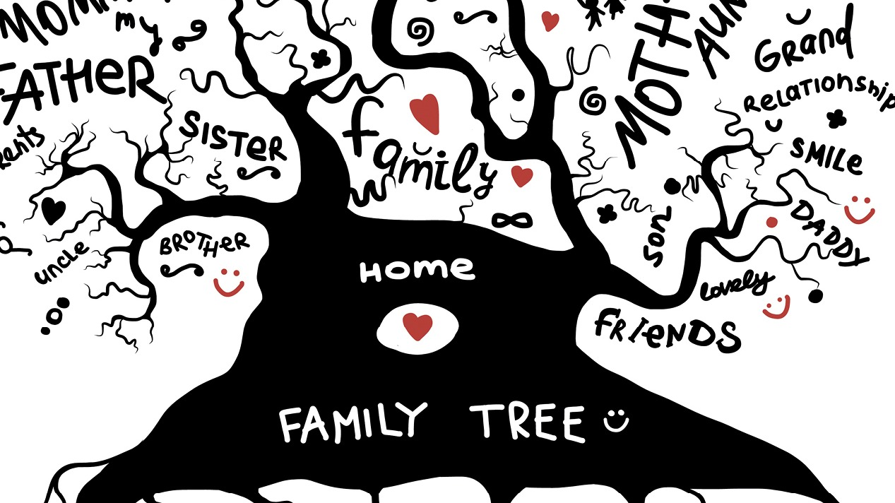
The children of your children are your…?
We need the 3rd letter.

Slide 8
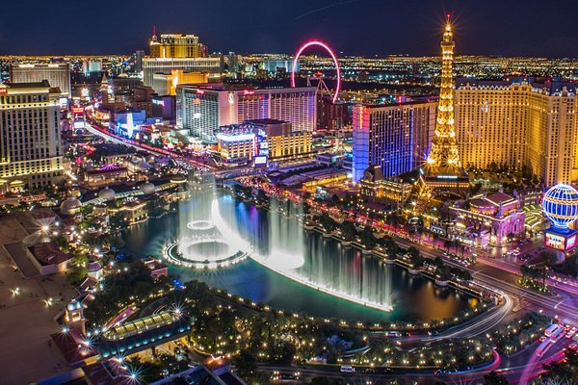
Las Vegas is famous as the United States’ gambling paradise and entertainment centre. We need the first letter of the state in which Las Vegas is located.

Slide 9
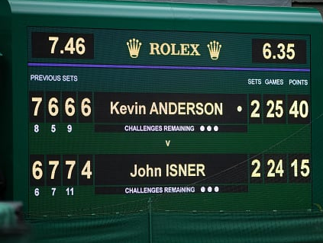
A tiebreak is played when both players have won six games. What sport is this? We need the 1st letter.

Slide 10
By now, you should have 6 letters on your list. Reshuffle them for something that you are part of.

Slide 11
House of Lords
Like the Bundestag and Bundesrat in Germany, the British Parliament has two chambers, namely the House of Commons and the House of …?
We need the second letter of …

Slide 12
Abraham Lincoln
The memorial at the west end of the National Mall in Washington D.C. commemorates an early U.S. president,
called “Abe” by his friends.
We need the third letter of his family name.

Slide 13
Two years ago, a country that has English as a national language overtook China as the world’s most populous nation. We need the last letter of the country's capital.
New Delhi, India

Slide 14
grandchildren
The children of your children are your…?
We need the 3rd letter.

Slide 15
Las Vegas is famous as the United States’ gambling paradise and entertainment centre. We need the first letter of the state in which Las Vegas is located.
Nevada

Slide 16
Tennis
A tiebreak is played when both players have won six games. What sport is this? We need the 1st letter.

Slide 17
By now, you should have 6 letters on your list. Reshuffle them for something that you are part of.
N A T I O N

