Slide 1
Preparation for Airport Memory
Airport vocabulary
Where do you wait for a flight?
departure lounge
Where do you get a boarding pass?
check-in
Where can you wait for friends who are coming to visit?
arrivals
What do you need to board your flight?
boarding pass
What can you take as hand baggage?
briefcase/handbag
Where can you buy perfume, alcohol and tobacco?
duty free shop
Where do you go to board your flight?
gate
Where can you have a coffee?
departure lounge
Where do you check in your baggage?
check-in
Where can you check what time your flight is boarding?
departure board
What do you call the place you are flying to?
destination
Where can you collect your baggage?
baggage reclaim
Where do you have to show your identification?
passport control
What do you need to check in?
flight number

Slide 2
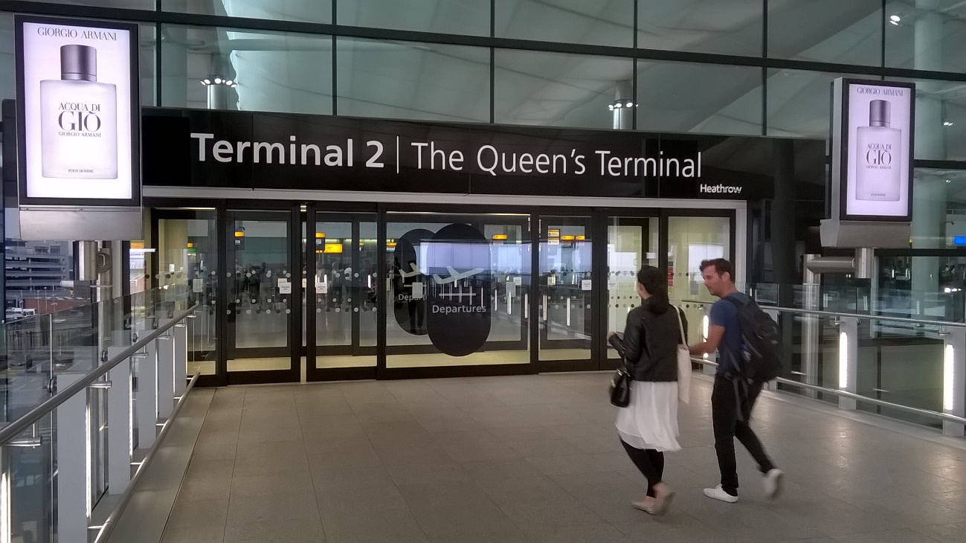
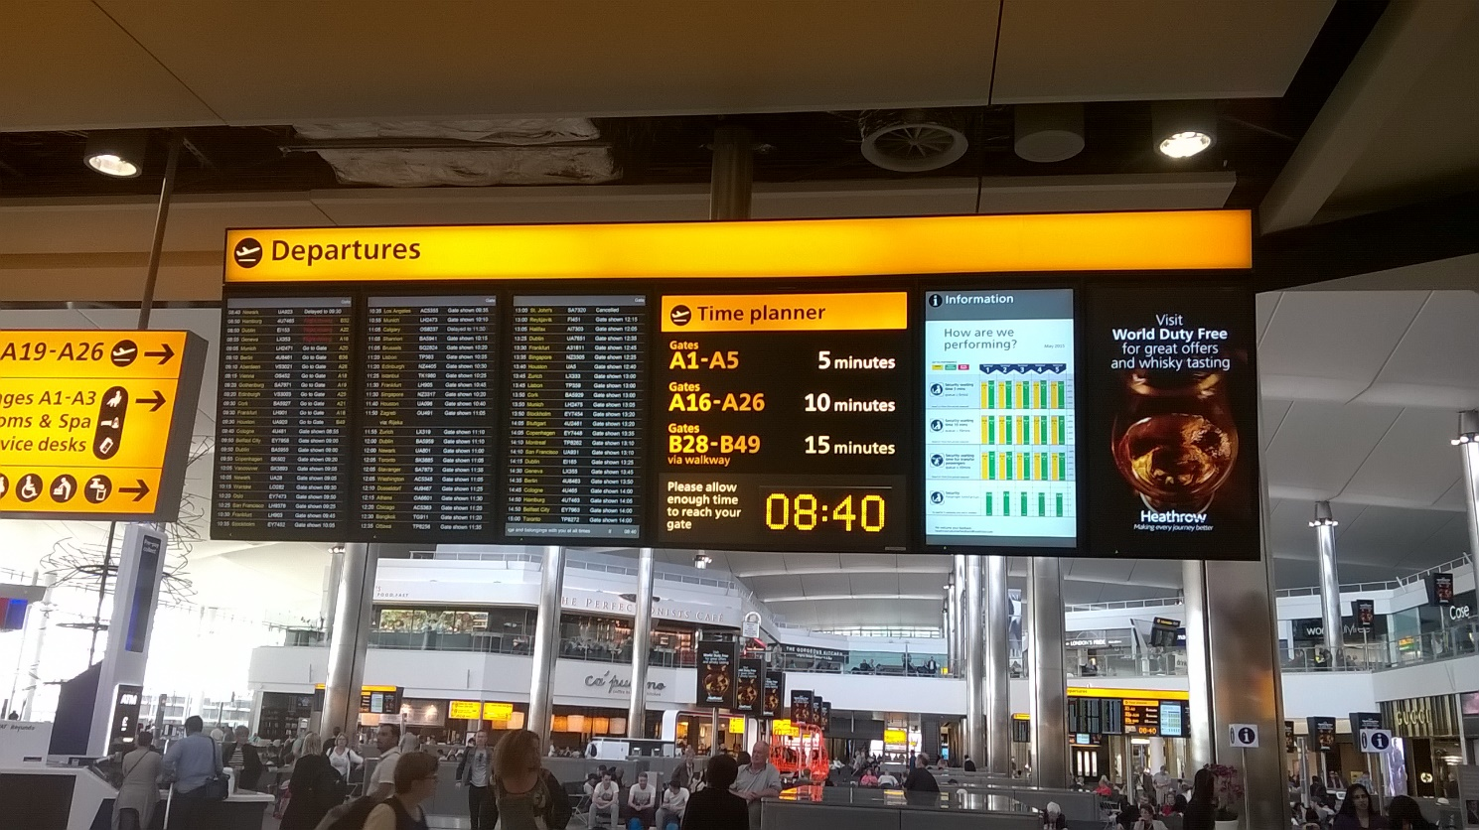
Preparation for Airport Memory
Airport vocabulary

Slide 3
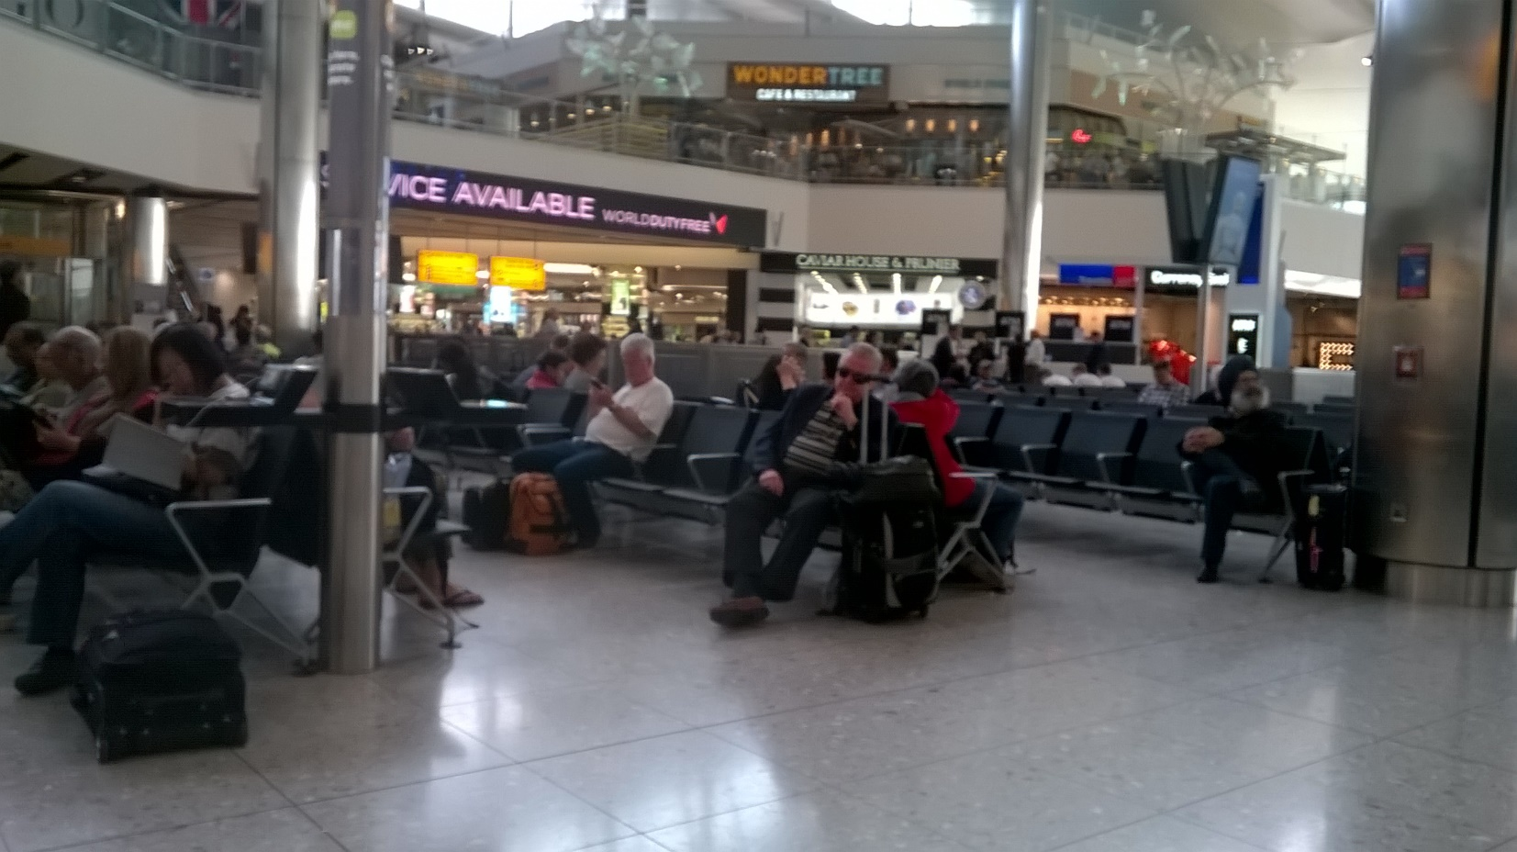
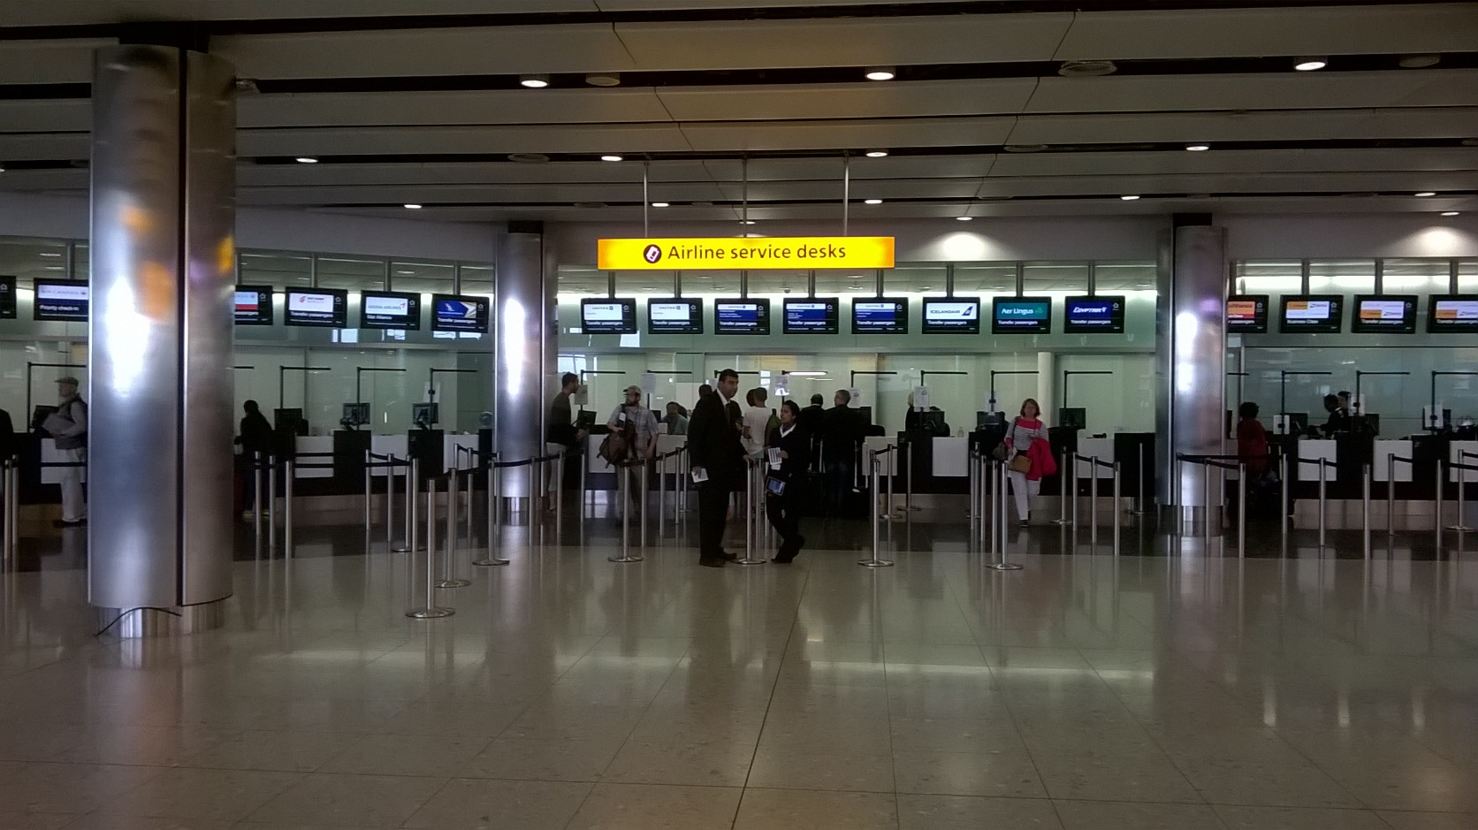
Preparation for Airport Memory
Airport vocabulary

Slide 4
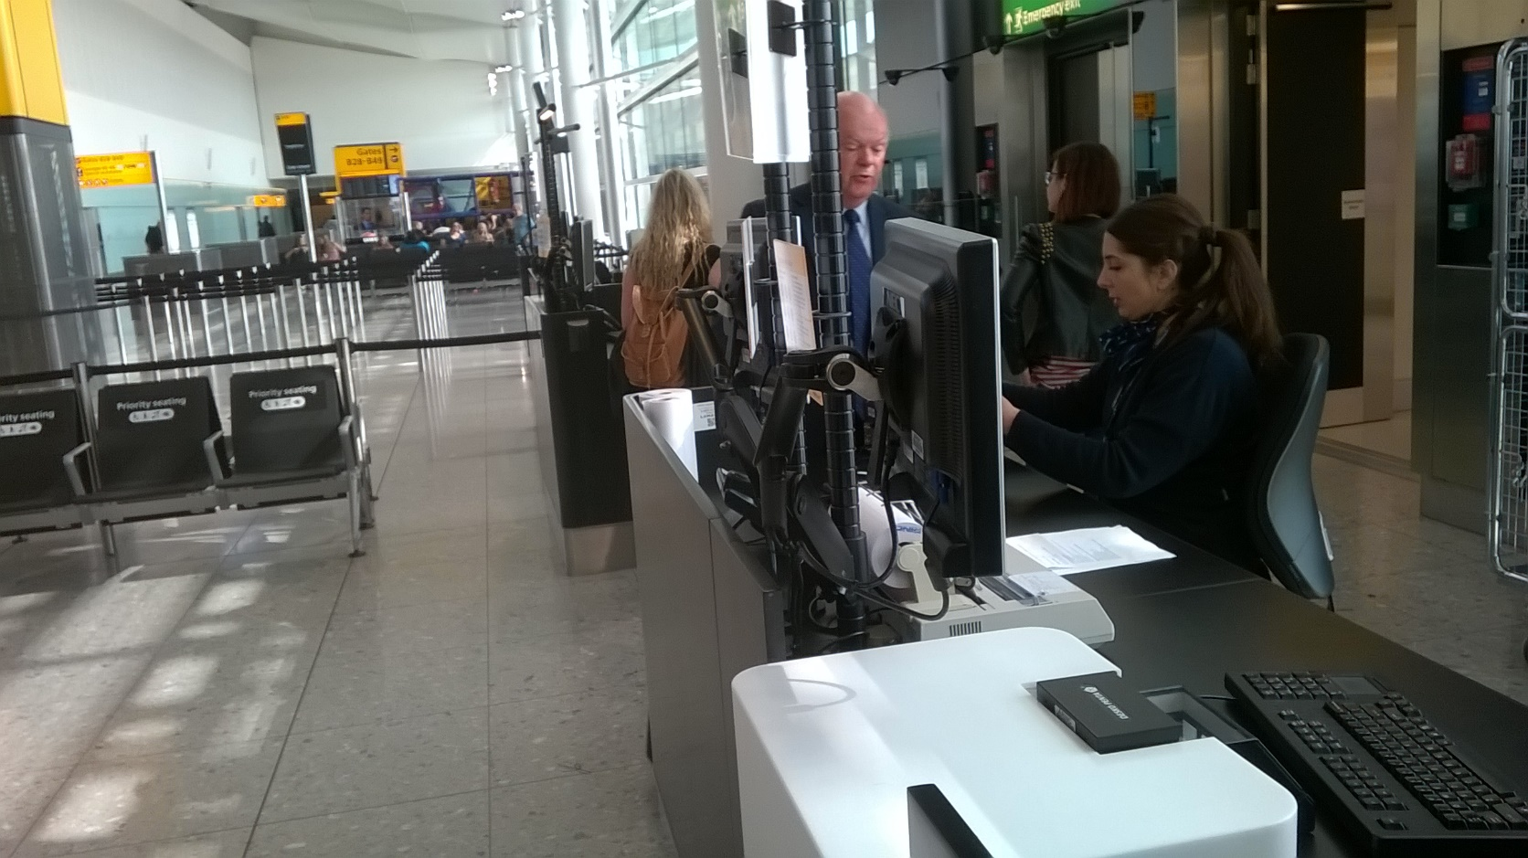
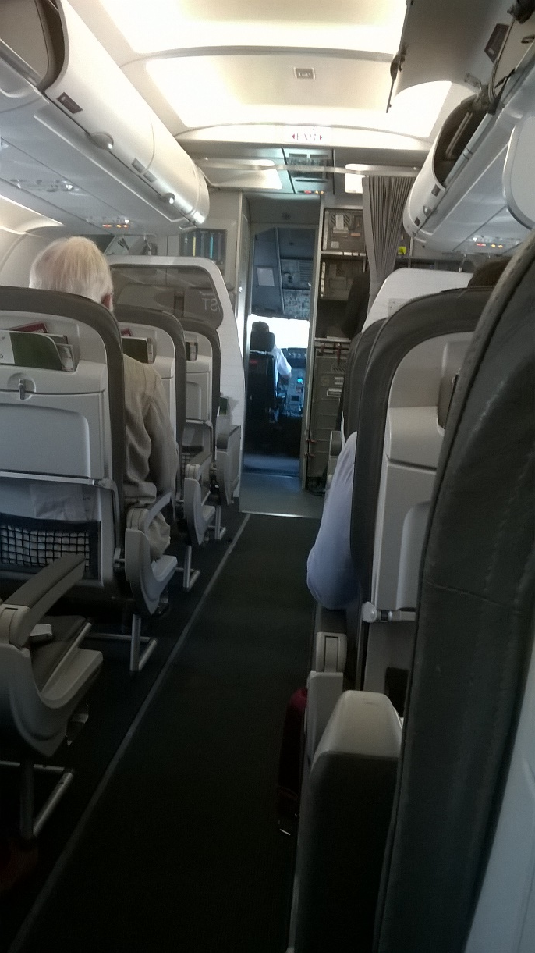
Preparation for Airport Memory
Airport vocabulary

