Slide 1
How much do you know about Scotland?

Slide 2
Quiz - “The Hot Chair” (Instructions)
Two teams compete (Team 1, Team 2).
There are 7 questions for each team.
The team that can answer most of the questions correctly is the winner.
Each question has to be answered by one team member/candidate alone.
The candidate can consult one (only 1!) other member of his team.
Each team has two 50/50 jokers that can be used by the candidates.
Moreover, each team has one “Vetos* that can be used if team members believe that the answer of their candidate is wrong.
In case of a “Veto” the team can correct the answer of their candidate and replace it by a second - then valid - answer.
*Veto – (lat.) „ich verbiete / I forbid“ (Einspruch)

Slide 3
What is the capital of Scotland?
Team 1 (1)
a) Aberdeen
b) Edinburgh
c) Glasgow
d) Belfast

Slide 4

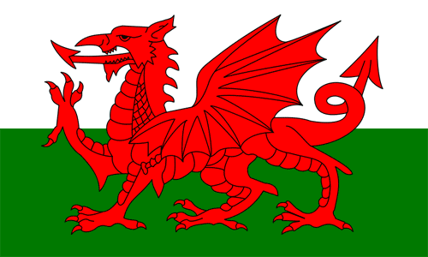
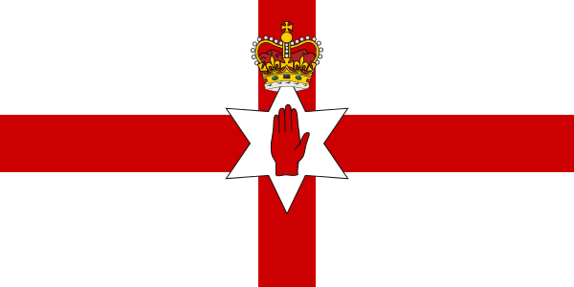
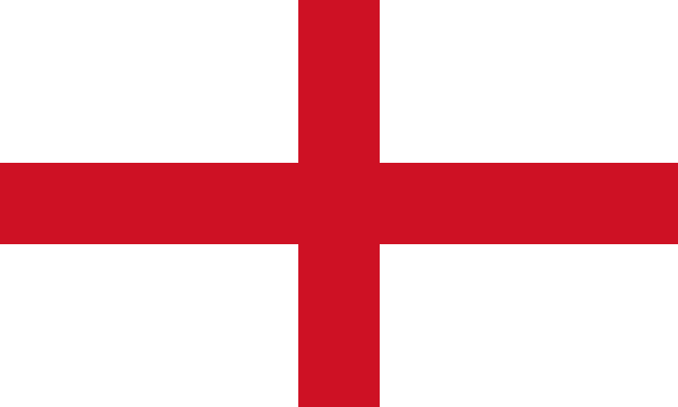
What is the Scottish flag?
Team 2 (1)
b)
c)
d)

Slide 5
Which of these places is not in Scotland?
Team 1 (2)
a) Perth
b) Scotland Yard
c) Inverness
d) Dundee

Slide 6
What kind of drink is Scotland famous for?
Team 2 (2)
a) Whisky
b) Uisge
c) Wisky
d) Whiskey

Slide 7
What is not an official language in Scotland?
Team 1 (3)
Scots, also known as Lowland Scots or Lallans, is a West Germanic language or - depending on the terminology - a series of English dialects in Scotland, which are native to the mountainous south of Scotland, the greater Glasgow-Edinburgh area, a strip of land along the east coast beyond Aberdeen and the Orkney and Shetland Islands. The term Lowland Scots or Scottishised Lallans expresses the contrast to the Highlands.
Gaelic
b) Lallans
c) Highland Scot
d) English

Slide 8
What is not typical Scottish food?
Team 2 (3)
a) Fish Stew
b) Shortbread
c) Kidney Pie
d) Haggis

Slide 9
What does Haggis consist of?
Team 1 (4)
a) Rice & beans
b) Oatmeal & offal
c) Beans & tomato sauce
d) Prawns & rice

Slide 10
What is the official Scottish national anthem?
Team 2 (4)
a) Scotland the Brave
c) Flower of Scotland
b) God save the King
d) Braveheart

Slide 11
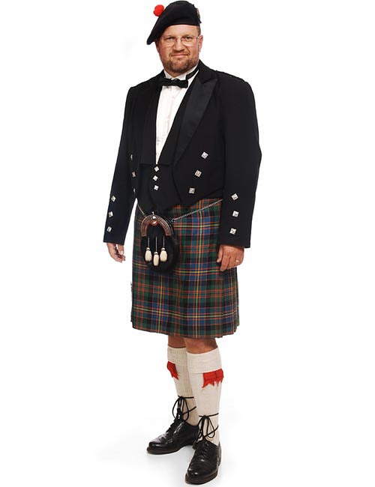
What are the Scottish “trousers” called?
Team 1 (5)
a) Skirt
b) Kilt
c) Skilt
d) Kirt

Slide 12
Which musical instrument is typical for Scotland?
Team 2 (5)
a) Harp
b) Tin Whistle
c) Bagpipe
d) Guitar

Slide 13
Team 1 (6)
Which of these celebrities is not Scottish?
Nicola Sturgeon
b) Sean Connery
c) Paul McCartney
d) Amy McDonald

Slide 14
What is Scotland’s head of government called?
Team 2 (6)
Chancellor
b) First Minister
c) Premier
d) Prime Minister

Slide 15
We have learned that a lake is called loch in Scotland?
But what is a mountain called?
Team 1 (7)
mont
b) ben
c) heap
d) clamp

Slide 16
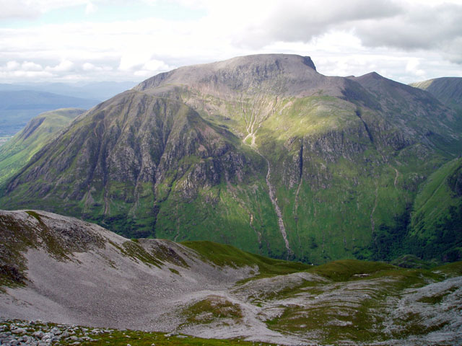
At 1435 metres, Ben Nevis in Scotland is the highest mountain in Great Britain.

Slide 17
Team 2 (7)
We have learned that in Scotland a lake is called loch and a mountain is called ben. But what is a valley called?
dale
b) canyon
c) glen
d) dell

Slide 18
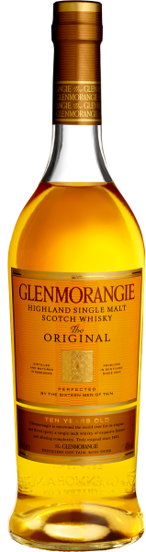
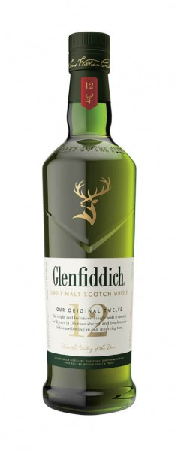
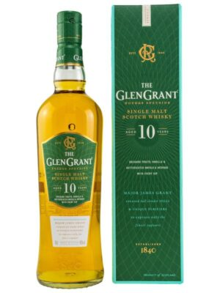
Whiskies named after the valley in which their distillery is located include
Glenmorangie, Glenfiddich and Glen Grant.

Slide 19
Scottish impressions

Slide 20
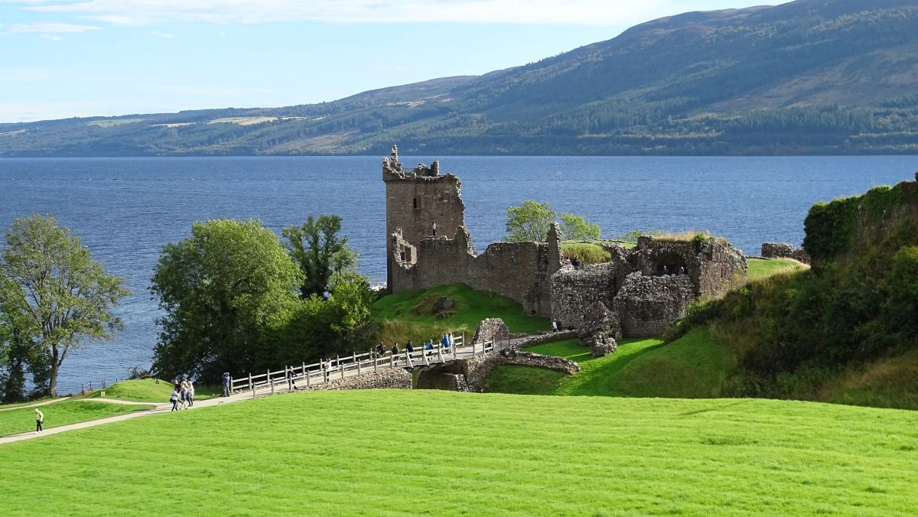
Urquart Castle, Loch Ness

Slide 21
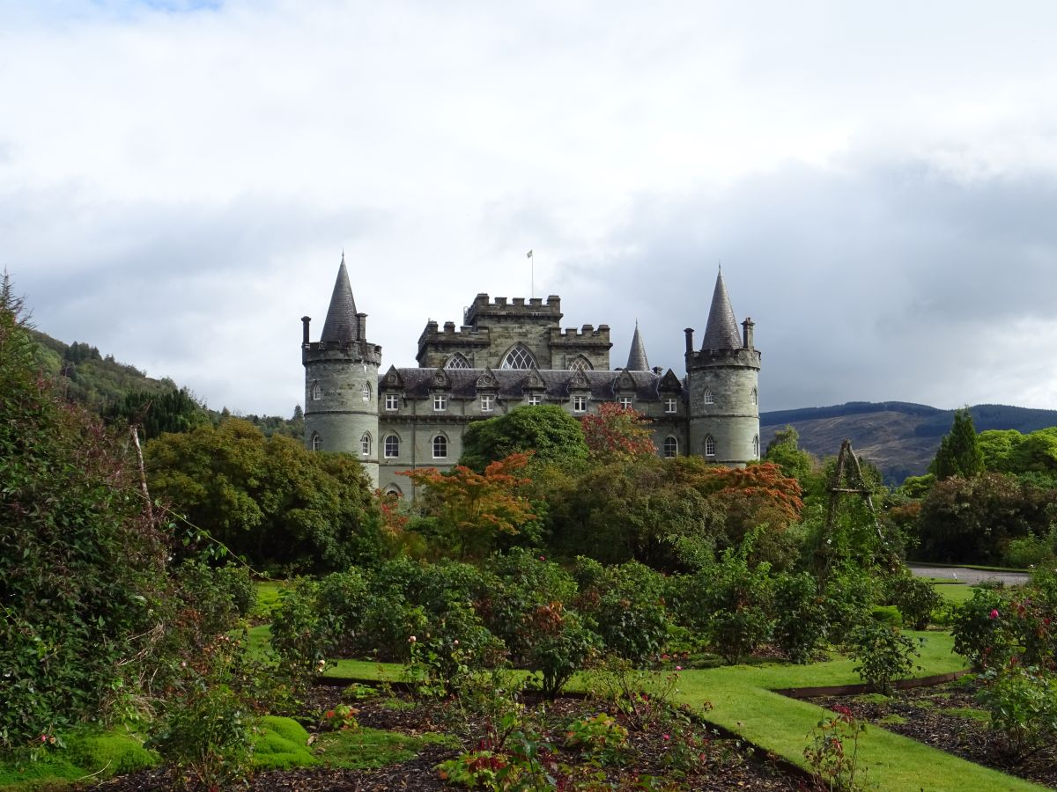
Inveraray Castle

Slide 22
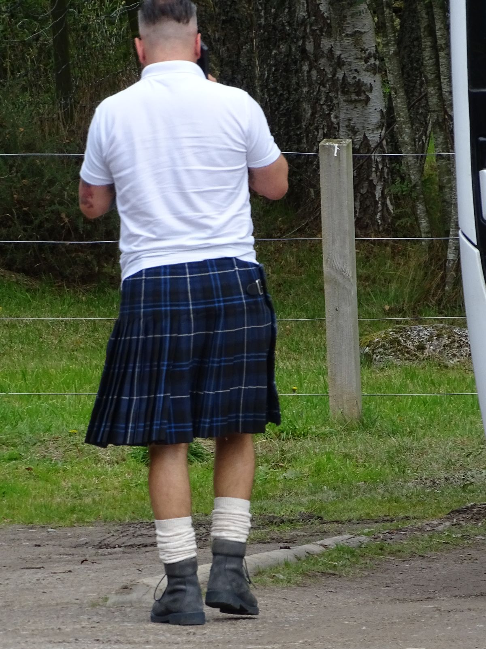
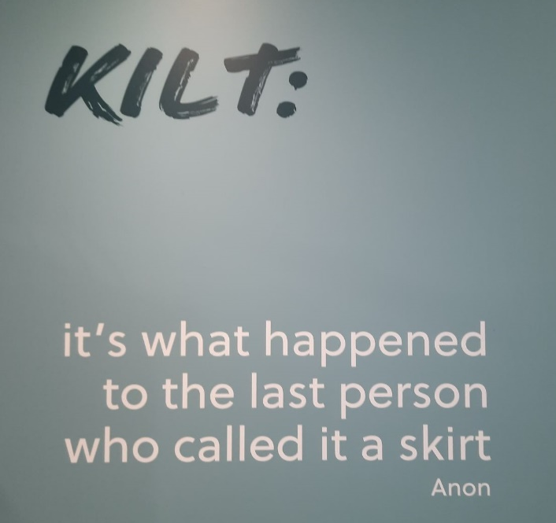
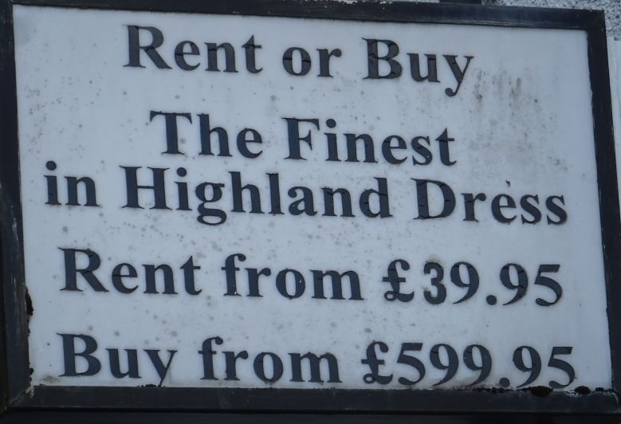
They wear it, really!

Slide 23
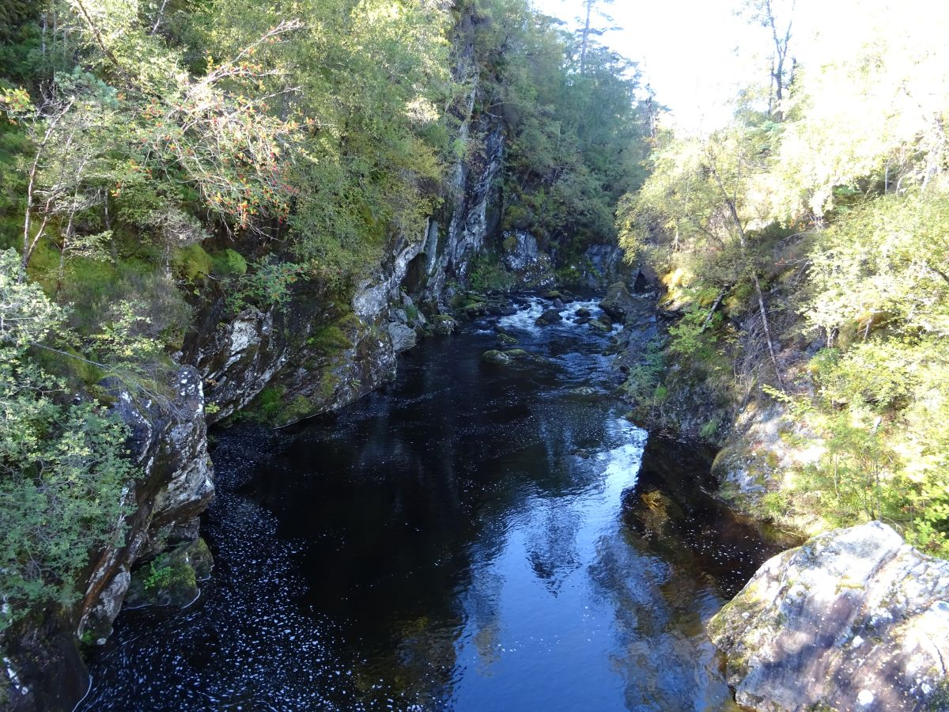
Glen Affric (south of Inverness)

Slide 24
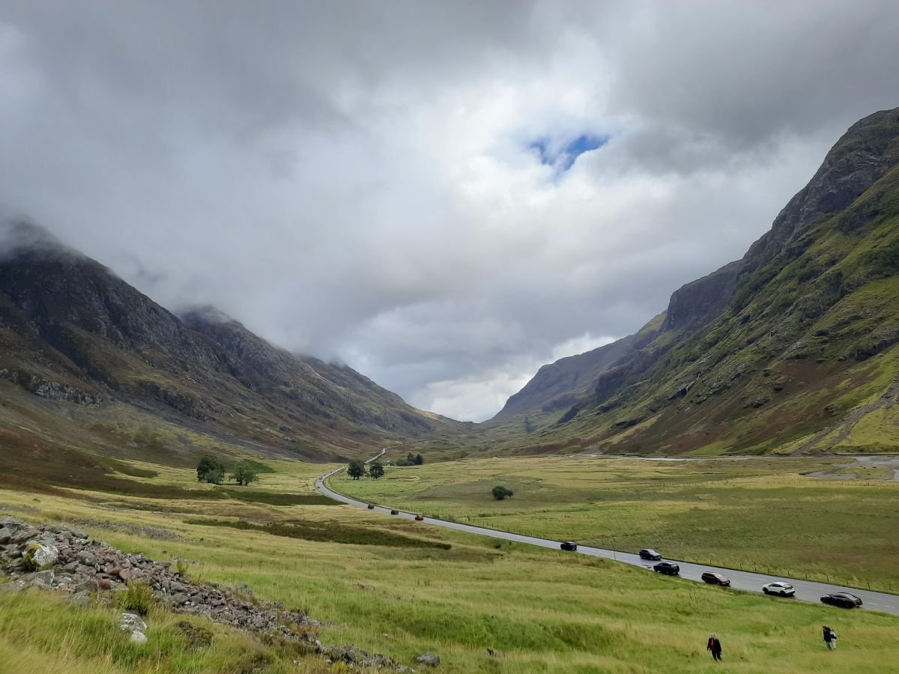
Glen Coe, “Valley of Tears“

Slide 25
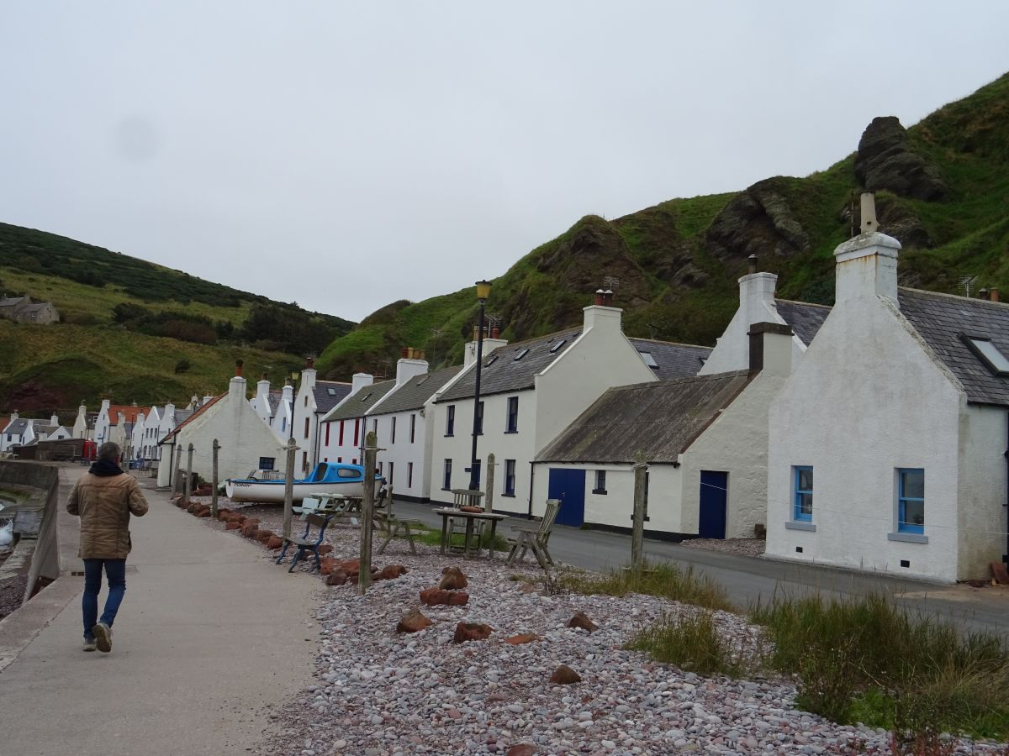
Pennan, set for the film “Local Hero”

Slide 26
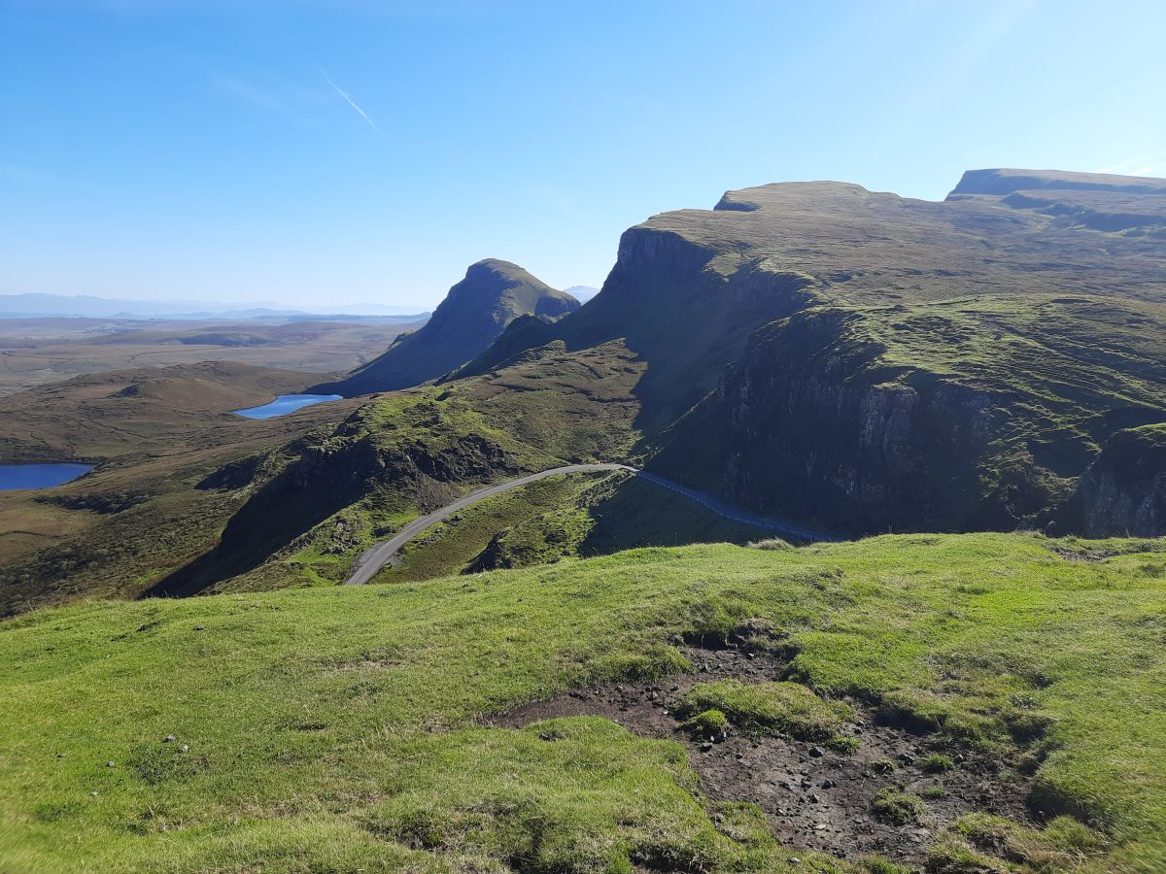
Isle of Skye

Slide 27
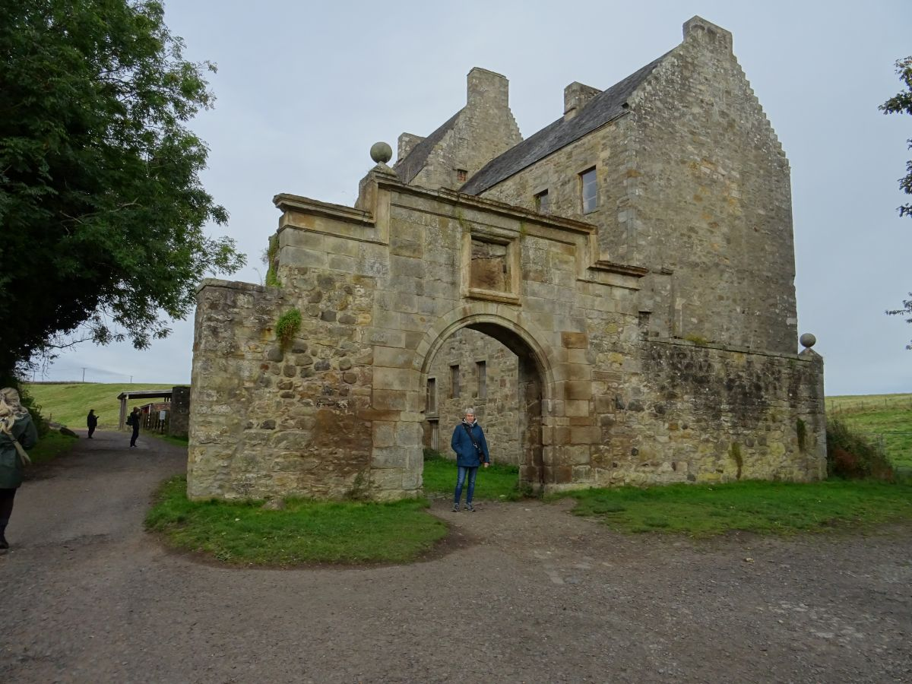
Midhope Castle on the southern rim of the Firth of Forth,
Jamie’s home and called Lallybroch in the Netflix series “Outlander”

