Slide 1
Quiz - The Hot Chair
Unit 5, 30 October 2025

Slide 2
Quiz - “The Hot Chair” (Instructions)
Two teams compete (Team 1, Team 2)
There are 6 questions for each team
The team that can answer most of the questions correctly is the winner
Each question has to be answered by one team member/candidate alone
The candidate must not consult the other members of his team
Each team has two 50/50 jokers that can be used by the candidates
Moreover, each team has one “Veto”* that can be used if team members believe that the answer of their candidate is wrong
In case of a “Veto” the team can correct the answer of their candidate and replace it by a second - then valid - answer
*Veto – (lat.) „ich verbiete / I forbid“ (Einspruch)

Slide 3
Which answer to “How are you?” is not correct?
Team 1 (1)
I’m fine, thank you.
b) I’m German.
c) Not too bad.
d) I’m okay.

Slide 4
What is not a reply to
“Hello, I’m Jim Beam.”?
Team 2 (1)
Nice to meet you, Jim
b) Hello Jim, I’m Nancy.
c) Hi Jim. How are you?
d) I’m German. Where are you from?

Slide 5
People from Rome are…?
Team 1 (2)
Italy
b) Italian
c) Italien
d) Italos

Slide 6
People from Zurich are…?
Team 2 (2)
Austrian
b) Swiss
c) Switzerland
d) Swedish

Slide 7
Which city is the capital of Australia?
Team 1 (3)
Sydney
b) Melbourne
c) Canberra
d) Ottawa

Slide 8
Which city is not in Canada?
Team 2 (3)
Toronto
b) Vancouver
c) Seattle
d) Quebec

Slide 9
What is in Washington D.C.?
Team 1 (4)
The Mall
b) Queen’s Park
c) Central Park
d) Capitol Garden

Slide 10
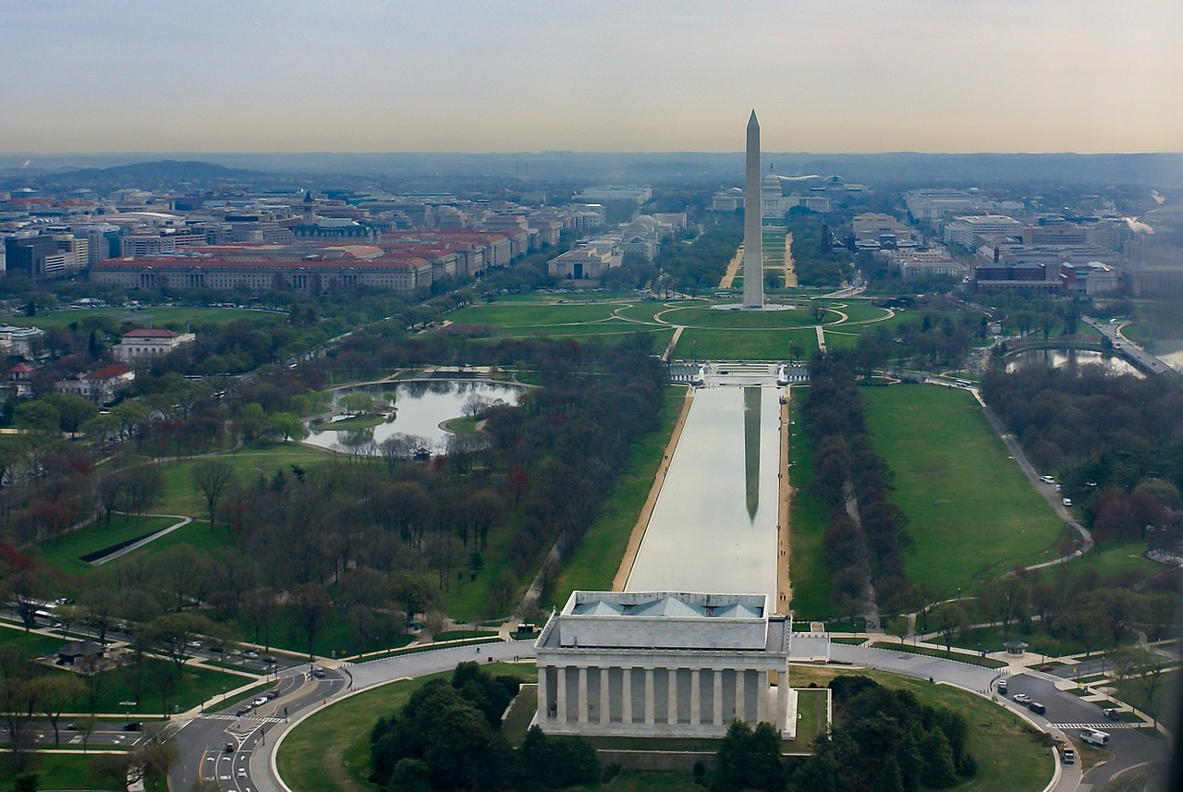

Slide 11
What is not in New York City?
Team 2 (4)
Empire State Building
b) Battery Park
c) Times Square
d) Hyde Park

Slide 12
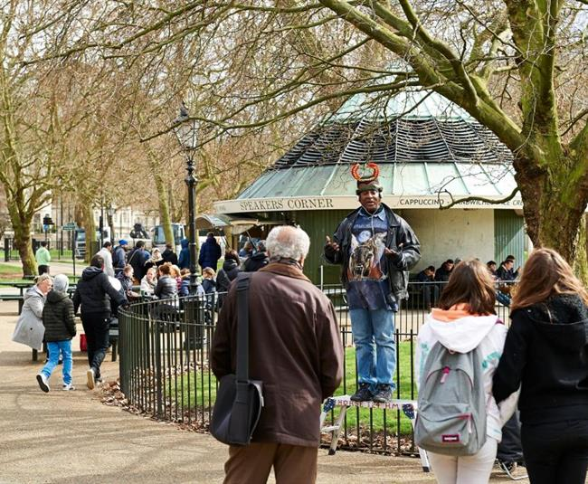
Speaker‘s Corner at HydePark, London

Slide 13
What is not an airport of London?
Team 1 (5)
John Lennon
b) Heathrow
c) Gatwick
d) Stansted

Slide 14
What is not a borough of New York City?
Team 2 (5)
The Bronx
b) Harlem
c) Staten Island
d) Queens

Slide 15
Who is not an American writer?
Team 1 (6)
Edgar Wallace
b) Edgar Allen Poe
c) Mark Twain
d) Tennessee Williams

Slide 16
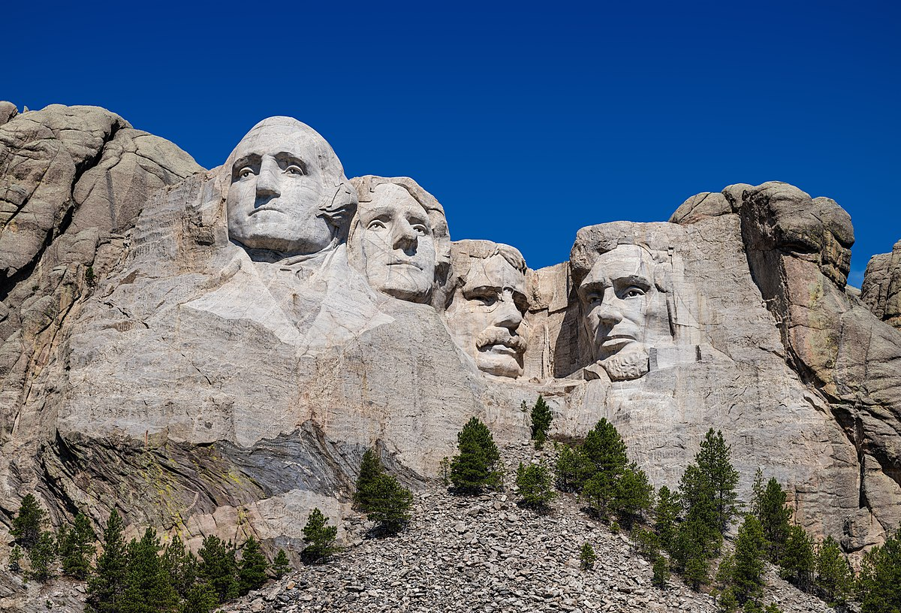
Mount Rushmore National Memorial, South Dakota, USA

Slide 17
Who was not a President of the United States?
Team 2 (6)
Thomas Jefferson
b) Abraham Lincoln
c) Thomas Alva Edison
d) Harry S. Truman

Slide 18
f.l.t.r.: George Washington, Thomas Jefferson, Theodore Roosevelt, Abraham Lincoln

