Slide 1

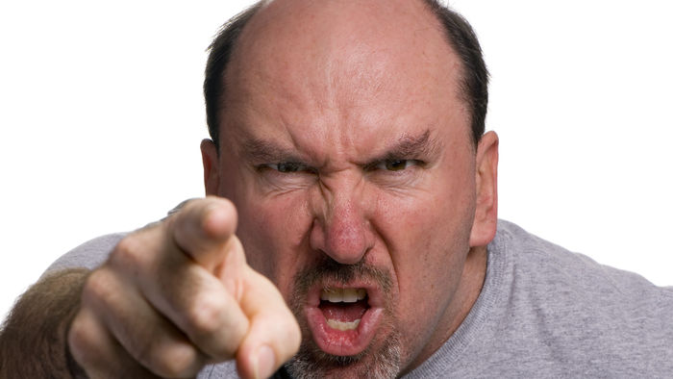
3rd unit, 02 October 2025
Uumphhh…
Aaarghhh…!
a bit angry
absolutely furious

Slide 2
3rd unit, 02 October 2025
Uumphhh…
Aaarghhh…!
a bit angry
absolutely furious
absolutely angry?
a bit furious?

