Slide 1
Which country is it?

Slide 2
Part of the Commonwealth of Nations 1509 – 1655: Spanish colony 1655 – 1962: British colony

Slide 3
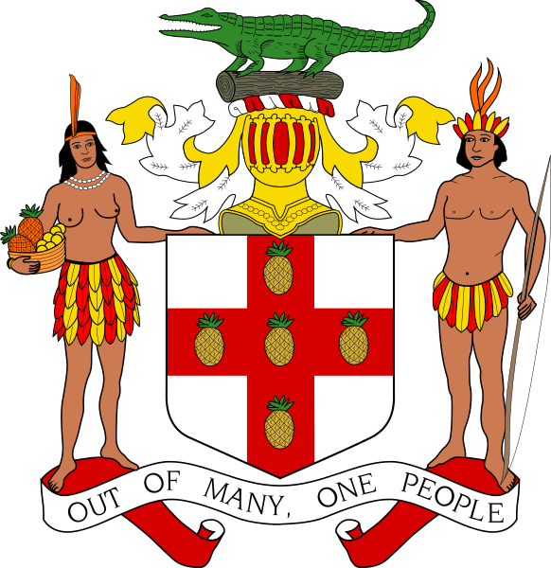

Slide 4
Currency? Dollar.

Slide 5
Island Length: 235 km Width: 35 – 82 km

Slide 6
Population: ~ 3 million, 91% of which are descendants of African slaves Average age: 23.7 years

Slide 7
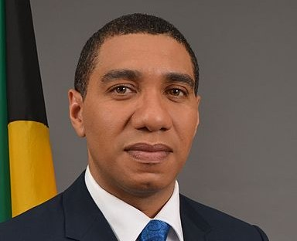
Parliamentary monarchy Head of State: King Charles III Head of Government: Andrew Holness, Prime Minister

Slide 8
Average temperature (capital): January – 25° July – 27°

Slide 9
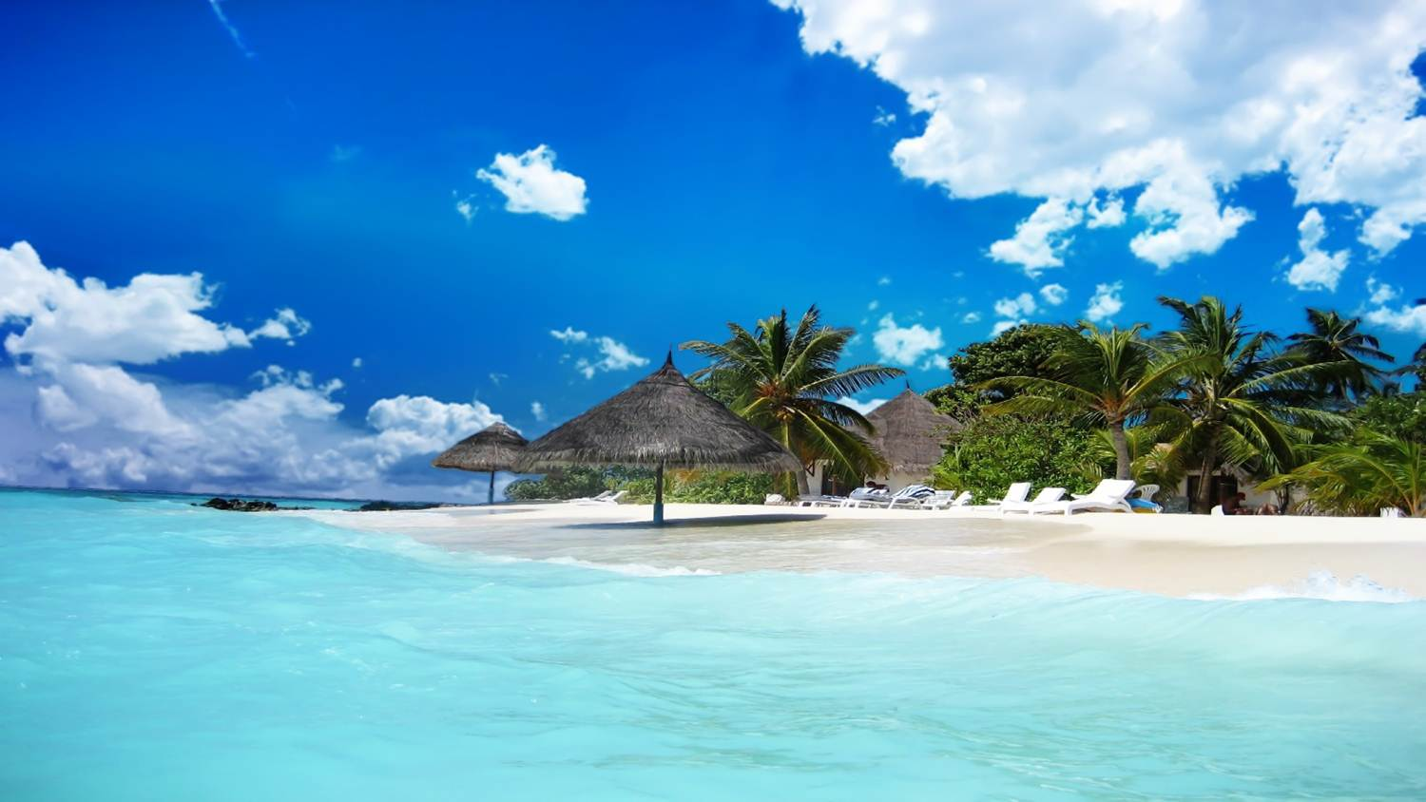

Slide 10
Music

Slide 11
Traffic? You drive on the left.

Slide 12
???

Slide 13
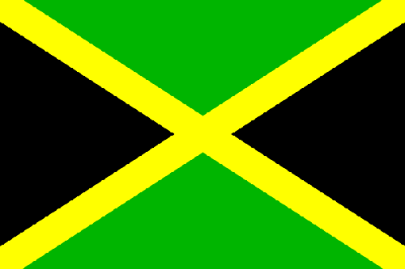

Slide 14
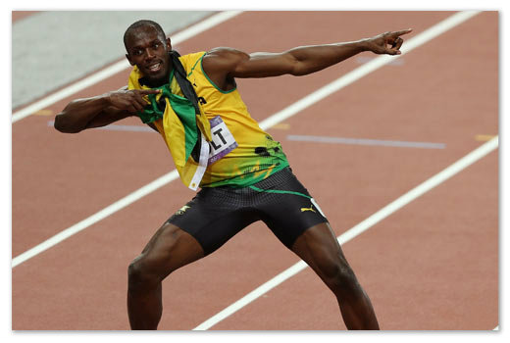
9.58 seconds, 37.58 km/h

Slide 15
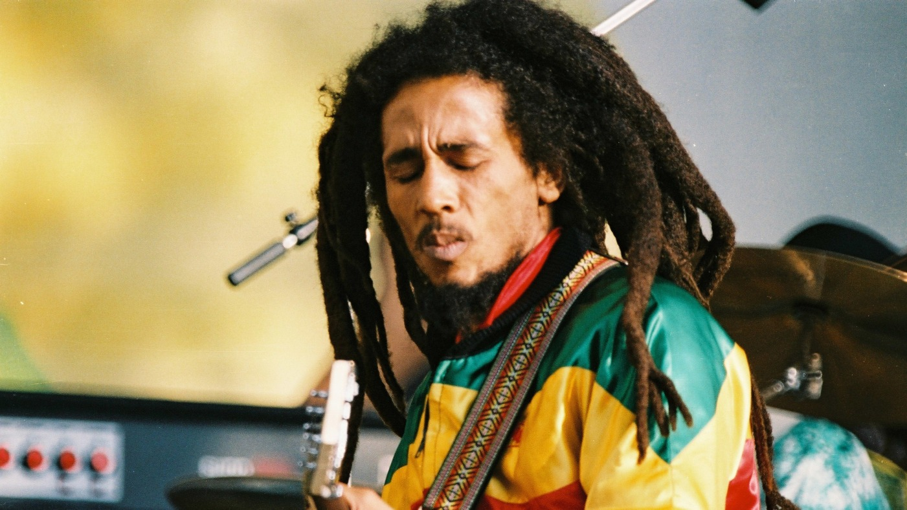

Slide 16
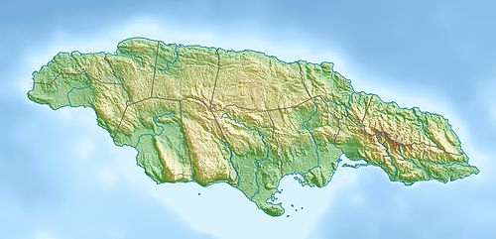

Slide 17
Marihuana is legal
„Too many of our young people have ended up with criminal convictions after being caught with a spliff, something that has affected their ability to do things like get jobs and get visas to travel overseas.“
Mark Golding, Minister of Justice

Slide 18
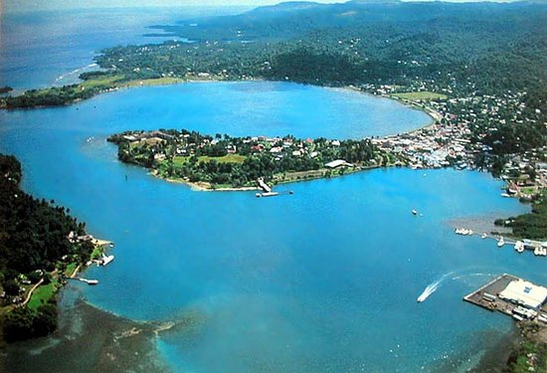
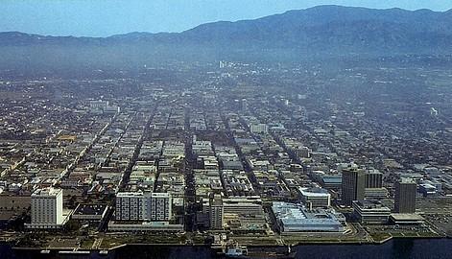
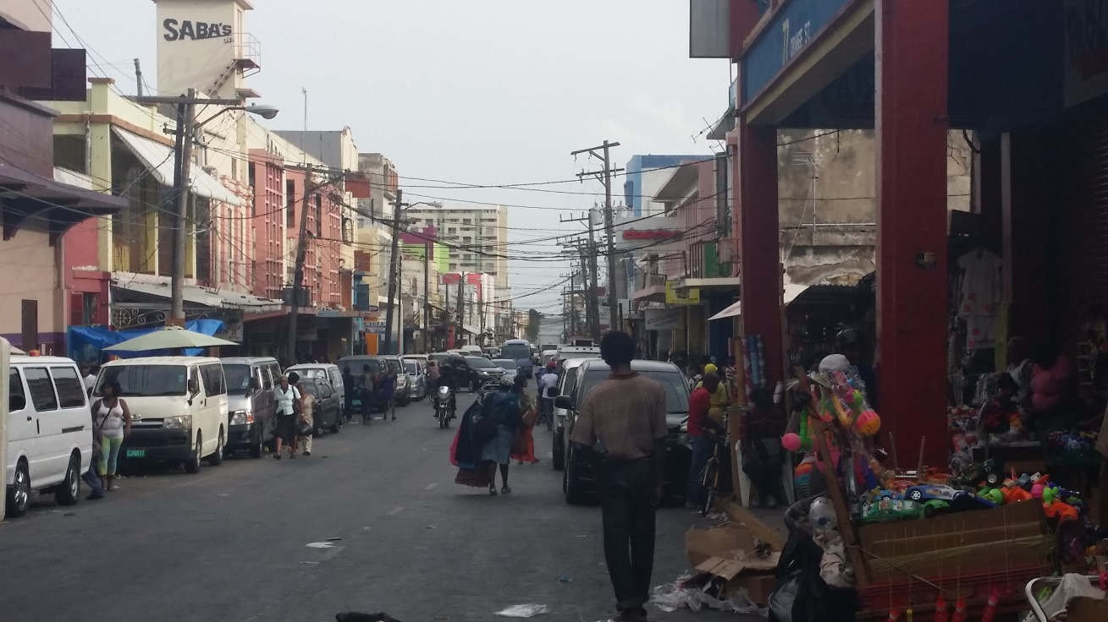
Capital: Kingston

Slide 19
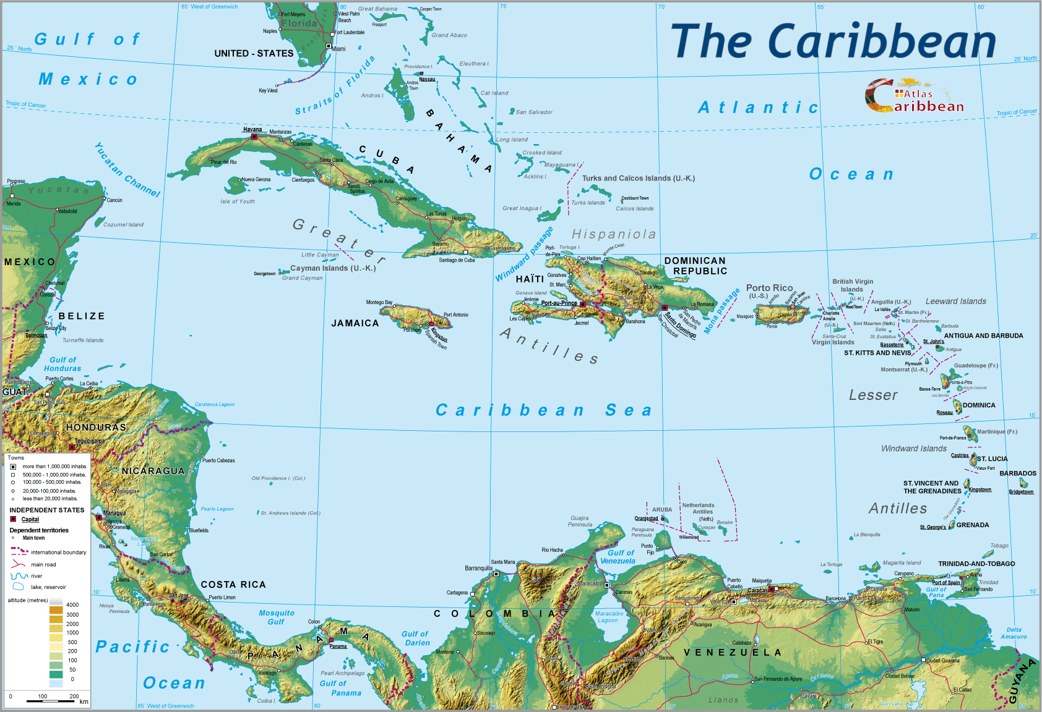
Jamaica

