Slide 1
Which country is it?

Slide 2
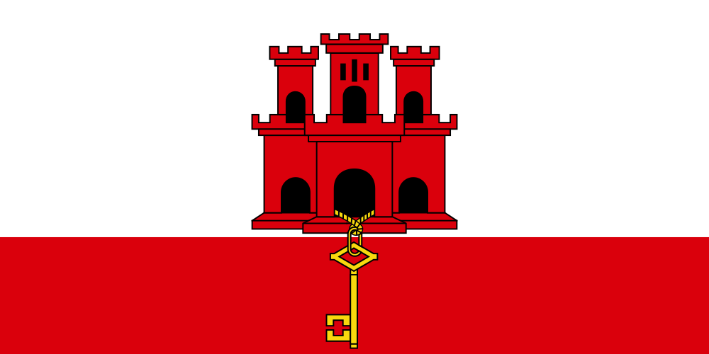
Coat of Arms National Flag

Slide 3
One of the most densely populated countries. 5,319 inhabitants / km²

Slide 4
Size: 6.5 km² Population: 38,471 (2023)

Slide 5
Head of State: King Charles III

Slide 6
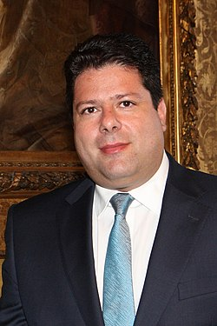
Head of Government: Chief Minister Fabian Raymond Picardo

Slide 7
Country code (telephone): +350

Slide 8
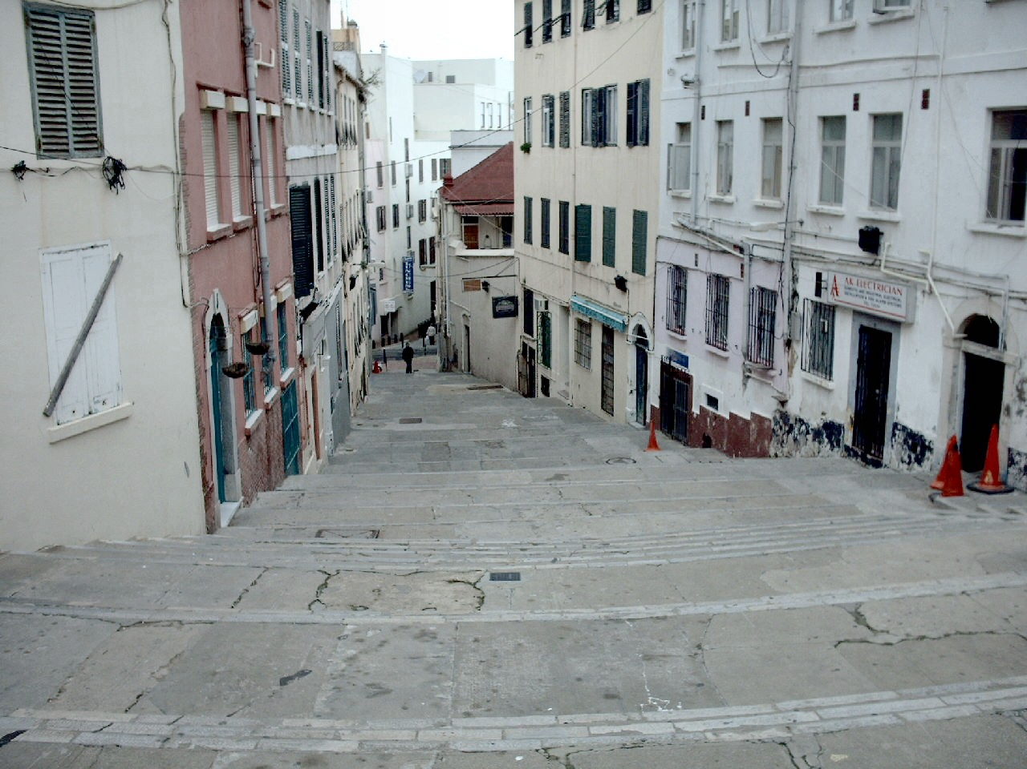

Slide 9
Traffic? You drive on the right.

Slide 10
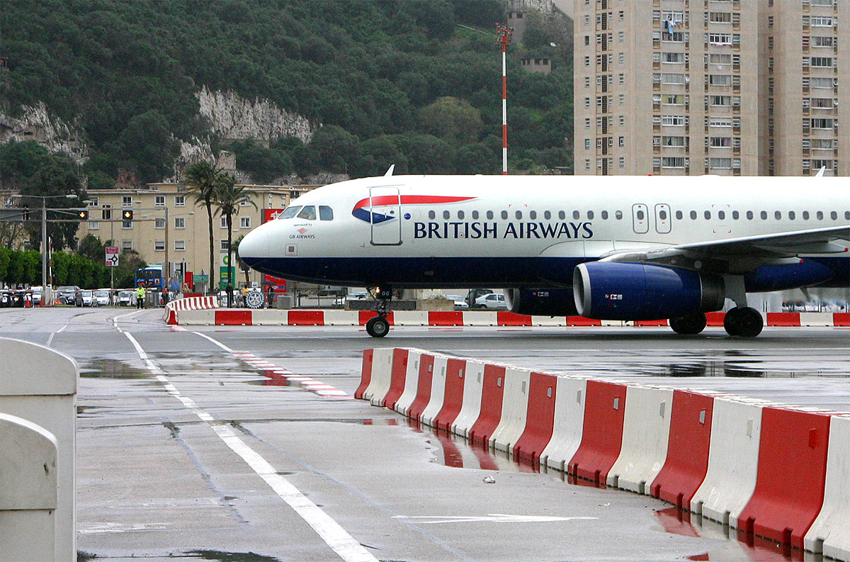

Slide 11
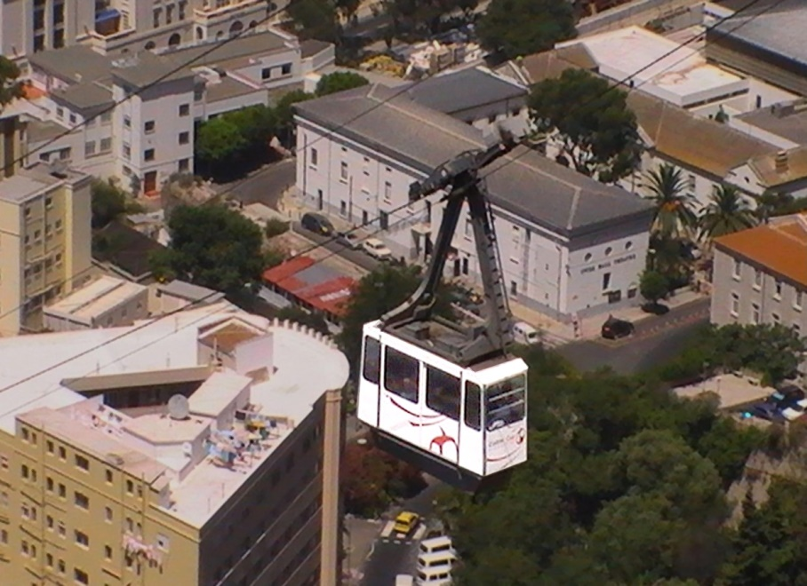

Slide 12
Country code (licence plate):
GBZ

Slide 13
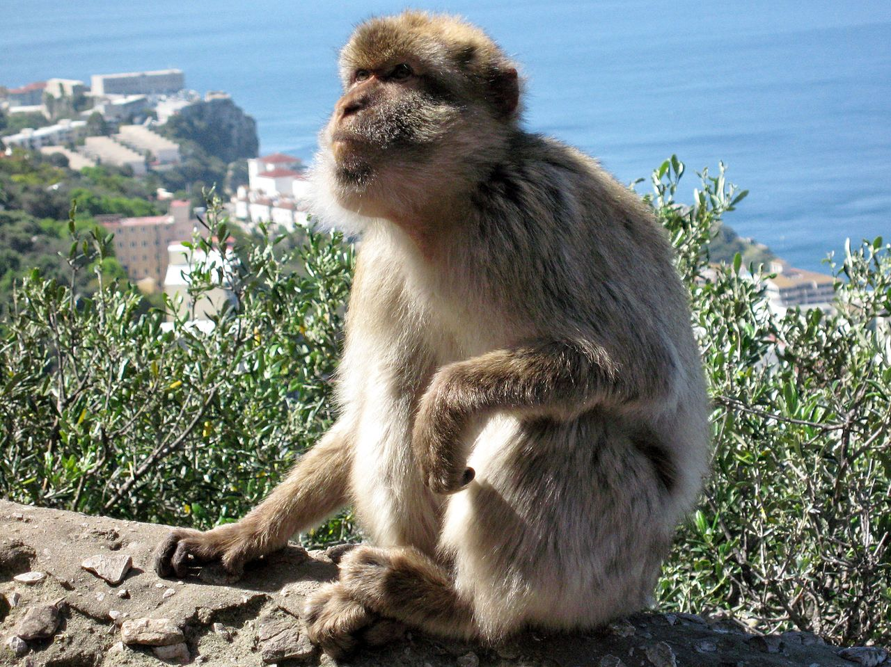

Slide 14
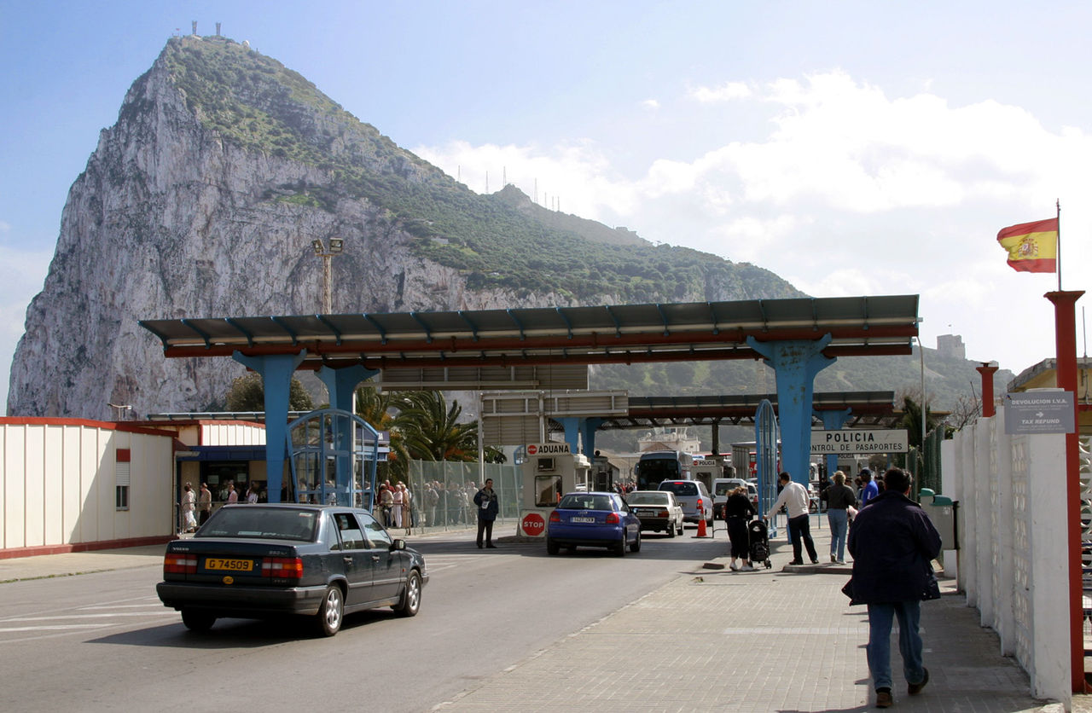

Slide 15
