Slide 1
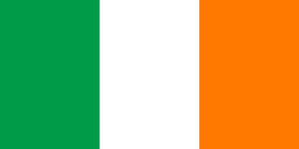
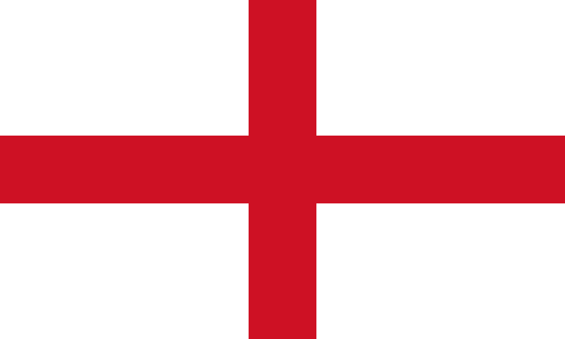
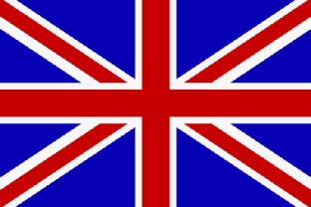
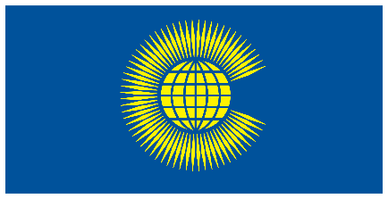
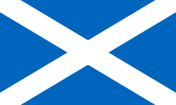
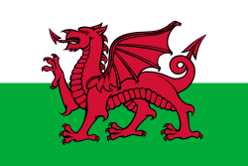
Great Britain
England
United Kingdom
Ireland
Northern Ireland
Wales
Republic of Ireland
Ulster
Scotland
Commonwealth

Slide 2
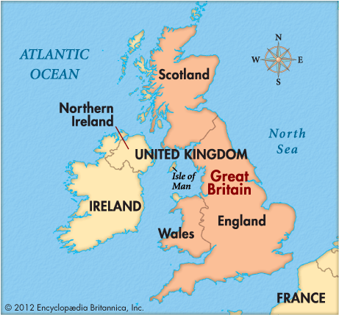

Slide 3
Geographical
Great Britain, also known as Britain, is an island in the North Atlantic off the north-west coast of continental Europe. The island has an area of 229,848 km², and is the largest island of the British Isles, the largest island in Europe and the ninth-largest in the world. With a population of about 67 million people, it is the third-most populous island in the world, after Java (Indonesia) and Honshu (Japan). It is surrounded by over 1,000 smaller islands. The island of Ireland lies to its west.

Slide 4
Great Britain - Political
The island is part of the United Kingdom of Great Britain and Northern Ireland, constituting most of its territory: most of England, Scotland, and Wales are on the island, with their respective capital cities, London, Edinburgh, and Cardiff.

Slide 5
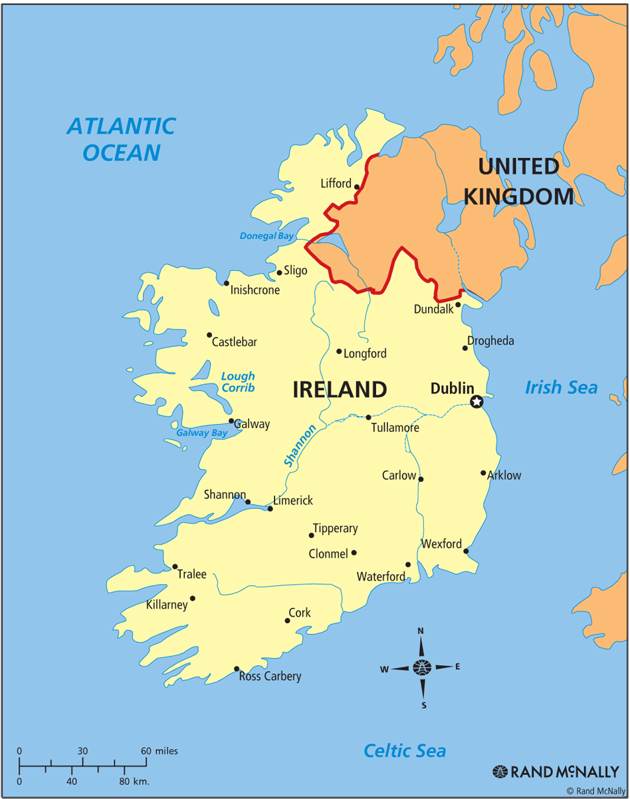

Slide 6
Ireland - Geographical
Ireland is an island in the North Atlantic to the west of Great Britain, from which it is separated by the North Channel, the Irish Sea, and St Georges Channel. It is the second-largest island of the British Isles archipelago. It is the third-largest island in Europe and the twentieth-largest island on Earth.
North Channel
St Georges Channel

Slide 7
Ireland - Political
Politically, Ireland is divided between the Republic of Ireland, which covers five-sixths of the island, and Northern Ireland (also called Ulster), a part of the United Kingdom, which covers the remaining area and is located in the north-east of the island. The population of Ireland is about 6.9 million. About 5 million live in the Republic of Ireland and just over 1.9 million live in Northern Ireland.

Slide 8
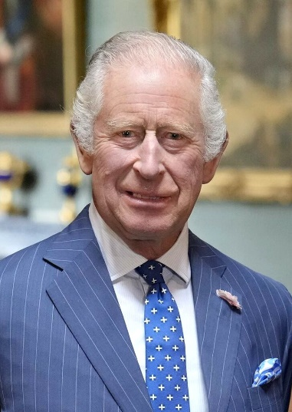
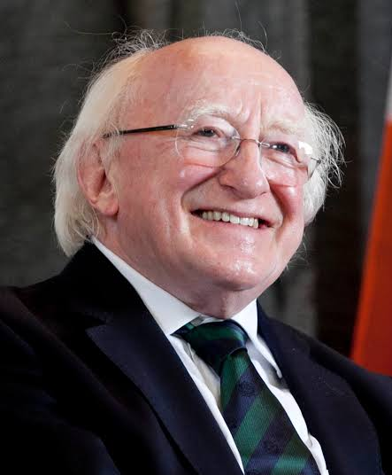
The United Kingdom and the Republic of Ireland
- Heads of State -
King Charles III
as the sucessor to Queen Elizabeth II Charles is the Head of State of the United Kingdom and as such the Head of State of England, Scotland, Wales and Northern Ireland (Ulster) as well as 14 further sovereign states designated Commonwealth Realms and including Canada, Australia and New Zealand.
In addition, he is the Head of the Commonwealth of Nations comprising 56 states.
King Charles‘ family name is Mountbatten-Windsor. Mountbatten is the anglicised variant of his fathers family name Battenberg.
The family name of Queen Elizabeth II was Windsor.
Michael D. Higgins
is a member of the Irish Labour Party and has been the 9th President of the Republic of Ireland since 11 November 2011.
In the Republic of Ireland the President is elected by the people, which is different from Germany where the President is elected by the Federal Assembly (Bundesversammlung) comprising all MPs and elected delegates from the German Länder.

Slide 9
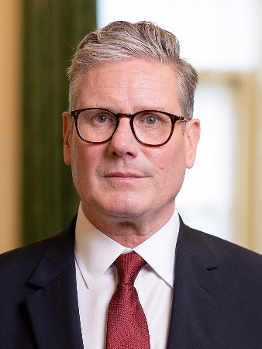
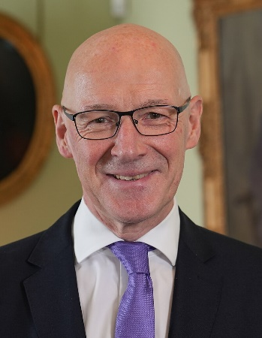
The United Kingdom and the Republic of Ireland
- Heads of Government -
As the sucessor to Rishi Sunak Sir Keir Rodney Starmer is the Prime Minister of the United Kingdom and as such the Head of Government of the UK and England. Aged 62 he is a member of the British Labour Party.
John Swinney is the Head of Government of Scotland. Designated First Minister the title is a deliberate distinction from the Prime Minister, the head of government for the whole of the United Kingdom.

Slide 10
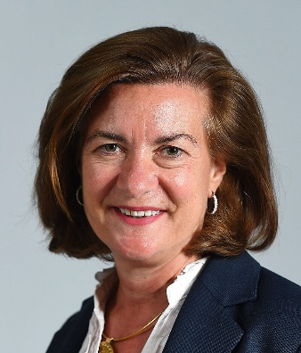
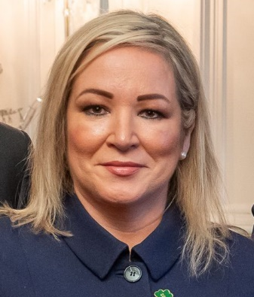
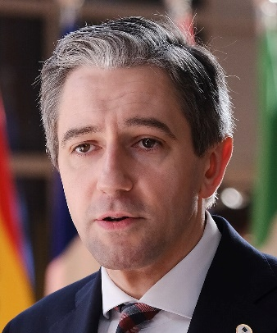
The United Kingdom and the Republic of Ireland
- Heads of Government -
Eluned Morgan, First Minister of Wales, has been the Head of Government of Wales since August 2024. In the UK countries, all Heads of Government are appointed by the King.
First Minister Michelle O‘Neill, a member of the Sinn Féin Party, is the Head of Government of Northern Ireland.
As the Taoiseach (pronounce: tea-shoch) Simon Harris is the Head of Government and Prime Minister of the Republic of Ireland. (Remember: The Republic of Ireland is an independent country and not a part of the United Kingdom.)

Slide 11
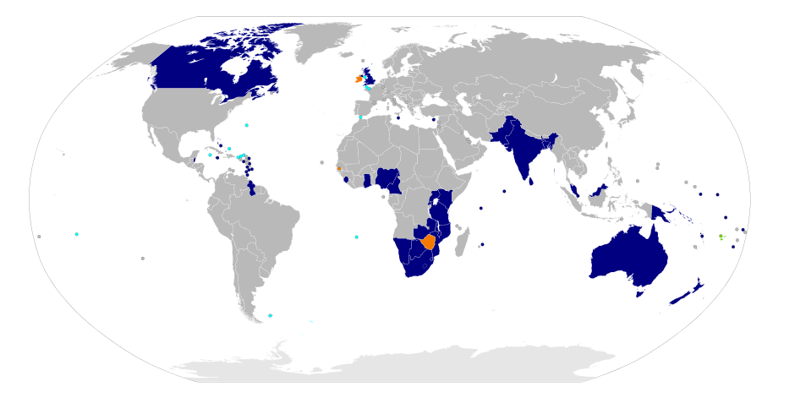
Commonwealth of Nations

Slide 12
The Commonwealth of Nations, commonly known as the Commonwealth (formerly the British Commonwealth), is an intergovernmental organisation of 53 member states that were mostly territories of the former British Empire. The Commonwealth operates by intergovernmental consensus of the member states, organised through the Commonwealth Secretariat, and non-governmental organisations, organised through the Commonwealth Foundation.

Slide 13
The Commonwealth dates back to the mid 20th century with the decolonisation of the British Empire through increased self-governance of its territories. It was formally constituted by the London Declaration in 1949, which established the member states as "free and equal". The symbol of this free association is King Charles III who is the Head of the Commonwealth.
Member states have no legal obligation to one another. Instead, they are united by language, history, culture, and their shared values of democracy, human rights, and the rule of law.

Slide 14
Querstions
Which countries are part of Great Britain?
England, Scotland and Wales
Which countries are part of the United Kingdom?
England, Scotland, Wales and Northern Ireland/Ulster
The German head of government is referred to as the Federal Chancellor. And the Welsh one?
First Minister
What is the capital of Scotland?
Edinburgh
Who is the head of state of Canada?
King Charles III
How many countries does the Commonwealth comprise?
56
What is the head of state of the Republic of Ireland referred to?
President
What is the family name of King Charles III??
Mountbatten-Windsor

