Slide 1
Find the word.

Slide 2
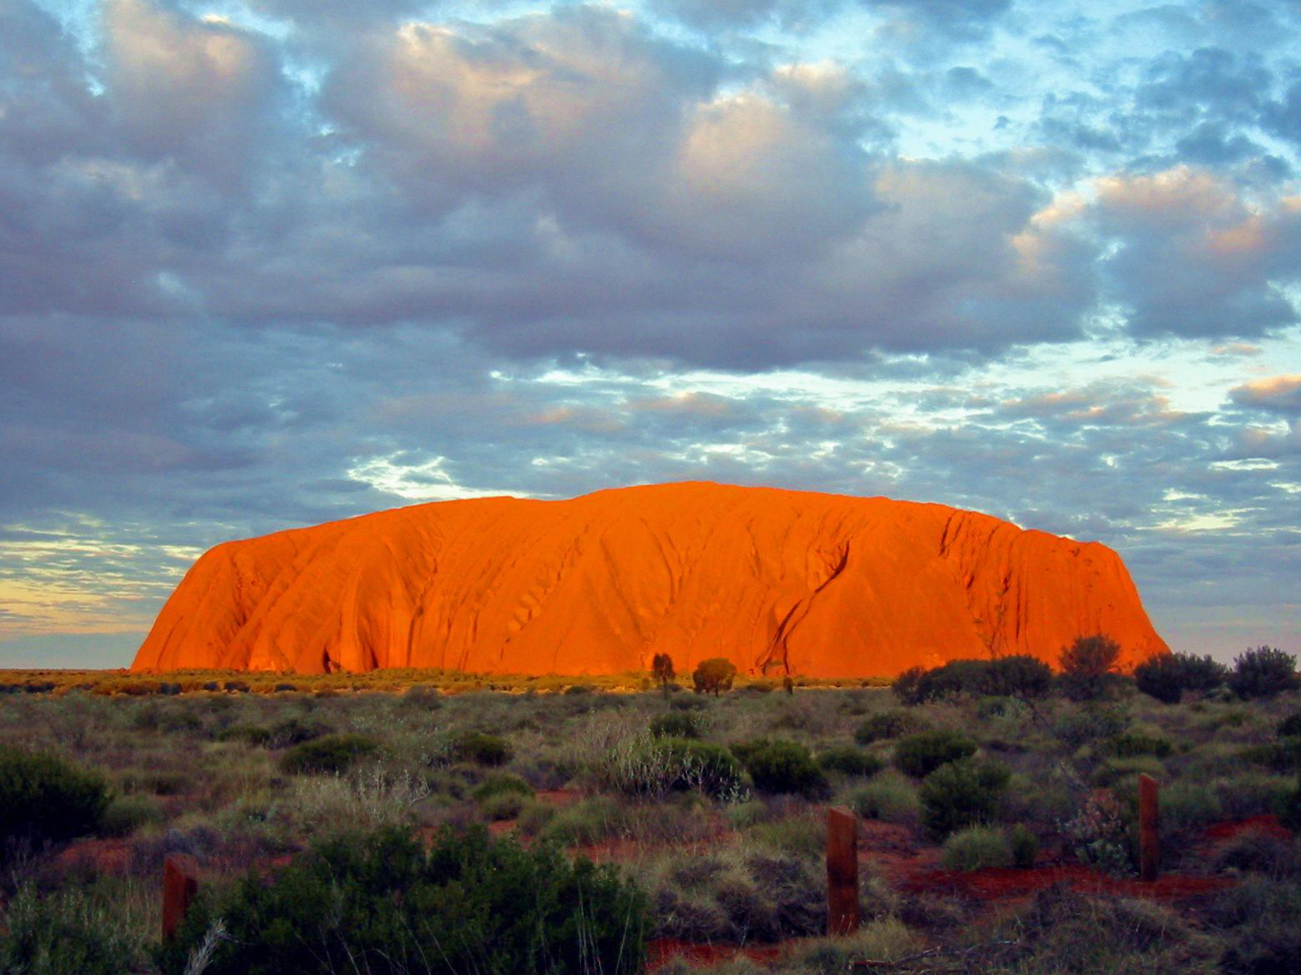
Ayer’s Rock (Uluru) is one of the country’s major touristic attractions.
We need the last letter of the country’s capital.

Slide 3
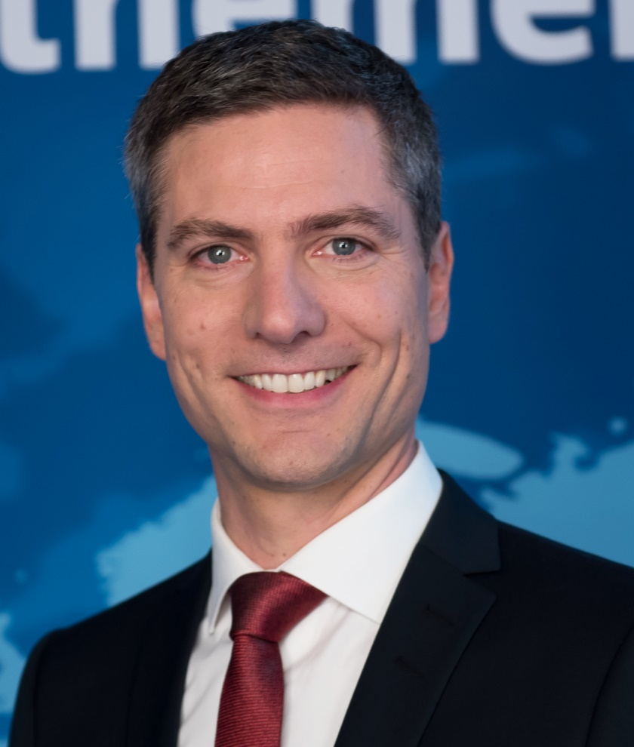
Ingo Zamperoni, same as Jessy Wellmer and Pinar Atalay,
is among the recent and current protagonists of the Tagesthemen news show.
What is his job called in English? We need the first letter.

Slide 4
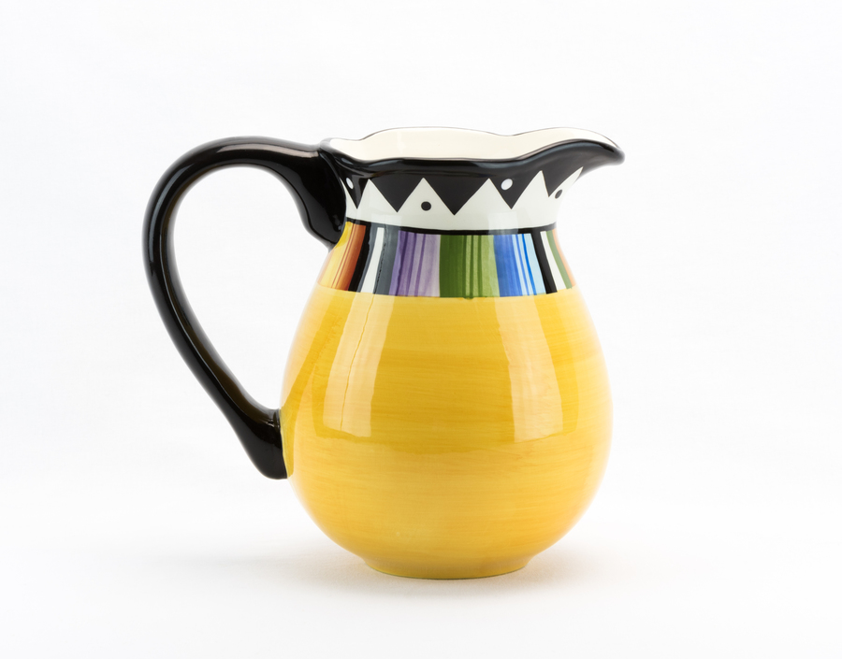
A ‘pitcher’ can be a container for liquids
or a position in a team sport,
of which we need the first letter.

Slide 5
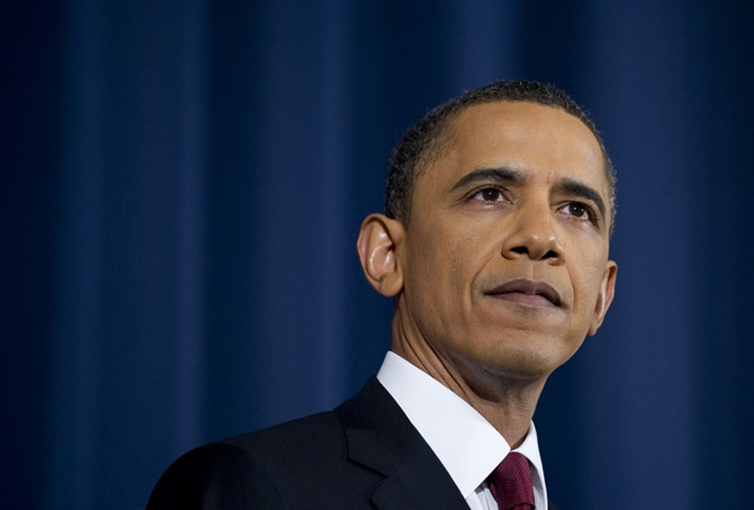
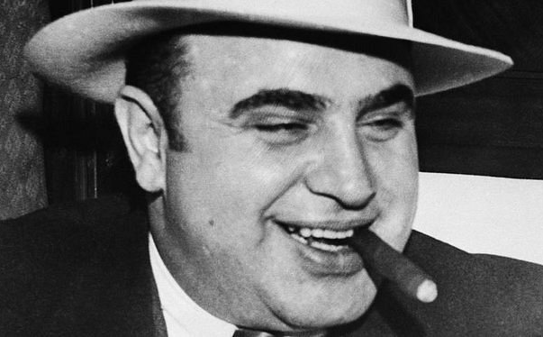
During certain periods of their lives both gentlemen had their ‘workplaces’ in a city bordering a lake and having a reputation of being pretty cold in winter. We need the first letter of the city’s name.

Slide 6
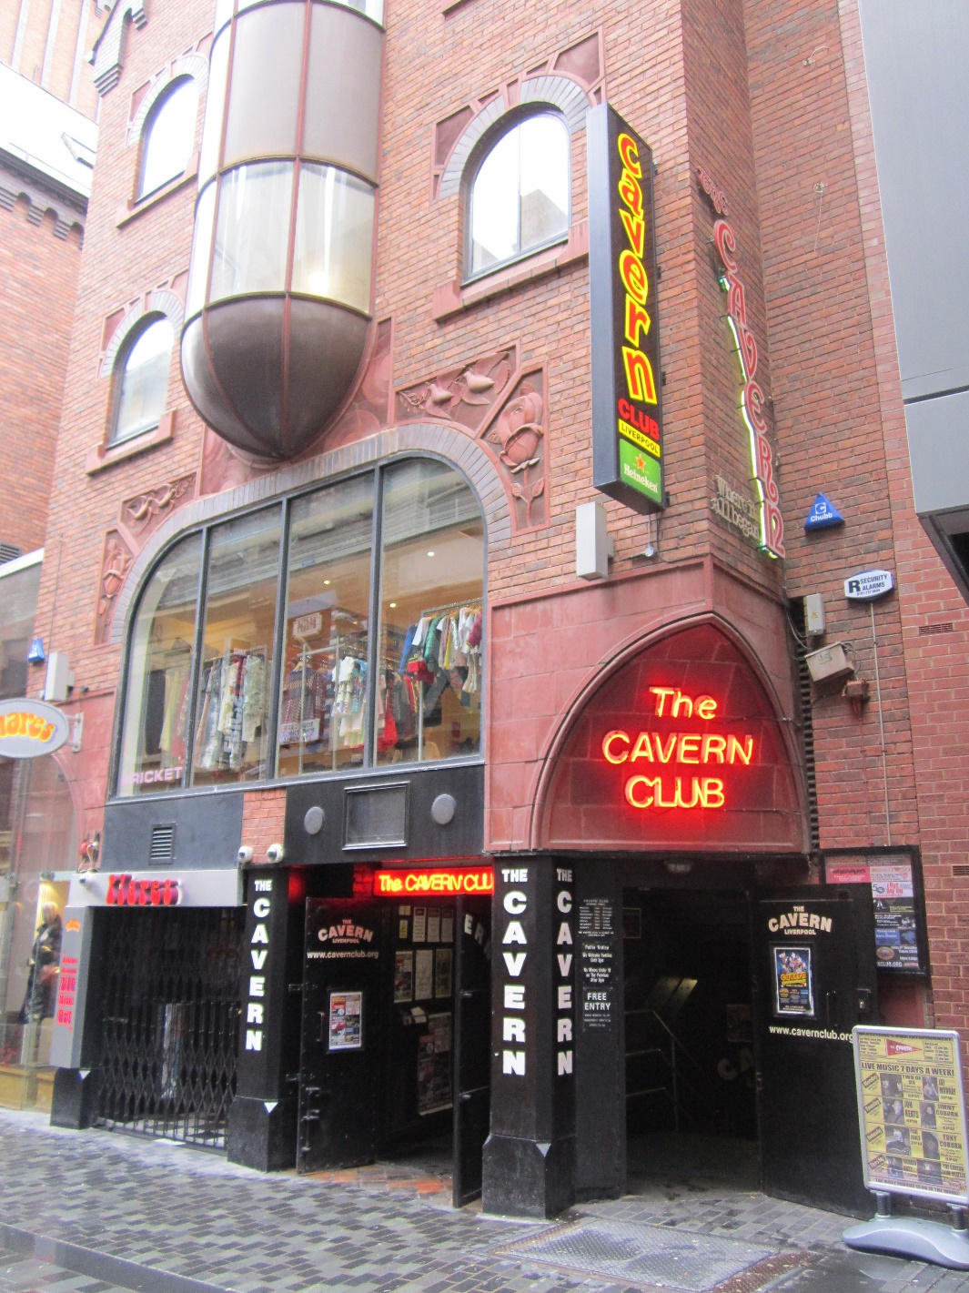
Apart from The Reds, the city in England’s northwestern region is famous as the place of foundation of many well-known bands, among them the Beatles, Frankie goes to Hollywood and Gerry and the Pacemakers.
We need the first letter of the city’s name.

Slide 7
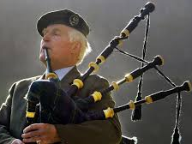
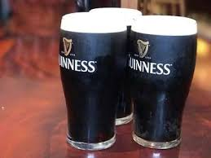
A Scotsman’s “Mac/Mc” is an Irishman’s …?
We need a common prefix to Irish surnames.

Slide 8
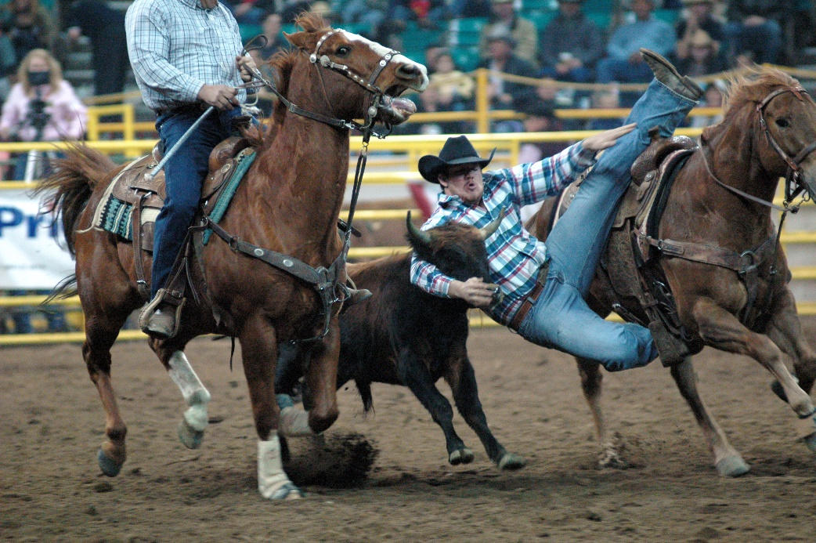
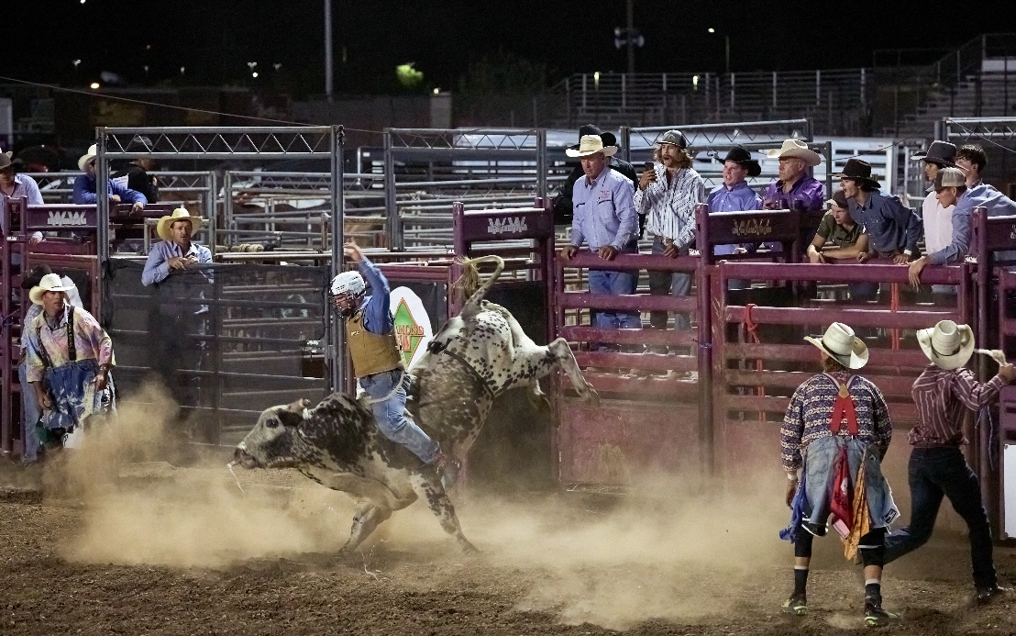
Bull riding, calf roping and bareback riding are among the classical disciplines of a form of sport fancied by cowboys and the likes.
What is this sport called? We need the first letter.

Slide 9
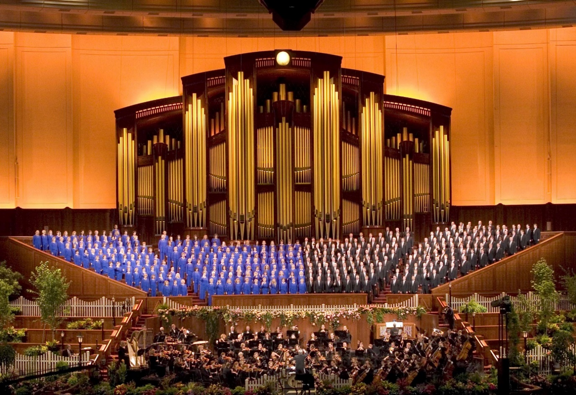
Different from Christian communities in Europe, the Mormons use the term ‘tabernacle’ for a church building or meeting place. The Mormons’ tabernacle is located in Salt Lake City in the state of…?
We need the first letter.

Slide 10
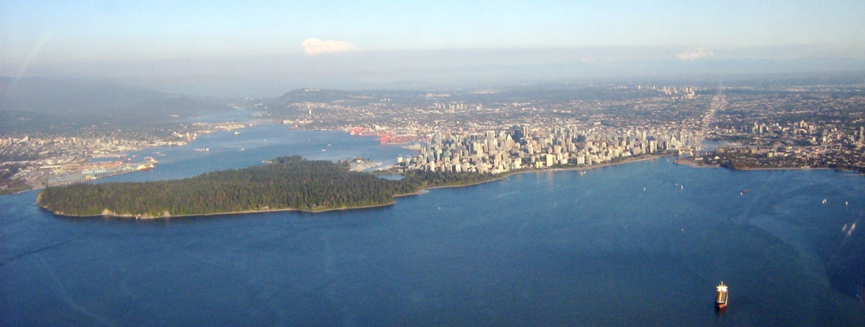
It is the third-largest city of the world’s second-largest country and its name might remind you of a kind of Dutch surnames.
We need the first letter of the city’s name.

Slide 11
m
funn
ee
ield
Add the missing letter.
That’s the one we need.

Slide 12
By now, you should have 10 letters (in alphabetical order) on your list. Reshuffle them for something that is essential when acquiring a foreign language.

Slide 13
Canberra (Australia)
Ayer’s Rock (Uluru) is one of the country’s major touristic attractions.
We need the last letter of the country’s capital.

Slide 14
anchorman
Ingo Zamperoni, same as Jessy Wellmer and Pinar Atalay,
is among the recent and current protagonists of the Tagesthemen news show.
What is his job called in English? We need the first letter.

Slide 15
Baseball
A ‘pitcher’ can be a container for liquids
or a position in a team sport,
of which we need the first letter.

Slide 16
During certain periods of their lives both gentlemen had their ‘workplaces’ in a city bordering a lake and having a reputation of being pretty cold in winter. We need the first letter of the city’s name.
Chicago

Slide 17
Liverpool
Apart from The Reds, the city in England’s northwestern region is famous as the place of foundation of many well-known bands, among them the Beatles, Frankie goes to Hollywood and Gerry and the Pacemakers.
We need the first letter of the city’s name.

Slide 18
O‘
A Scotsman’s “Mac/Mc” is an Irishman’s …?
We need a common prefix to Irish surnames.

Slide 19
Rodeo
Bull riding, calf roping and bareback riding are among the classical disciplines of a form of sport fancied by cowboys and the likes.
What is this sport called? We need the first letter.

Slide 20
Utah
Different from Christian communities in Europe, the Mormons use the term ‘tabernacle’ for a church building or meeting place. The Mormons’ tabernacle is located in Salt Lake City in the state of…?
We need the first letter.

Slide 21
Vancouver (Canada)
It is the third-largest city of the world’s second-largest country and its name might remind you of a kind of Dutch surnames.
We need the first letter of the city’s name.

Slide 22
m
y
funn
ee
ield
Add the missing letter.
That’s the one we need.

Slide 23
By now, you should have 10 letters (in alphabetical order) on your list. Reshuffle them for something that is essential when acquiring a foreign language.
V O C A B U L A R Y

