Slide 1
Which person is it?
Welcome to your English class!
Course # 242-40660
English Grammar Refresher B1-B2
First teaching unit: 10 October 2024
Last teaching unit: 28 November 2024
www.jürgenhensel.de
Quiz

Slide 2
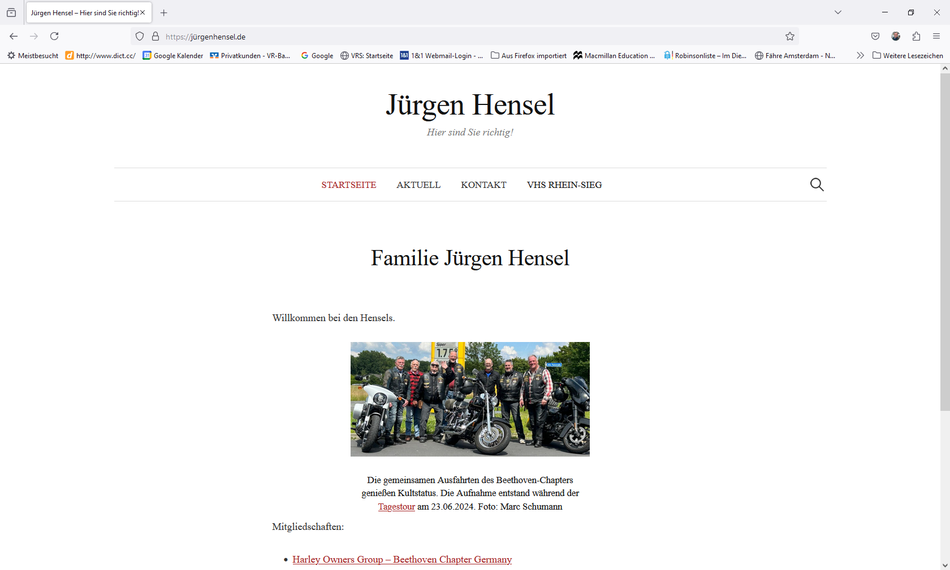

Slide 3
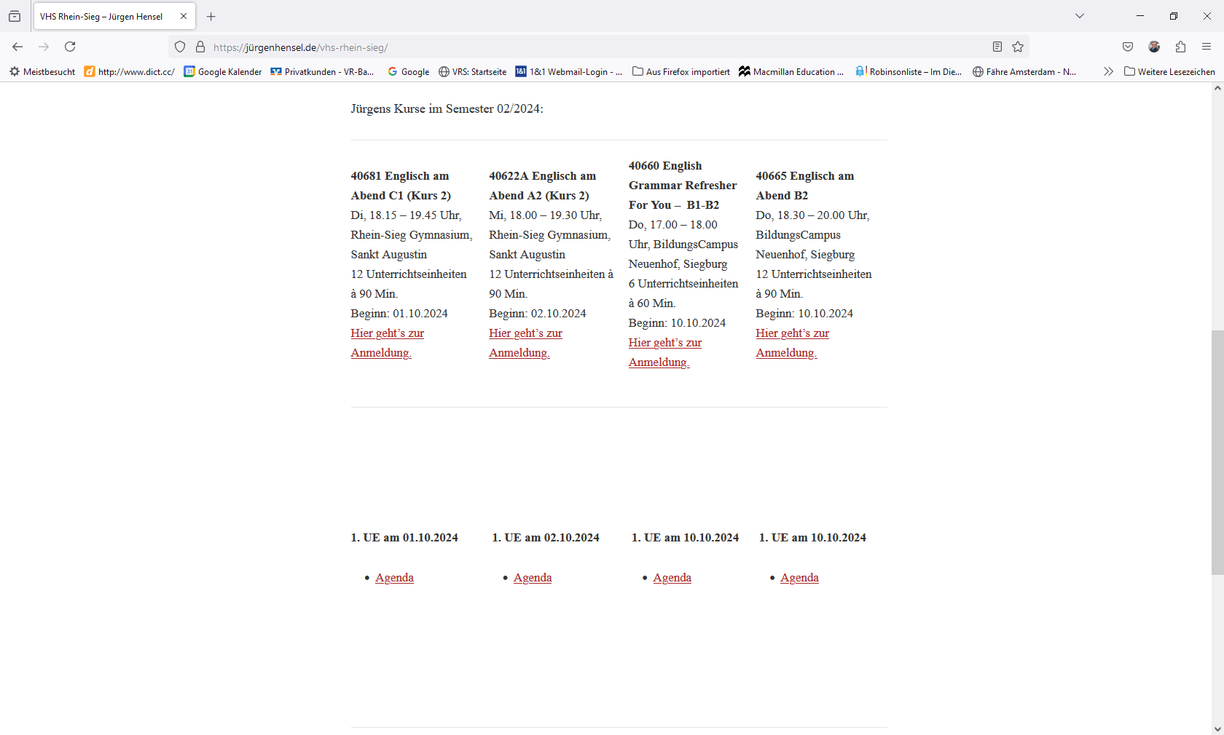

Slide 4
Next class: 31 October 2024
Objectives 10/10/24:
Revise and practise
- the present tense,
- present perfect and
- past tense

Slide 5
What tenses do you know?
Present tense
The weather is nice.
Present perfect
I have finished my homework.
Past tense
Barack Obama was the 44th president of the United States.
Past perfect
I had watched the news before I went to bed.
Future tense I
I will stay home tomorrow.
Future tense II
We will have eaten dinner by the time you arrive.

Slide 6
What tenses do you know?
Present tense
The weather is nice.

Slide 7
What tenses do you know?
Present tense
a) is used to describe something that constitutes a (regular) status:
Spiders have eight legs. Insects do not/don’t have eight legs.
The Eiffel Tower is in Paris. The Tower Bridge is not in Paris.
Jeff gets up a 6 o’clock. Tim does not/doesn’t get up at 6 o’clock.
To describe a status, the present tense uses the simple form.
b) is used to describe an ongoing process or a temporary action:
You are listening to me. (ongoing process)
He is working on a project this week. (temporary action)
c) is used to describe future arrangements:
I am having dinner with my boss tomorrow.
d) is used to describe ongoing trends or changes:
The climate is getting warmer.
What elements are used for the continuous/progressive form in the present tense?
With the introduction of AI, technology is advancing rapidly.
In these cases (b, c, d), the present tense is used in the continuous/progressive form.
The form of to be corresponding to the subject of the sentence + the present participle (-ing form) of the sentence’s the main verb (= the sentence’s predicate)

Slide 8
The present tense
Translate:
(using the present tense)
Wir schauen uns normalerweise die Tagesschau um 8 Uhr an.
We normally watch the Tagesschau at 8 o’clock.
Was machst du (gerade)?
What are you doing?
Ich wohne in Siegburg.
I live in Siegburg.
Die Zeiten werden härter.
Times are getting harder.
Gewöhnlich regnet’s im November.
It usually rains in November.
“Wie ist das Wetter?” - “Es regnet.”
“What’s the weather like?” - “It’s raining.”
Wir spielen morgen Fußball.
We are playing football tomorrow.
Ich habe kein Auto.
I don’t have a car.

Slide 9
What tenses do you know?
Present perfect
I have finished my homework.
What elements are used to build the present perfect?
The form of the auxiliary (Hilfsverb) to have corresponding to the subject of the sentence + the past participle of the sentence’s the main verb (= the sentence’s predicate)
Note: In English, like in German, to have can appear as both an auxiliary and a full verb:
He has a car. In the latter case, both variants are used to build the present perfect:
“He has (auxiliary) had (full verb in the past participle) a car since he was 20 years old.”

Slide 10
What tenses do you know?
Present perfect
a) is used to express actions or states that began in the past but have not been completed yet/are still ongoing:
I have always lived in Germany. (I still live in Germany.)
I have never been to Africa. (from the past until the present time)
I have been waiting for twenty minutes. (I am still waiting.)
b) is used to express actions or states that happened in the past but have a connection or relevance to the present:
I have finished my homework. (It is still finished)
She has lost her keys. (…and still has not found them)
Note: Other than in the German language, the present perfect and the past tense are not interchangeable in English.
German: Ich war gestern in Bonn. - Ich bin gestern in Bonn gewesen.
English: I was in Bonn yesterday. (But: I have been in/to Bonn since yesterday.)
Adverbs of frequency that indicate the use of either the present tense or the present perfect include:
always, never, often, usually (present tense), ever (present perfect).
I always/usually eat lunch at noon. I have always liked icecream.
We never have coffee for breakfast. He has never been to Paris.
We often have lunch together. He has often travelled to Paris.
Have you ever been to Australia?

Slide 11
The present perfect
Translate:
(using the present perfect)
Sie war schon immer sehr schüchtern.
She has always been very shy.
Ich war noch niemals in New York.
I have never been to New York.
Warst du schon mal in Australien?
Have you (ever) been to Australia?
Ich warte hier schon zwei Stunden.
I have already been waiting here for two hours.
Ich wohne seit dem letzten Jahr in Siegburg
I have lived in Siegburg since last year.
I habe John in der letzten Zeit häufiger getroffen.
I have met John quite often recently.
Die Brille, die ich letzte Woche verlegt habe, habe ich noch nicht gefunden.
I still have not found the glasses that I misplaced last week.
Note: Even if the present or past tense are used in colloquial German, the present perfect may be the only option acceptable in English!

Slide 12
What tenses do you know?
Past tense
Barack Obama was the 44th president of the United States.

Slide 13
What tenses do you know?
Past tense
a) is used to describe actions or states that happened and were finished in the past:
We had a barbecue yesterday. (The barbecue is over.)
They went to the beach last week. (They are no longer at the beach.)
b) is used to describe past habits, repeated actions or states or conditions that existed in the past:
When we were in Italy, we always had tea for breakfast.
He used to play the piano every day after school.
Our first car was a VW.
c) is used in reported speech:
She said: “I like icecream”.
She said that she liked icecream.
He said: “I am watching the football match”.
He said that he was watching the football match.
Note: to describe something that happened during an ongoing process in the past, the action that started first is presented in the progressive form, the later action uses the simple form:
While we were having dinner, it started to rain.
The phone rang when he was having a shower.

Slide 14
The past tense
Complete with the correct form of the verb in the past tense:
Yesterday, I (to eat) pizza for dinner.
Yesterday, I ate pizza for dinner.
When they (to play) chess, a thunderstorm (to come up).
When they were playing chess, a thunderstorm came up.
Put into reported speech:
She said: “I am interested in music.”
She said that she was interested in music.
John said: “I don’t have a car.”
John said that he didn’t have a car.
The tour guide asked: “Are you ready?”
The tour guide asked if we/they were ready.
Translate:
Er hatte einen Unfall, als er nach hause fuhr.
He had an accident when he was driving home.
Erst ist er gestern in’s Kino gegangen,
dann hat er seinen Autoschlüssel verloren
Yesterday, he first went to the movies, then he lost his car key.
Er fragte den Kellner, wo die Toilette sei.
He asked the waiter where the toilet/restroom was..

