Slide 1
Quiz – “The Hot Chair”
Unit 6, 10 April 2024

Slide 2
Quiz - “The Hot Chair” (Instructions) Two teams compete (Team 1, Team 2) There are 6 questions for each team The team that can answer most of the questions correctly is the winner Each question has to be answered by one team member/candidate alone The candidate must not consult with the other members of his team Each team has two 50/50 jokers that can be used by the candidates Moreover, each team has one “Veto”* that can be used if team members believe that the answer of their candidate is wrong In case of a “Veto” the team can correct the answer of their candidate and replace it by a second - then valid - answer *Veto – (lat.) „ich verbiete / I forbid“ (Einspruch)

Slide 3
John Hancock
Team 1 (1)
a military medal
b) a men’s fragrance
c) a person’s signature
d) a £50.00 note

Slide 4
goose egg
Team 2 (1)
cushion, pillow
b) bomb, explosive
c) nothing, zero
d) unwanted gift/present

Slide 5
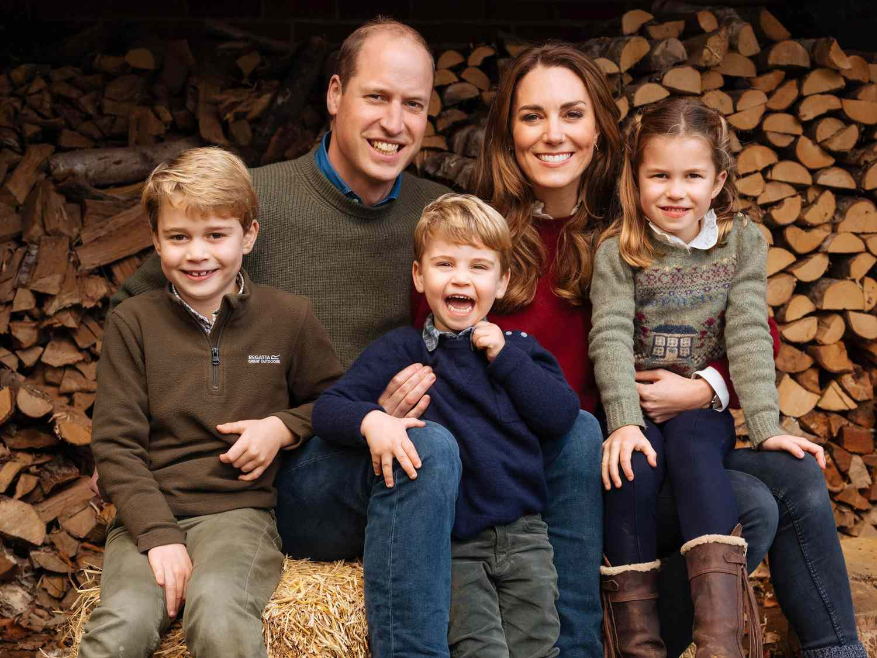
William and Kate have three children, George, …?
Team 1 (2)
Elizabeth and Louis
b) Victoria and Charles
c) Charlotte and Charles
d) Charlotte and Louis

Slide 6
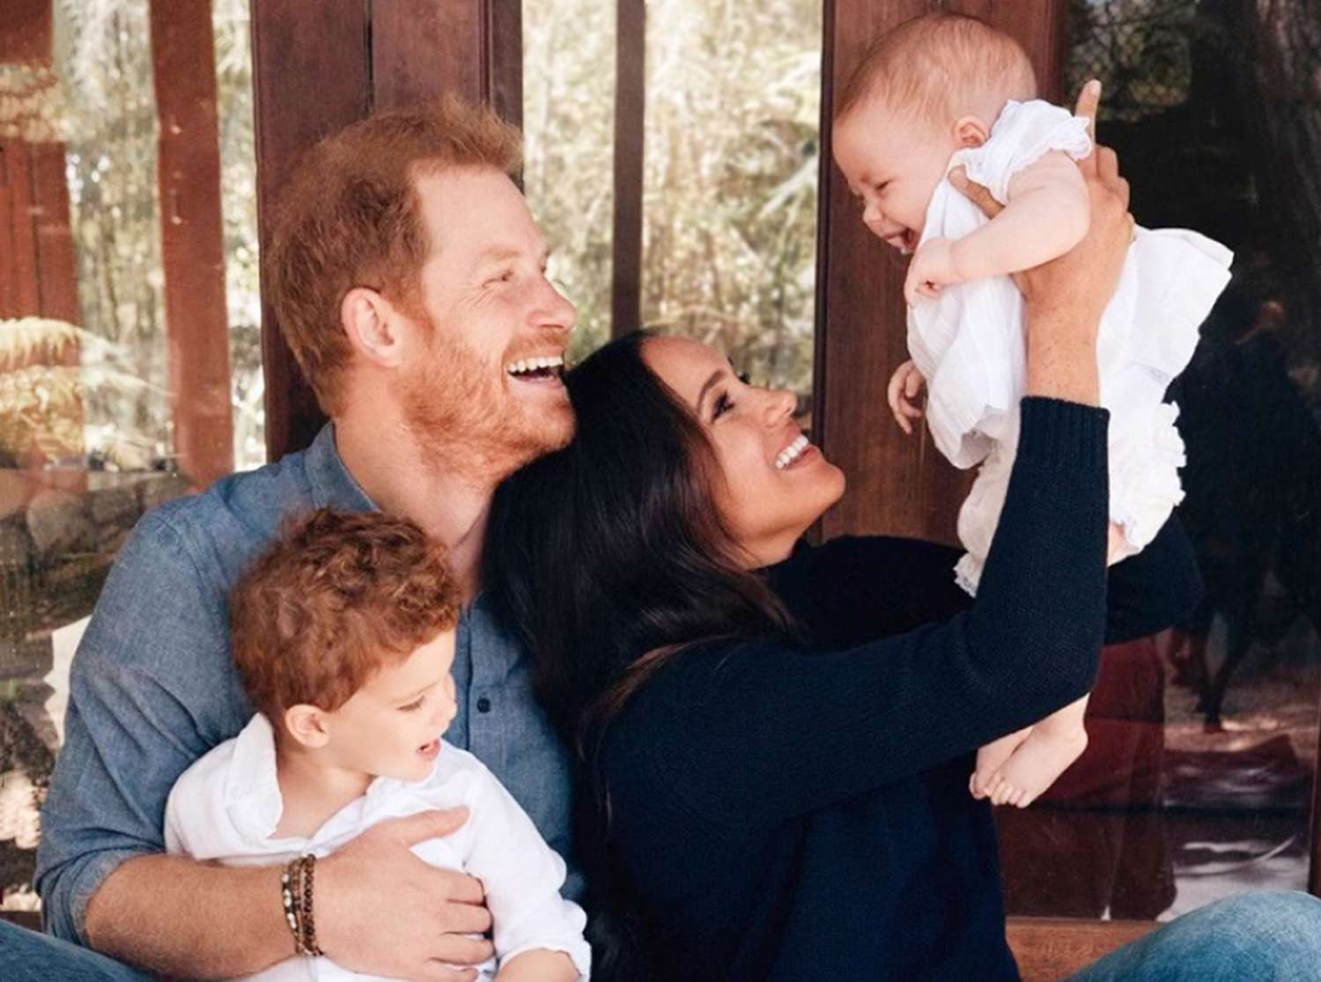
Meghan and Harry have two children, namely…?
Team 2 (2)
a) Victoria and Charles
b) George and Diana
c) Archie and Lilibet
d) Harrison and Diana

Slide 7
What is not part of the British Government?
Team 1 (3)
a) Senate
b) Cabinet
c) House of Lords
d) House of Commons

Slide 8
What is not part of the U.S. Government?
Team 2 (3)
a) Senate
b) Cabinet
c) House of Representatives
d) Congress

Slide 9
oxymoron
Team 1 (4)
a) critical remark
b) paradoxal statement
c) word with identical forward and backward spelling
d) foolish undertaking

Slide 10
trumped-up
Team 2 (4)
a) decisively won (game)
b) artificially beautified (person)
c) falsely invented (excuse)
d) significantly exaggerated (statement)

Slide 11
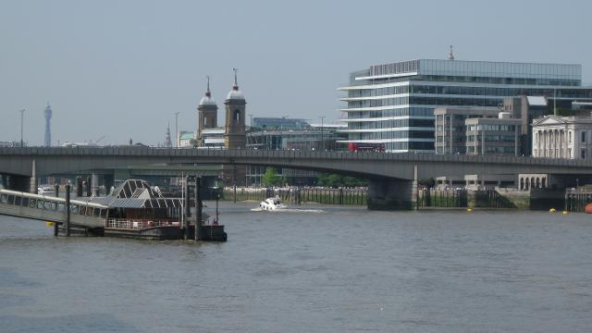
The Best
Simply the Best · 1991
London
Team 1 (5)
a) Tower Bridge
b) Westminster Bridge
c) London Bridge
d) Millennium Bridge

Slide 12
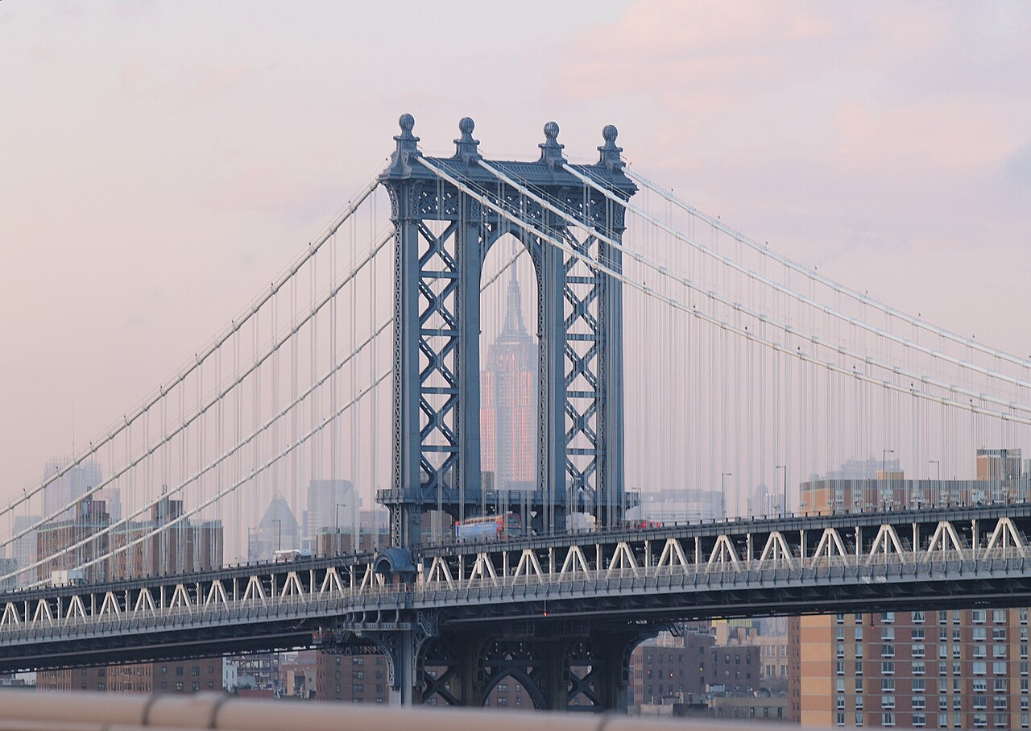
New York City
Team 2 (5)
a) Manhattan Bridge
b) Brooklyn Bridge
c) East River Bridge
d) Queensboro Bridge

Slide 13
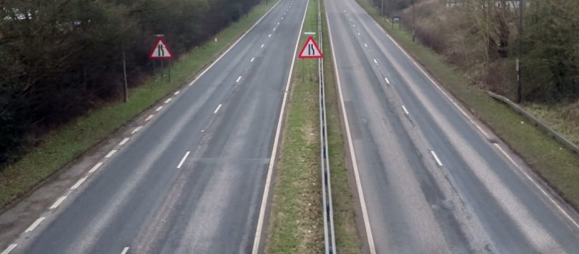
In the UK this is called a …
Team 1 (6)
A dual carriageway differs from a motorway in that
it does not have a hard shoulder and can also be used by vehicles other than cars.
a) turnpike
b) motorway
c) dual carriageway
d) expressway

Slide 14
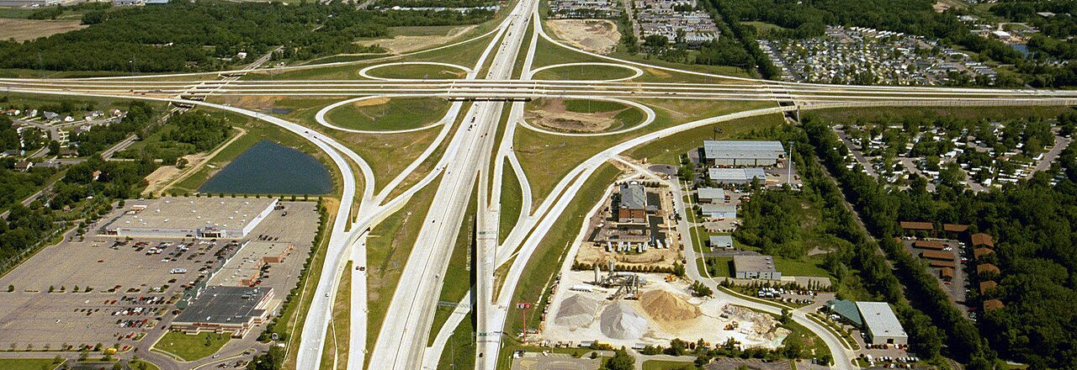
In the United States this is called a/an …
Team 2 (6)
a) turnpike
b) junction
c) interchange
d) motorway crossing

